Slide 1

Welcome!
Dr. Sofya Malik, Assistant Professor - Teaching Stream, Educational Leadership & Policy (ELP), OISE
Vesna Bajic, Communications & Special Projects, Leadership, Adult& Higher Education, OISE

Slide 2
Land Acknowledgement
We wish to acknowledge this land on which the University of Toronto operates. For thousands of years it has been the traditional land of the Huron-Wendat, the Seneca, and most recently, the Mississaugas of the Credit River. Today, this meeting place is still the home to many Indigenous people from across Turtle Island and we are grateful to have the opportunity to work on this land.

Slide 3
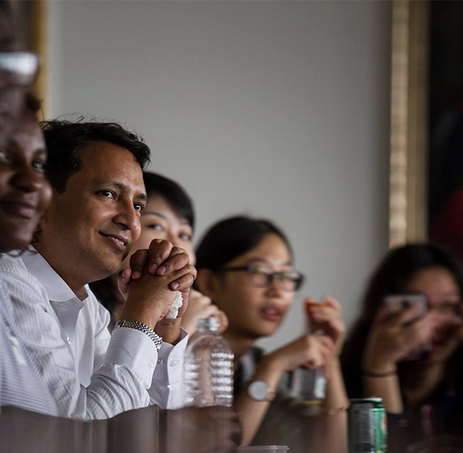
AGENDA
OISE Educational Leadership & Policy (ELP)
Why the EdD?
About the EdD Programs
Panel Discussion
Q&A

Slide 4
Carnegie Project on the Education Doctorate (CPED)
“The professional doctorate in education prepares educators for
the application of appropriate and specific practices, the
generation of new knowledge, and for the stewardship of the
profession.”
WHY THE EdD?

Slide 5
The Professional Doctorate in Education:
Scholarly Practitioner:
blend practical wisdom with professional skills and knowledge to name, frame, and solve problems of practice.
use practical research and applied theories as tools for change to understand the importance of equity and social justice.
disseminate work in multiple ways, and have an obligation to resolve problems of practice by collaborating with key stakeholders, including the university, the educational institution, the community, and individuals.
The CPED Framework ©

Slide 6
Career Prospects
Leadership: School Boards, Ministries, Organizational Systems
Research: School Boards, Universities, Government, NGO’s, non-profits, etc.
Private Sector: Publishing; Consulting

Slide 7
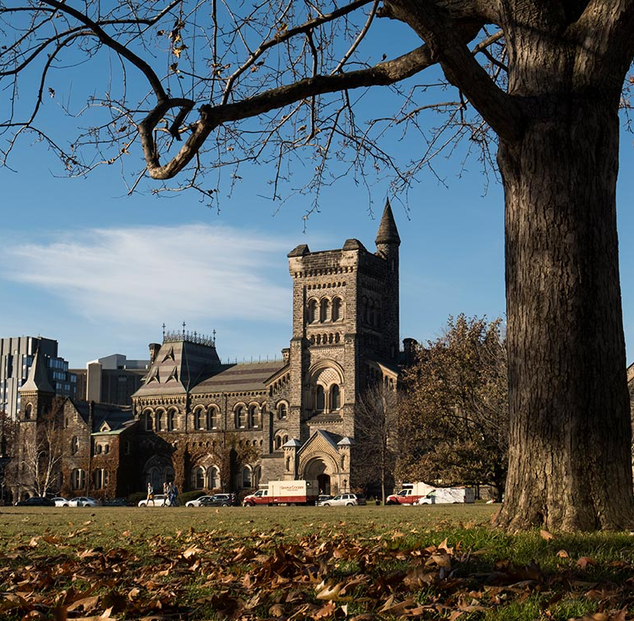
OISE and the University of Toronto
OISE: Canada’s most research-intensive
Faculty of Education -- ranked #4 worldwide (QS).
OISE: leader in education policy research and international education.
University of Toronto: a historic campus, serving 90,000 students from around the world.
Toronto: a multi-cultural city, with one of the world’s strongest and most inclusive education systems.

Slide 8
Professional Stream Degree
International
EdD
8 courses + comprehensive exam + proposal + dissertation in practice
Full time degree, approx. 3-4 years
*Self-funded, often chosen by practicing professionals
Cohort Model
*Online courses with annual in person 2-week institute
* 1-3 courses per term
Applications are open until cohort full
Notes:
Add in info session

Slide 9

For more information, visit www.oise.utoronto.ca/lhae/
OISE Registrar’s Office and Student Experience admissions.oise@utoronto.ca
International Student Recruitment and Success, Andy Xia xiaoyong.xia@utoronto.ca
IELP EdD Program Coordinator Dr. Sofya Malik at sofya.malik@utoronto.ca
sofya.malik@utoronto.ca

Slide 10
Panelists
Session Moderator: Dr. Sofya Malik, Assistant Professor - Teaching Stream, OISE, International Leadership and Policy EdD Program Coordinator
Dr. Ahmad Jibran, Director Academics, The Punjab School System, Pakistan
Min (Caroline) Xu, Deputy Head of School (Academics) & Principal and Head of Hongqiao Campus, YK Pao School, Shanghai
Dr. Katherine Witherow, Associate Faculty at Royal Roads University, in the Master of Arts in Educational Leadership & Management program

Slide 11
Panelist Introductions: your current role and why you chose to do the EdD degree

Slide 12
What is the impact of the EdD on your career?
How DO/did your doctoral studies at OISE influence or inform your career?
Could you describe the role of transferable skills, the OISE network or community in shaping your journey?

Slide 13

Audience Q&A

Slide 14

THANK YOU!
Contact for questions about the programs:
OISE Registrar’s Office and Student Experience admissions.oise@utoronto.ca
IELP EdD Program Coordinator Dr. Sofya Malik sofya.malik@utoronto.ca

