Slide 1
Information Session on Statistical Methods Offerings in LHAE and OISE
Prof. Anna Katyn Chmielewski
Prof. Scott Davies
July 11, 2022

Slide 2


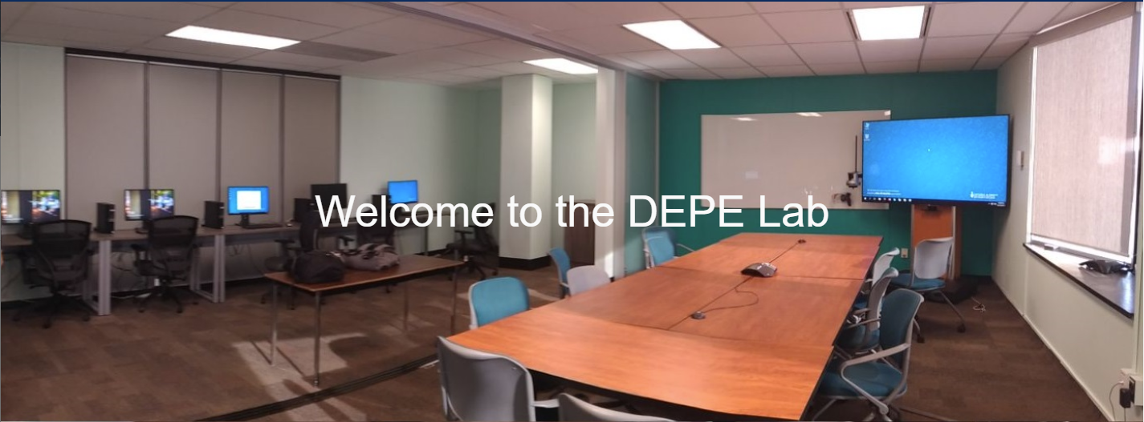
Introductions
Anna Katyn Chmielewski
Associate Professor of Educational Leadership & Policy
Research interests: Educational equity in North America and internationally; socio-economic disparities in academic achievement; school segregation; curriculum differentiation and streaming; international large-scale assessments (PISA, PIRLS, TIMSS, PIAAC); sociology of education; quantitative methods
Scott Davies
Professor of Educational Leadership & Policy
Research interests: Sociology of education; large-scale data analysis; research design and methods; policy-oriented research; organizational analyses; student achievement
Data, Equity & Policy in Education (DEPE) lab
Department of Leadership, Higher & Adult Education
Community of faculty and students interested in quantitative analysis of educational policy and educational inequality; repository for large-scale datasets; regular speaker series and workshops (Zoom)

Slide 3
Introductions
Departments
Applied Psychology & Human Development (APHD)
Curriculum, Teaching & Learning (CTL)
Leadership, Higher & Adult Education (LHAE)
Social Justice Education (SJE)
Degrees
MEd
MA
EdD
PhD
Programs
Adult Education & Community Development (AECD)
Educational Leadership & Policy (ELP)
Higher Education (HE)

Slide 4
Overview
Introductions
Why learn statistical methods?
Do I get “Research Methods [RM]” credit toward my degree program for statistics courses?
Where can I find statistics courses at OISE?
Which statistics courses are available?
How can I figure out which course(s) to take?
How can I plan my schedule of statistics courses?
Which software is used in statistics courses?
Where can I find up-to-date info on statistics course offerings?
How can I enrol in statistics courses?
Additional questions?

Slide 5
2. Why learn statistical methods?
Fun!
Powerful tools for research
Valuable skills for the job market
Past non-university research placements: HEQCO, Ministry of Advanced Education and Skills Development, Statistics Canada, People for Education, Ministry of Community of Social Services, Ministry of Education, Education Quality and Accountability Office (EQAO), Council of Ministers of Education Canada; TDSB and other school board research offices; college institutional research offices
Past university placements: University of Guelph, Nipissing, Laurier, Waterloo, Harvard, Lakehead U, U of Saskatchewan, Western U, York U, Laurentian U, U of Ottawa

Slide 6
3. Do I get “Research Methods [RM]” credit toward my degree program for statistics courses?
Most grad programs in LHAE require 1 or more courses in research methods, chosen in consultation with Faculty Advisor
Additional research methods may be taken as electives
Research methods courses are indicated by [RM] in the OISE Graduate Bulletin and on ACORN
All statistical methods courses have [RM] designation

Slide 7
3. Do I get “Research Methods [RM]” credit toward my degree program for statistics courses?
Departments
Applied Psychology & Human Development (APHD)
Curriculum, Teaching & Learning (CTL)
Leadership, Higher & Adult Education (LHAE)
Social Justice Education (SJE)
Degrees
MEd
MA
EdD
PhD
Programs
Adult Education & Community Development (AECD)
Educational Leadership & Policy (ELP)
Higher Education (HE)

Slide 8
3. Do I get “Research Methods [RM]” credit toward my degree program for statistics courses?
 | Adult Education & Community Development | Educational Leadership & Policy | Higher Education
MEd | “one research methods course is recommended” | one research methods course is recommended if writing a Major Research Paper | “a half-course in research methods approved by the faculty advisor”
MA | “at least one research methods course is required” | one course in research methods is required
EdD | N/A | 3005 & 3006 required (alternative RM course may be substituted for 3006)
PhD | “at least one research methods course is required” | two courses in research methods
2022-2023 OISE Graduate Bulletin: https://oise.academic-guide.utoronto.ca/

Slide 9
4. Where can I find statistics courses at OISE?
May be open to LHAE students
Applied Psychology & Human Development (APHD)
1 stats
4 quant
Curriculum, Teaching & Learning (CTL)
several mixed- methods
Leadership, Higher & Adult Education (LHAE)
Social Justice Education (SJE)
0 stats
Joint OISE courses (JOI)
6 stats
Adult Education & Community Development (AECD)
1 mixed-methods
Educational Leadership & Policy (ELP)
1 stats
1 quant
Higher Education (HE)
2 quant
Open to all OISE students
Usually open to all LHAE students

Slide 10
5. Which statistics courses are available this year?
Introductory
Fall 2022 & Winter 2023 – JOI1287: Introduction to Applied Statistics [RM] – online or in person (M. Azimi or L. Fiksenbaum)
Intermediate (pre-requisite: JOI1287 or equivalent)
Winter 2023 – JOI3048: Intermediate Statistics in Educational Research: Multiple Regression Analysis [RM] – Tuesdays, in person (A.K. Chmielewski)
Advanced (pre-requisite: JOI3048, JOI1288 or equivalent)
Fall 2022 – JOI6003: Quantitative Research Practicum [RM] – Wednesdays, in person (S. Davies)

Slide 11
6. How can I figure out which courses to take?
Ask your Faculty Advisor!
For general skills, mixed methods thesis – intro or intermediate
For quantitative-only master’s thesis – (at least) intermediate
For quantitative-only doctoral dissertation – (at least) one advanced course

Slide 12
6. How can I figure out which courses to take? (cont.)
Math Pre-requisites: high school math (algebra, graphing functions, solving equations, basic probability); NO calculus or matrix algebra necessary
Statistics Pre-requisites:
Introductory (JOI1287) – no pre-requisite (i.e., NO prior experience needed)
If you are not sure whether to take intro (e.g., you took a similar course in undergrad), a self-administered placement test is available here: https://q.utoronto.ca/enroll/AFAGPG
(Log in with your UTORid, click on the “Enroll in Course” button, and click on the “Go to the Course” button. The test is non-credit. Please complete the demographic survey before attempting the test. Recommendations will be presented to you upon completing the test and viewing your results.)
Intermediate (JOI3048, JOI1288) – pre-requisite: intro (JOI1287 or equivalent)
Advanced (JOI6003, LHA6005, JOI3229) – pre-requisite: intermediate (JOI3048, JOI1288 or equivalent)
Pre-requisites need not be taken at OISE

Slide 13
JOI1287: Introduction to Applied Statistics
Fall 2022 Mon online or Tue in person or Winter 2023 Thur in person
Instructor: M. Azimi or L. Fiksenbaum
NO prior experience with stats needed
Univariate and bivariate descriptive stats
Sampling, experimental design, statistical inference
Chi-square, t-test, ANOVA, regression
Intro to SPSS software
Students will be able to analyze real data and interpret results
Examples: What is the average math score in the school, and how much do scores vary across students?
Is the math score of Classroom 1 significantly higher than Classroom 2?
Are the math scores of girls significantly different from boys?

Slide 14
JOI3048: Intermediate Statistics in Educational Research: Multiple Regression Analysis
Winter 2023, Tuesdays 5-8pm, Ed Commons (3rd floor) Lab 6
Prof. Anna Katyn Chmielewski
Bivariate and multivariate linear regression models
Curvilinear regression functions; dummy & categorical variables; interactions
Intro to Stata software (may use SPSS)
Students will be able to run, interpret and write about regression models in their own research
Examples: Do students of higher socio-economic status have higher math scores?
Does this relationship persist after we hold educational resources constant?
Does the relationship between socio-economic status and math scores differ between Ontario and Quebec?

Slide 15
JOI6003: Quantitative Research Practicum
Prof. Scott Davies
Date, Time and Location
Fall 2022, Wednesdays 5-8pm
OISE 6-184 (Data, Equity and Policy in Education [DEPE] Lab)

Slide 16
JOI6003: Quantitative Research Practicum (cont.)
Purposes of this Course
Instruction in causal inference (quasi-experiments, propensity score matching), categorical analysis, missing data analysis
Guidance in management and analysis of large scale data sets, either provided or students’ own data
Access to unique educational data sets
Term papers: draft article involving data analysis

Slide 17
JOI6003: Quantitative Research Practicum (cont.)
(Hopefully) Available Data Sets
OISE Surveys 1978-2017: Public opinion on educational issues, Ontario adults
TDSB-UofT: track cohort of students from grade 9 to BA years
Ontario Summer Learning: cross-sectional and 3 year longitudinal
Ontario EDI-EQAO: track cohorts of students from Kindergarten – Grade 6

Slide 18
Other advanced courses offered in past/future years
LHA6005: Multilevel and Longitudinal Modelling in Educational Research [RM] (A.K. Chmielewski)
JOI3229: Meta-Analysis [RM]
JOI6001: Categorical Data Analysis [RM]
APD6001: Multivariate Statistical and Psychometric Applications in Education and Psychology [RM] (E. Jang)

Slide 19
7. How can I plan my schedule of statistics courses?
Introductory courses are typically offered fall and winter
Intermediate courses are typically offered once per year
Advanced courses are typically offered less frequently (e.g., every 2 years)
Sample schedule:
1st Year |  | 2nd Year
Fall 2022 | Winter 2023 | Fall 2023 | Winter 2024
JOI1287 (intro) | JOI3048 (intermediate) | Advanced course

Slide 20
8. Which software is used in statistics courses?
Introductory
JOI1287 Introduction to Applied Statistics | SPSS
Intermediate
JOI3048 Intermediate Statistics in Educational Research: Multiple Regression Analysis | Stata (or SPSS)
JOI1288 Intermediate Statistics and Research Design | SPSS
Advanced
JOI6003 Quantitative Research Practicum | Stata (or SPSS)
LHA6005 Multilevel and Longitudinal Modelling | HLM (& Stata or SPSS)
Other Quantitative Methods Courses
JOI3043 Survey Research in Educational Leadership and Policy | SPSS

Slide 21
9. Where can I find up-to-date info on statistics course offerings?
Visit our webpage!
Google “oise lhae quantitative courses”
http://www.oise.utoronto.ca/lhae/Current_Students/Quantitative_Research_Methods_Courses.html
OISE Registrar’s Office Graduate Course Schedules site → use [RM] filter
Google “oise ro course schedules”
https://www.oise.utoronto.ca/orss/Course_Enrolment/index.html

Slide 22
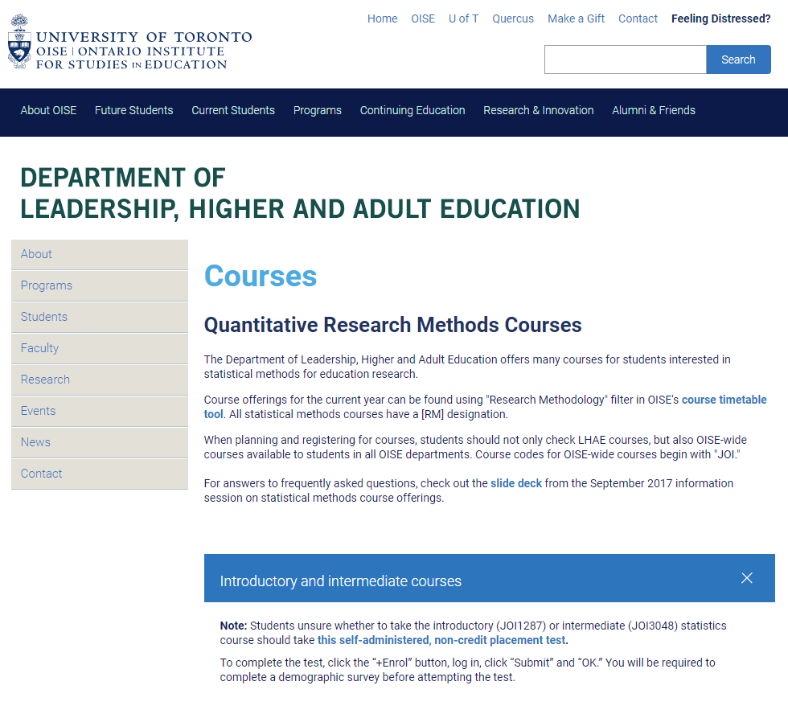
Google “oise lhae quantitative courses”
http://www.oise.utoronto.ca/lhae/Current_Students/Quantitative_Research_Methods_Courses.html

Slide 23
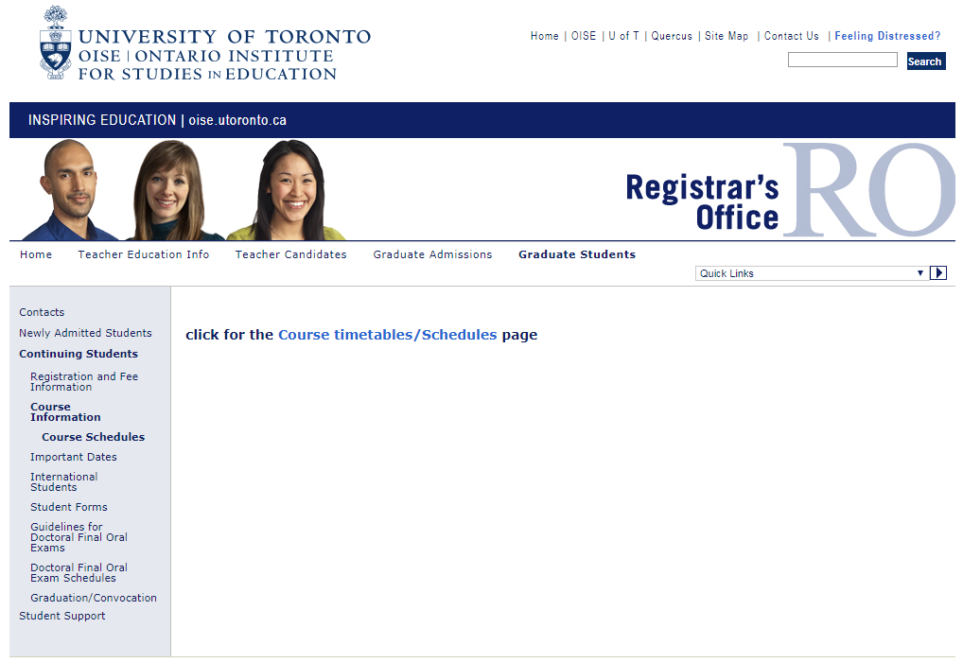
Google “oise ro course schedules”
http://www.oise.utoronto.ca/ro/Graduate_Students/Continuing_Students/Course_Information/Course_Schedules/

Slide 24
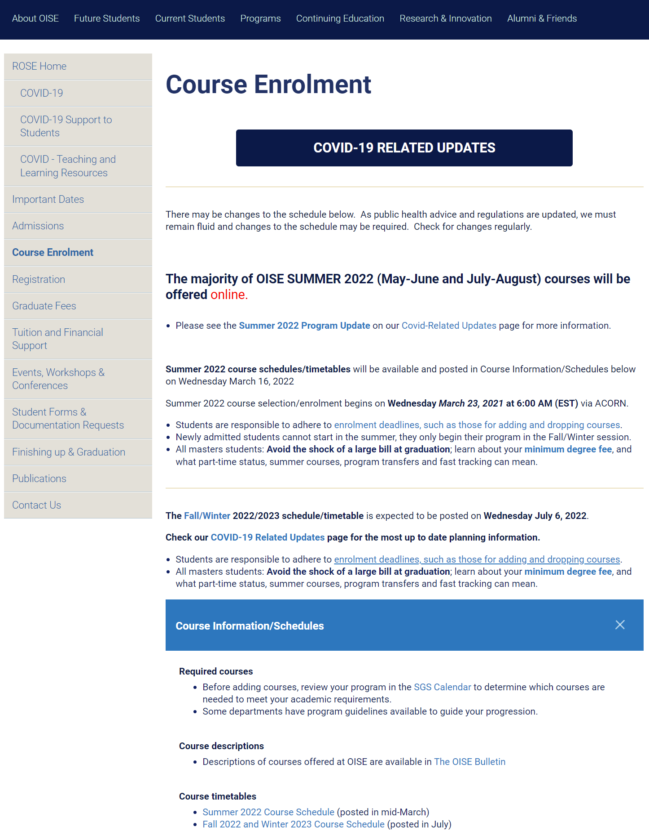

Slide 25
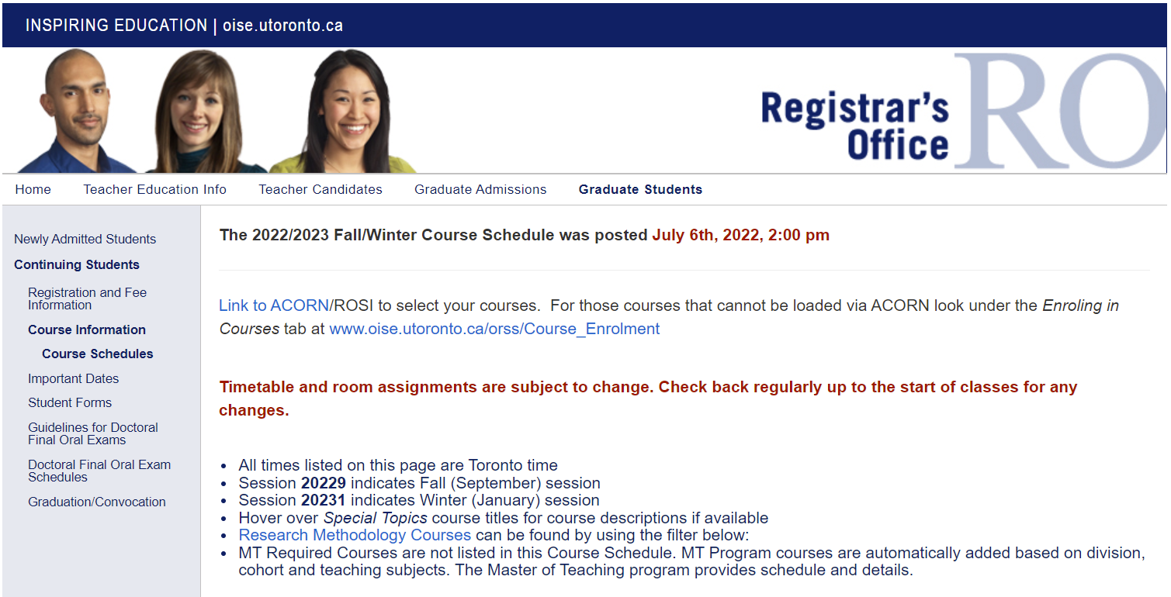
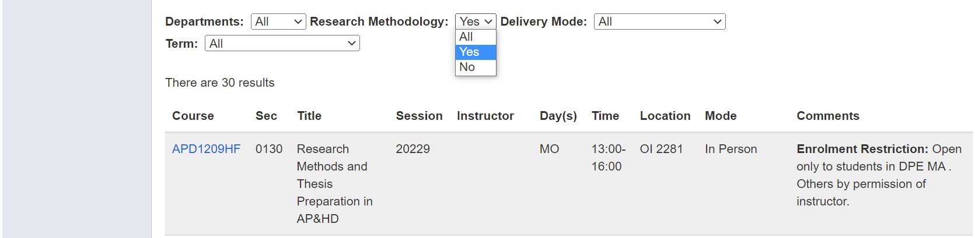

Slide 26
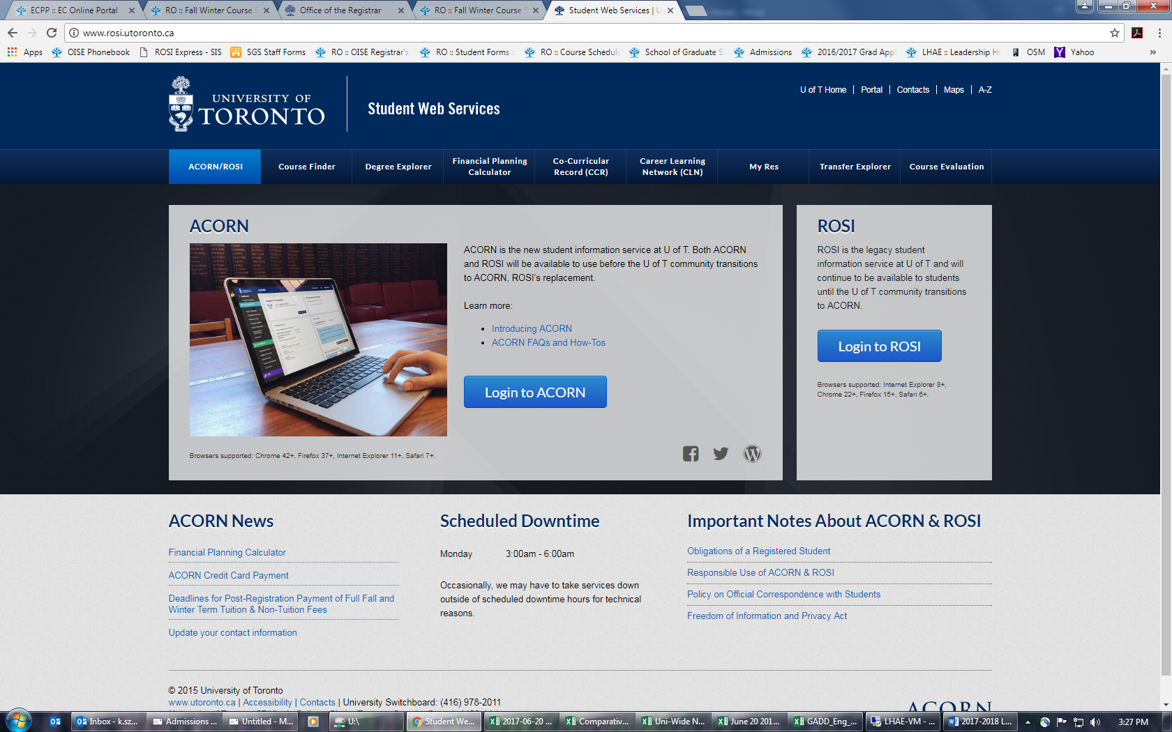
10. How can I enrol in statistics courses? www.acorn.utoronto.ca

Slide 27
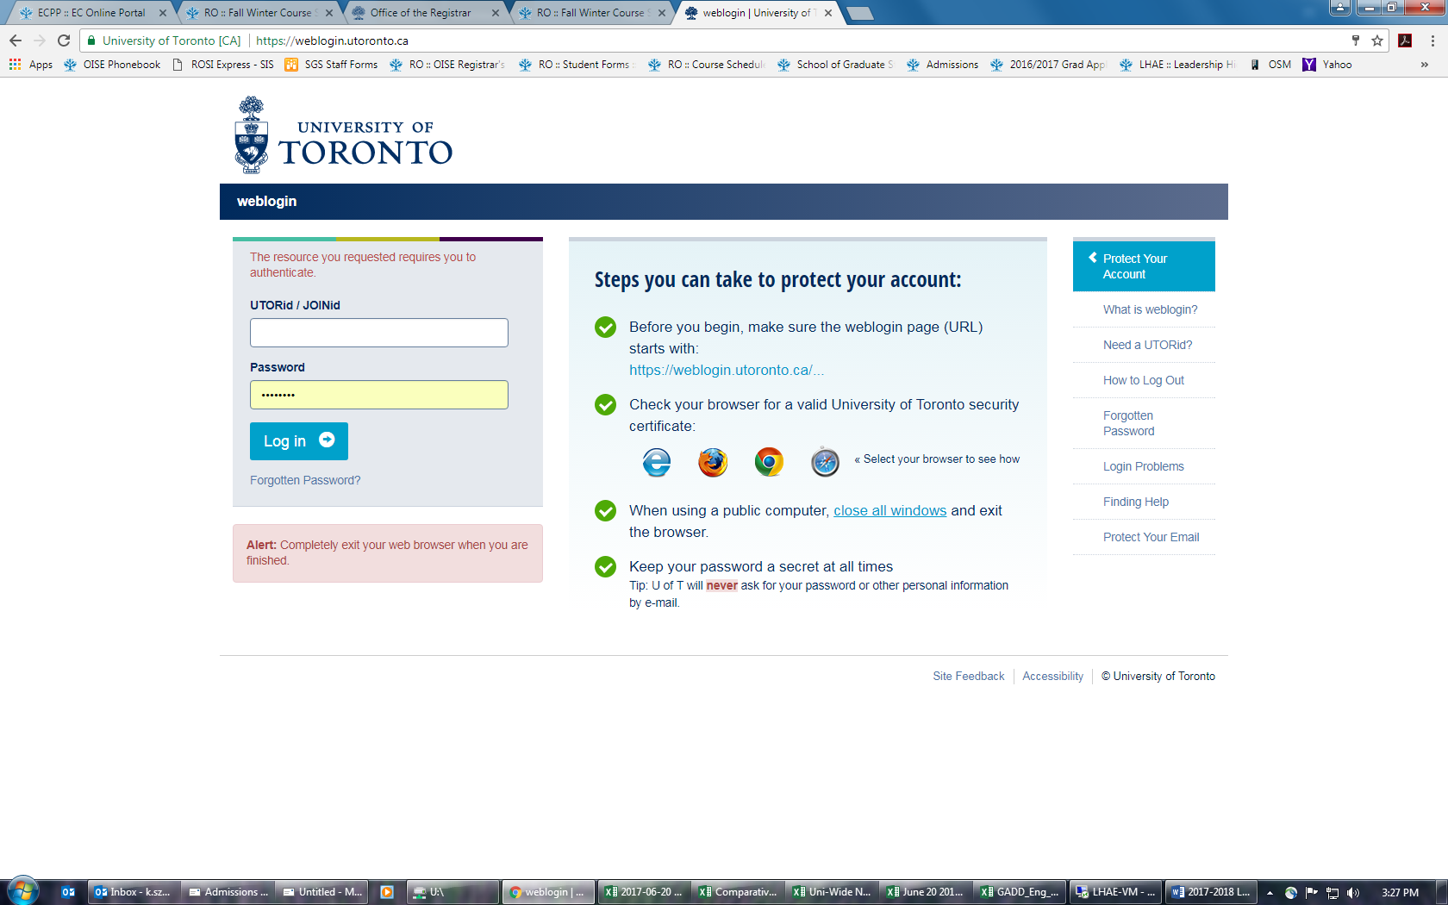
10. How can I enrol in statistics courses? www.acorn.utoronto.ca

Slide 28
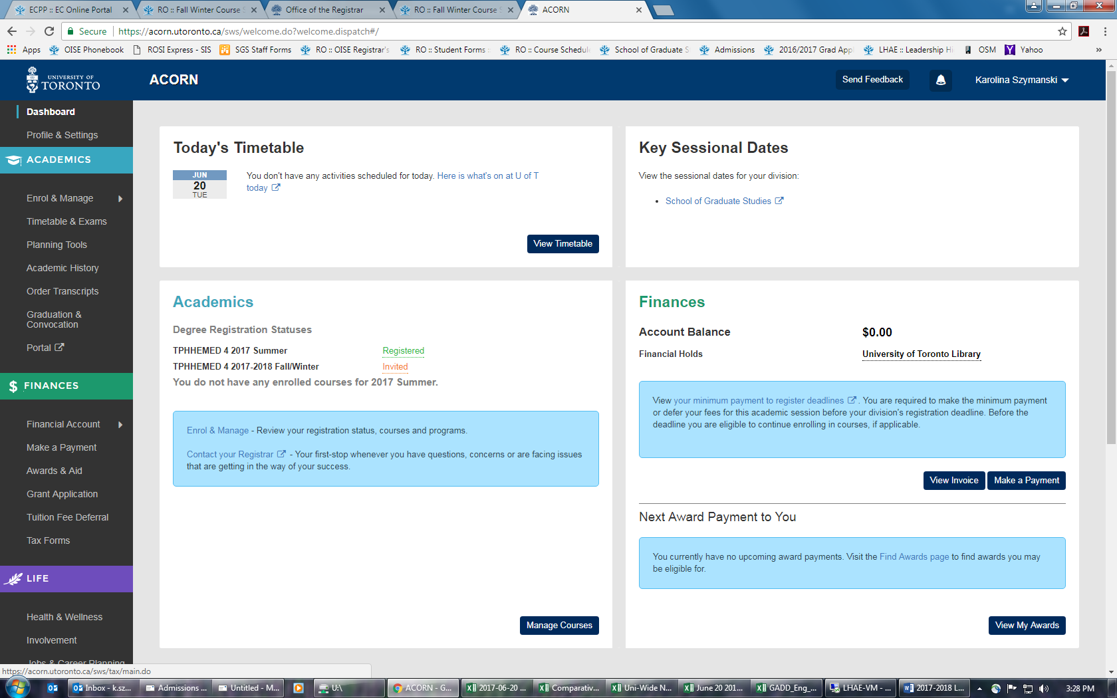
10. How can I enrol in statistics courses? www.acorn.utoronto.ca

Slide 29
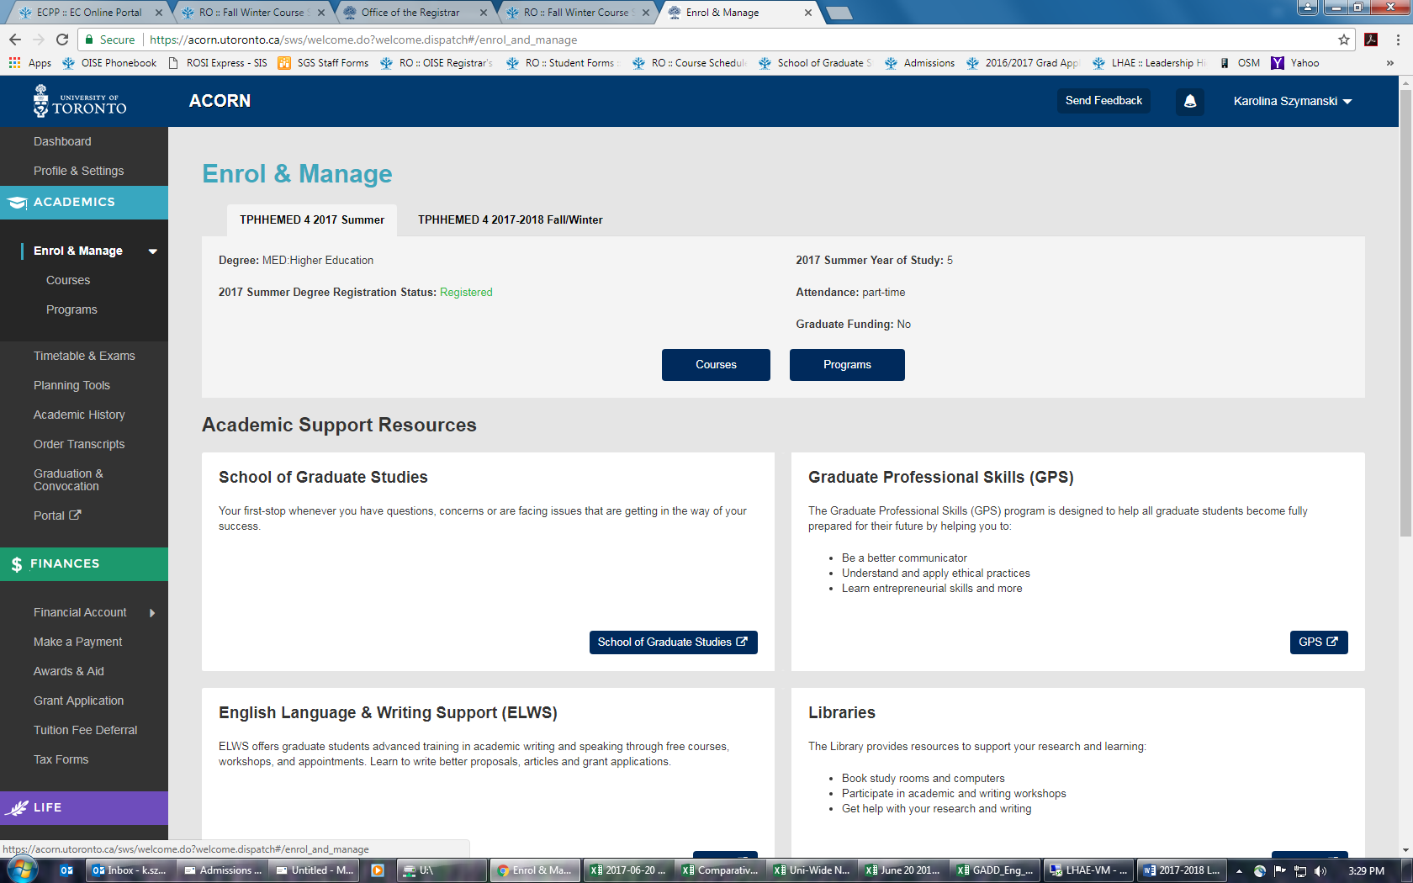
10. How can I enrol in statistics courses? www.acorn.utoronto.ca

Slide 30
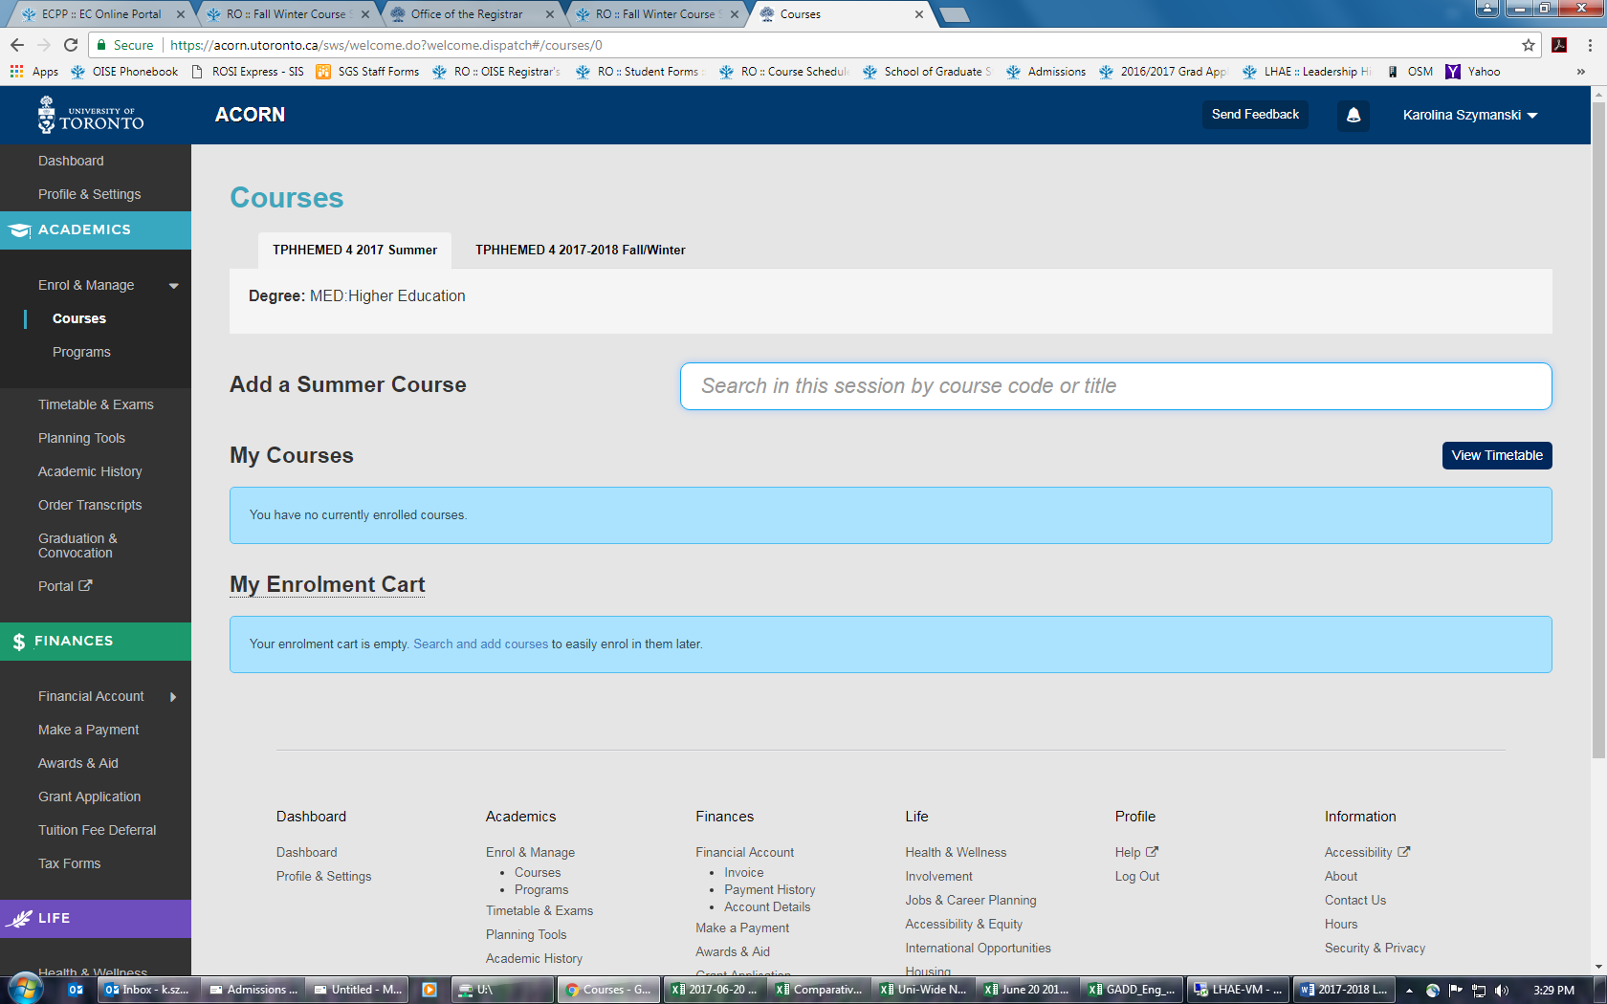
10. How can I enrol in statistics courses? www.acorn.utoronto.ca

Slide 31
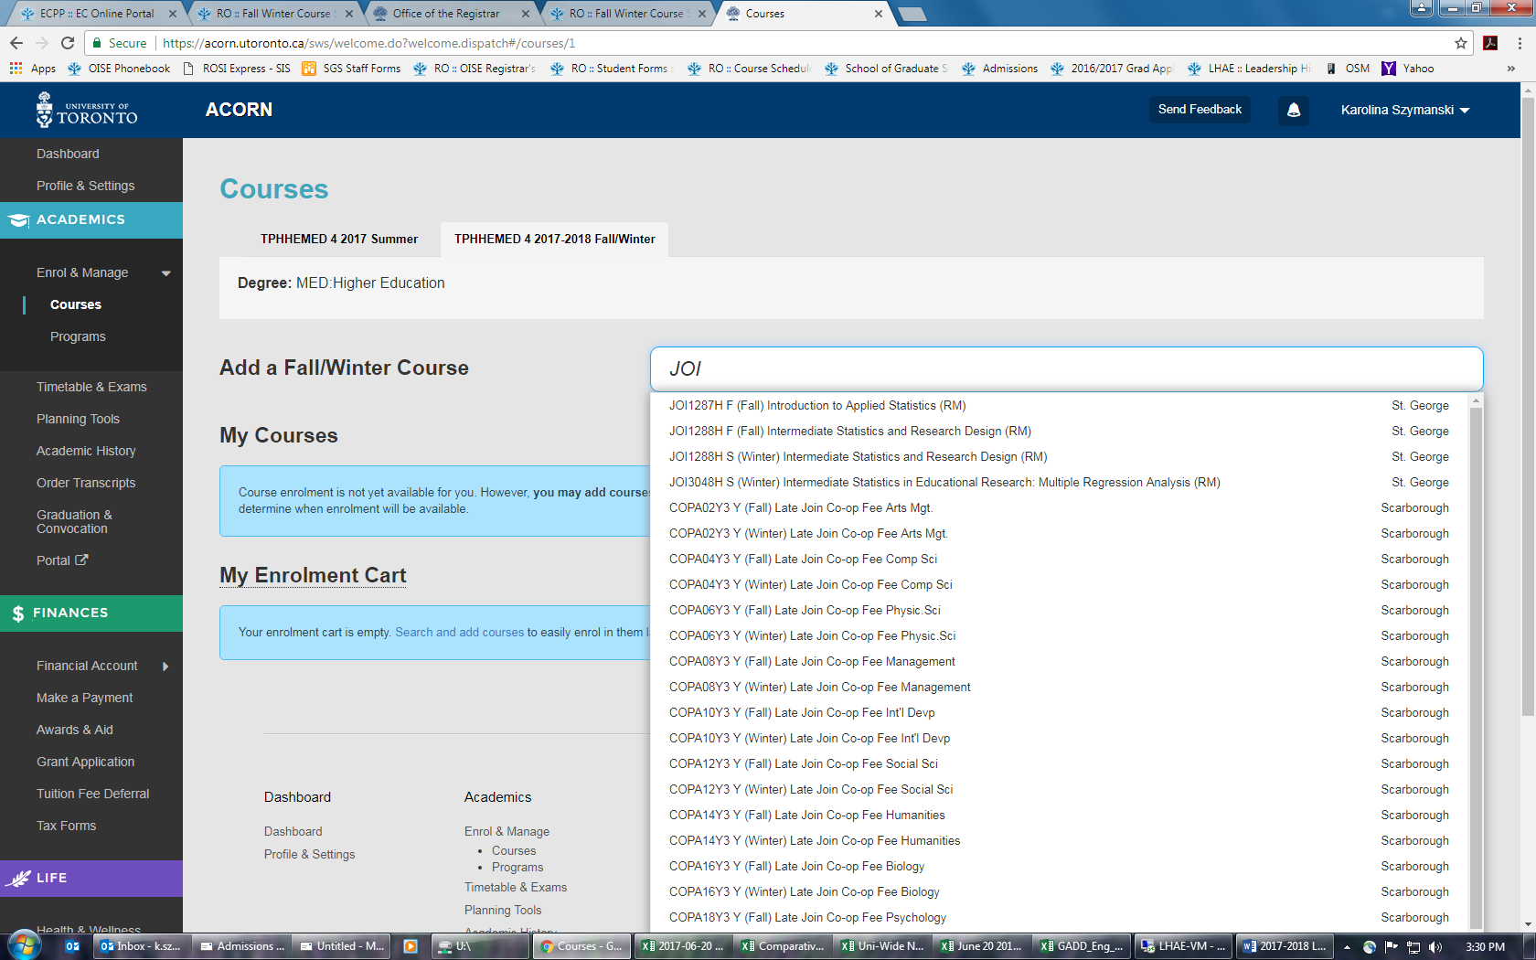
10. How can I enrol in statistics courses? www.acorn.utoronto.ca

Slide 32
11. Additional questions?

