Slide 1
Information Session on Statistical Methods Offerings in LHAE and OISE
Prof. Anna Katyn Chmielewski
Prof. Scott Davies
Sep. 7, 2023

Slide 2


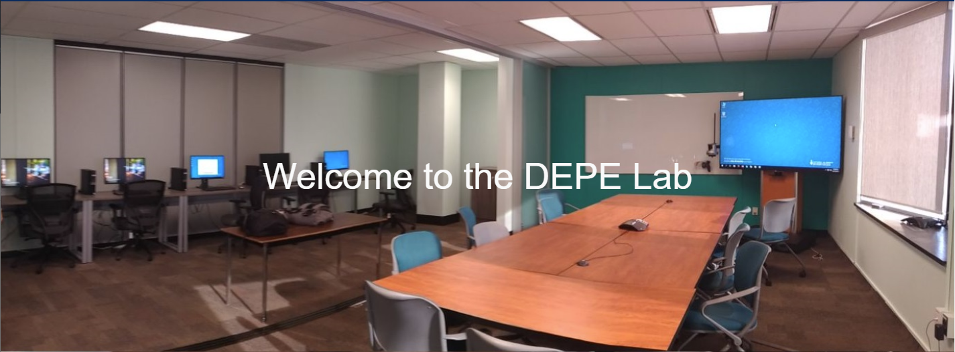
Introductions
Anna Katyn Chmielewski
Associate Professor of Educational Leadership & Policy
Research interests: Educational policy and social inequality; socio-economic disparities in academic achievement; school segregation; policies around school and program choice, streaming and tracking; international large-scale assessments (PISA, PIRLS, TIMSS, PIAAC); sociology of education; quantitative methods
Scott Davies
Professor of Educational Leadership & Policy
Research interests: Sociology of education; large-scale data analysis; research design and methods; policy-oriented research; organizational analyses; student achievement
Data, Equity & Policy in Education (DEPE) lab
Department of Leadership, Higher & Adult Education
Community of faculty and students interested in quantitative analysis of educational policy and educational inequality; repository for large-scale datasets; regular speaker series and workshops

Slide 3
Introductions
Departments
Applied Psychology & Human Development (APHD)
Curriculum, Teaching & Learning (CTL)
Leadership, Higher & Adult Education (LHAE)
Social Justice Education (SJE)
Degrees
MEd
MA
EdD
PhD
Programs
Adult Education & Community Development (AECD)
Educational Leadership & Policy (ELP)
Higher Education (HE)

Slide 4
Overview
Introductions
Why learn statistical methods?
Where can I find statistics courses at OISE?
Which statistics courses are available?
How can I figure out which course(s) to take?
How can I plan my schedule of statistics courses?
Do I get “Research Methods [RM]” and/or elective credit toward my degree program for statistics courses?
Which software is used in statistics courses?
Where can I find up-to-date info on statistics course offerings?
How can I enrol in statistics courses?
Additional questions?

Slide 5
2. Why learn statistical methods?
Fun!
Powerful tools for research
Valuable skills for the job market
  Past non-university research placements: HEQCO, Ministry of Advanced Education and Skills Development, Statistics Canada, People for Education, Ministry of Community of Social Services, Ministry of Education, Education Quality and Accountability Office (EQAO), Council of Ministers of Education Canada; TDSB and other school board research offices; college institutional research offices; UNICEF
  Past university placements: University of Guelph, Nipissing, Laurier, Waterloo, Harvard, Lakehead U, U of Saskatchewan, Western U, York U, Laurentian U, U of Ottawa

Slide 6
3. Where can I find statistics courses at OISE?
Applied Psychology & Human Development (APHD)
APD1292 (quant)
APD6001 (stats)
JOI1287 (stats)
JOI1288 (stats)
JOI3229 (stats)
JOI6001 (stats)
Curriculum, Teaching & Learning (CTL)
Leadership, Higher & Adult Education (LHAE)
LHA1828 (quant)
LHA5014 (stats)
LHA6003 (stats)
JOI3043 (quant)
JOI3048 (stats)
JOI3049 (stats)
Social Justice Education (SJE)
APD – open only to APHD students
LHA – open only to LHAE students
JOI (joint OISE) – open to (or some spots reserved for) all OISE students – but still housed in a home department

Slide 7
4. Which statistics courses are available this year?
LHAE Department | APHD Department
Introductory (NO pre-requisites or experience with stats needed)
LHA5014: Introduction to Statistics for Educational Research [RM] – Fall 2023 – Thursdays, in person (A.K. Chmielewski) | JOI1287: Introduction to Applied Statistics [RM] – Fall 2023 & Winter 2024 – online or in person (L. Fiksenbaum or M. Azimi)
Intermediate (pre-requisite: LHA5014, JOI1287 or equivalent)
JOI3048: Intermediate Statistics in Educational Research: Multiple Regression Analysis [RM] – Winter 2024 – Thursdays, in person (A.K. Chmielewski) | JOI1288: Intermediate Statistics and Research Design [RM] – Winter 2024 – Tuesdays, online (F. Ji)
Advanced (pre-requisite: JOI3048, JOI1288 or equivalent)
LHA6003: Quantitative Research Practicum [RM] – Fall 2023 – Thursdays, in person (S. Davies) | APD6001: Multivariate Statistical and Psychometric Applications in Education and Psychology – Fall 2023 – Mondays, in person (O. Falenchuk)

Slide 8
LHA5014: Introduction to Statistics for Educational Research
Fall 2023, Thursdays, 5:15-8:15pm, in person
Prof. Anna Katyn Chmielewski
NO prior experience with stats needed
Univariate and bivariate descriptive stats
Sampling, experimental design, statistical inference
Chi-square, t-test, ANOVA, regression
Intro to Excel software
Students will be able to analyze real data and interpret results
Examples: What is the average math score in the school, and how much do scores vary across students?
Is the math score of Classroom 1 significantly higher than Classroom 2?
Are the math scores of girls significantly different from boys?

Slide 9
JOI3048: Intermediate Statistics in Educational Research: Multiple Regression Analysis
Winter 2024, Thursdays, 5:15-8:15pm, in person
Prof. Anna Katyn Chmielewski
Bivariate and multivariate linear regression models
Curvilinear regression functions; dummy & categorical variables; interactions
Intro to Stata software (may use SPSS)
Students will be able to run, interpret and write about regression models in their own research
Examples: Do students of higher socio-economic status have higher math scores?
Does this relationship persist after we hold educational resources constant?
Does the relationship between socio-economic status and math scores differ between Ontario and Quebec?

Slide 10
Should I take LHA5014 or JOI1287 (intro)?
Should I take JOI3048 or JOI1288 (intermed)?
LHAE Department LHA5014 and JOI3048 | APHD Department JOI1287 and JOI1288
Probably slightly more appropriate for most LHAE students | Probably slightly less appropriate for most LHAE students
Policy-oriented | Psychology-oriented
Secondary analysis of existing large-scale data | Analysis of original small-scale data, collected by researcher (e.g., lab-based)
Non-experimental/observational | Experimental
LHA5014 (intro) – 25 spots available, in person only | JOI1287 (intro) – additional spots available, online or in person
…both departments’ classes are great options, depending on your needs and course availability!

Slide 11
LHA6003: Quantitative Research Practicum
Prof. Scott Davies
Date, Time and Location
Fall 2023, Thursdays 5:15-8:15pm
OISE 6-184 (Data, Equity and Policy in Education [DEPE] Lab)

Slide 12
JOI6003: Quantitative Research Practicum (cont.)
Purposes of this Course
Instruction in causal inference (quasi-experiments, propensity score matching), categorical analysis, missing data analysis
Guidance in management and analysis of large scale data sets, either provided or students’ own data
Access to unique educational data sets
Term papers: draft article involving data analysis

Slide 13
JOI6003: Quantitative Research Practicum (cont.)
(Hopefully) Available Data Sets
OISE Surveys 1978-2017: Public opinion on educational issues, Ontario adults
TDSB-UofT: track cohort of students from grade 9 to BA years
Ontario Summer Learning: cross-sectional and 3 year longitudinal
Ontario EDI-EQAO: track cohorts of students from Kindergarten – Grade 6

Slide 14
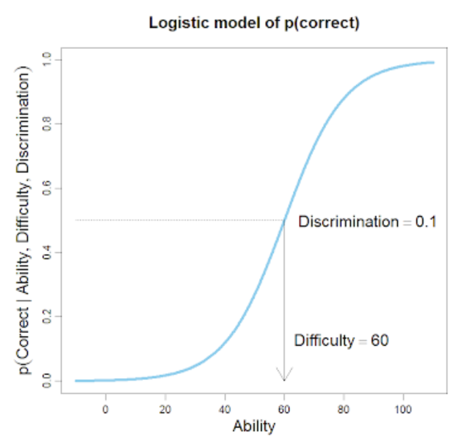
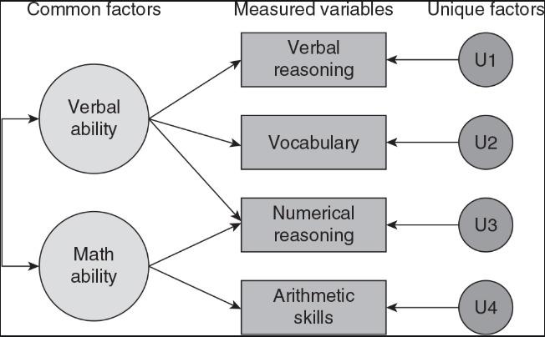
APD6001: Multivariate Statistical and Psychometric Applications in Education and Psychology
Fall 2023, Mondays 5-8pm
Dr. Olesya Falenchuk
Design and analysis of assessments – reliability, validity, differential item functioning, classical test theory, item response theory, scaling
Factor analysis
Structural equation modelling
Cluster analysis
Latent class/profile analysis
Examples: How to analyze statistically whether a test item is high- or low quality?
Data reduction: How to combine different survey items into a single scale (e.g., self-efficacy)?

Slide 15
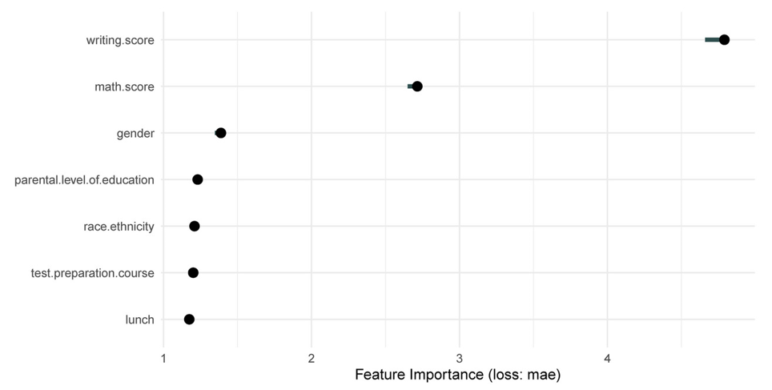
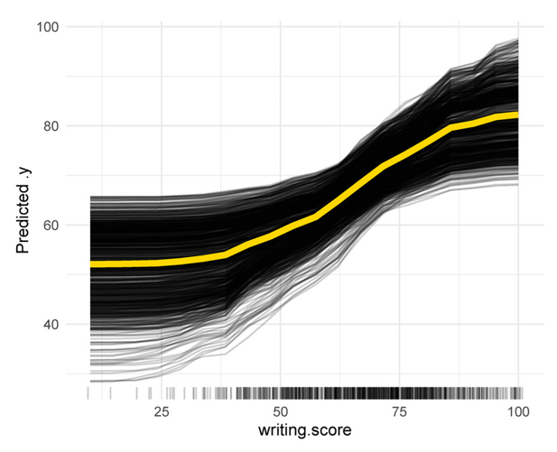
APD5044: Machine Learning Applications in Psychology and Education
Fall 2023, Mondays 1-4pm
Prof. Feng Ji
Practical applications of machine learning within psych. and education
Supervised and unsupervised learning algorithms
Techniques for handling multimodal data types (e.g., text)
Real-world applications, examples & case studies
Examples: Analysis of “big data” (high-dimensional data), e.g., from online learning or assessments
Predictive modelling of student outcomes

Slide 16
Other advanced courses offered in past/future years
JOI3049: Multilevel and Longitudinal Modelling in Educational Research [RM] (A.K. Chmielewski)
JOI3229: Meta-Analysis [RM]
JOI6001: Categorical Data Analysis [RM]

Slide 17
5. How can I figure out which courses to take?
Ask your Faculty Advisor!
For general skills, mixed methods thesis – intro or intermediate
For quantitative-only master’s thesis – (at least) intermediate
For quantitative-only doctoral dissertation – (at least) one advanced course

Slide 18
5. How can I figure out which courses to take? (cont.)
Math Pre-requisites: high school math (algebra, graphing functions, solving equations, basic probability); NO calculus or matrix algebra necessary
Statistics Pre-requisites:
  Introductory (LHA5014, JOI1287) – no pre-requisite (i.e., NO prior experience needed)
    If you are not sure whether to take intro (e.g., you took a similar course in undergrad), a self-administered, non-credit placement test is available here: https://q.utoronto.ca/enroll/AFAGPG
  Intermediate (JOI3048, JOI1288) – pre-requisite: intro (LHA5014, JOI1287 or equivalent)
  Advanced (LHA6003, APD6001, APD5044, JOI3049) – pre-requisite: intermediate (JOI3048, JOI1288 or equivalent)
Pre-requisites need not be taken at OISE

Slide 19
6. How can I plan my schedule of statistics courses?
Introductory courses are typically offered fall and winter
Intermediate courses are typically offered once per year
Advanced courses are typically offered less frequently (e.g., every 2 years)
Sample schedule:
1st Year |  | 2nd Year
Fall 2023 | Winter 2024 | Fall 2024 | Winter 2025
LHA5014 (intro) | JOI3048 (intermediate) | Advanced course

Slide 20
7. Do I get “Research Methods [RM]” and/or elective credit toward my degree program for statistics courses?
Yes (usually).
  See the SGS Calendar for official degree requirements, and consult your Faculty Advisor
Research methods [RM] credit:
  Most research-stream degrees (PhD, EdD, MA) in LHAE require 1 or more courses in research methods, chosen in consultation with Faculty Advisor. MEd students may take research methods courses as electives.
  Research methods courses are indicated by [RM] at the end of the course title in the OISE Registrar’s Course Schedule website and on ACORN. All stats courses have [RM] designation.
Elective credit:
  Stats courses can also be counted as open electives, and may count as program electives, if offered in LHAE (consult lhae.masters@utoronto.ca or lhae.doctoral@utoronto.ca for more info)

Slide 21
8. Which software is used in statistics courses?
Introductory
LHA5014 Intro to Statistics for Educational Research | Excel
JOI1287 Introduction to Applied Statistics | SPSS
Intermediate
JOI3048 Intermediate Statistics in Educational Research: Multiple Regression Analysis | Stata (or SPSS)
JOI1288 Intermediate Statistics and Research Design | SPSS
Advanced
LHA6003 Quantitative Research Practicum | Stata (or SPSS)
JOI3049 Multilevel and Longitudinal Modelling | HLM (& Stata or SPSS)
Other Quantitative Methods Courses
JOI3043 Survey Research in Educational Leadership and Policy | SPSS

Slide 22
9. Where can I find up-to-date info on statistics course offerings?
Visit our webpage!
  Google “oise lhae quantitative courses”
  https://www.oise.utoronto.ca/lhae/quantitative-research-methods-courses
OISE Registrar’s Office Graduate Course Schedules site → use [RM] filter
  Google “oise ro course schedules”
  https://www.oise.utoronto.ca/home/registrar-students/course-enrolment

Slide 23
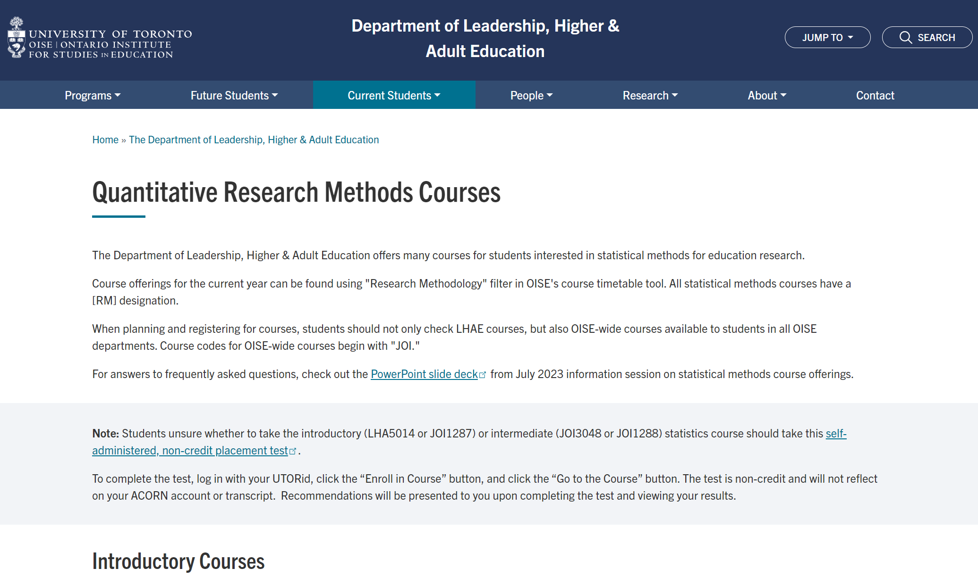
9. Where can I find up-to-date info on statistics course offerings?
Google “oise lhae quantitative courses”
https://www.oise.utoronto.ca/lhae/quantitative-research-methods-courses

Slide 24
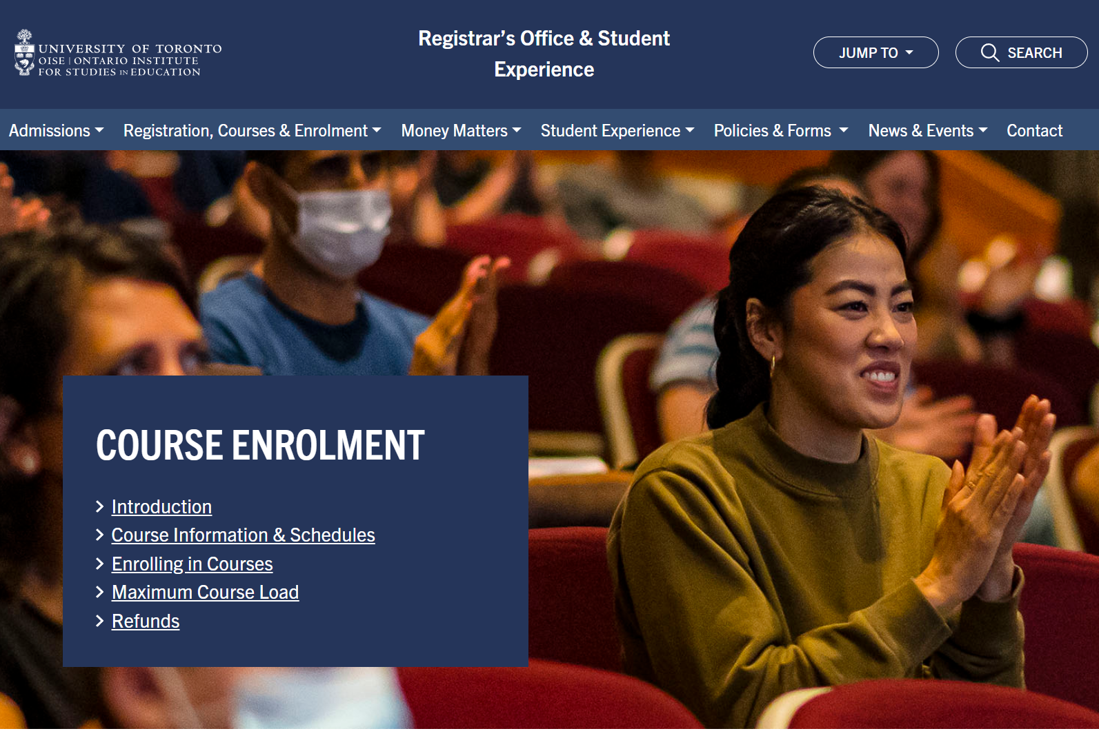
9. Where can I find up-to-date info on statistics course offerings?
Google “oise ro course schedules”
https://www.oise.utoronto.ca/home/registrar-students/course-enrolment

Slide 25
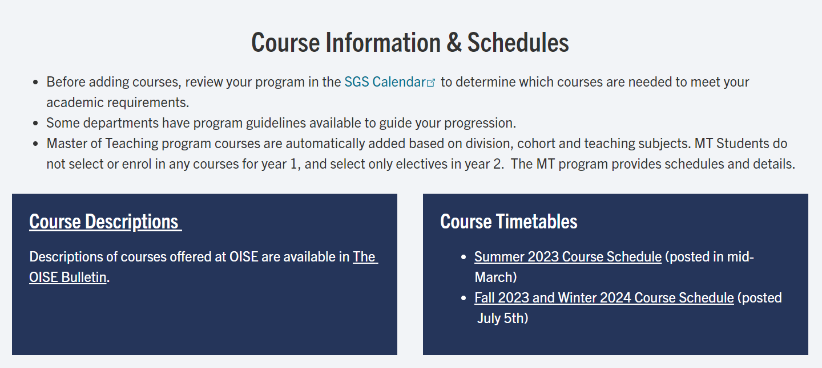
9. Where can I find up-to-date info on statistics course offerings?
Google “oise ro course schedules”
https://www.oise.utoronto.ca/home/registrar-students/course-enrolment

Slide 26
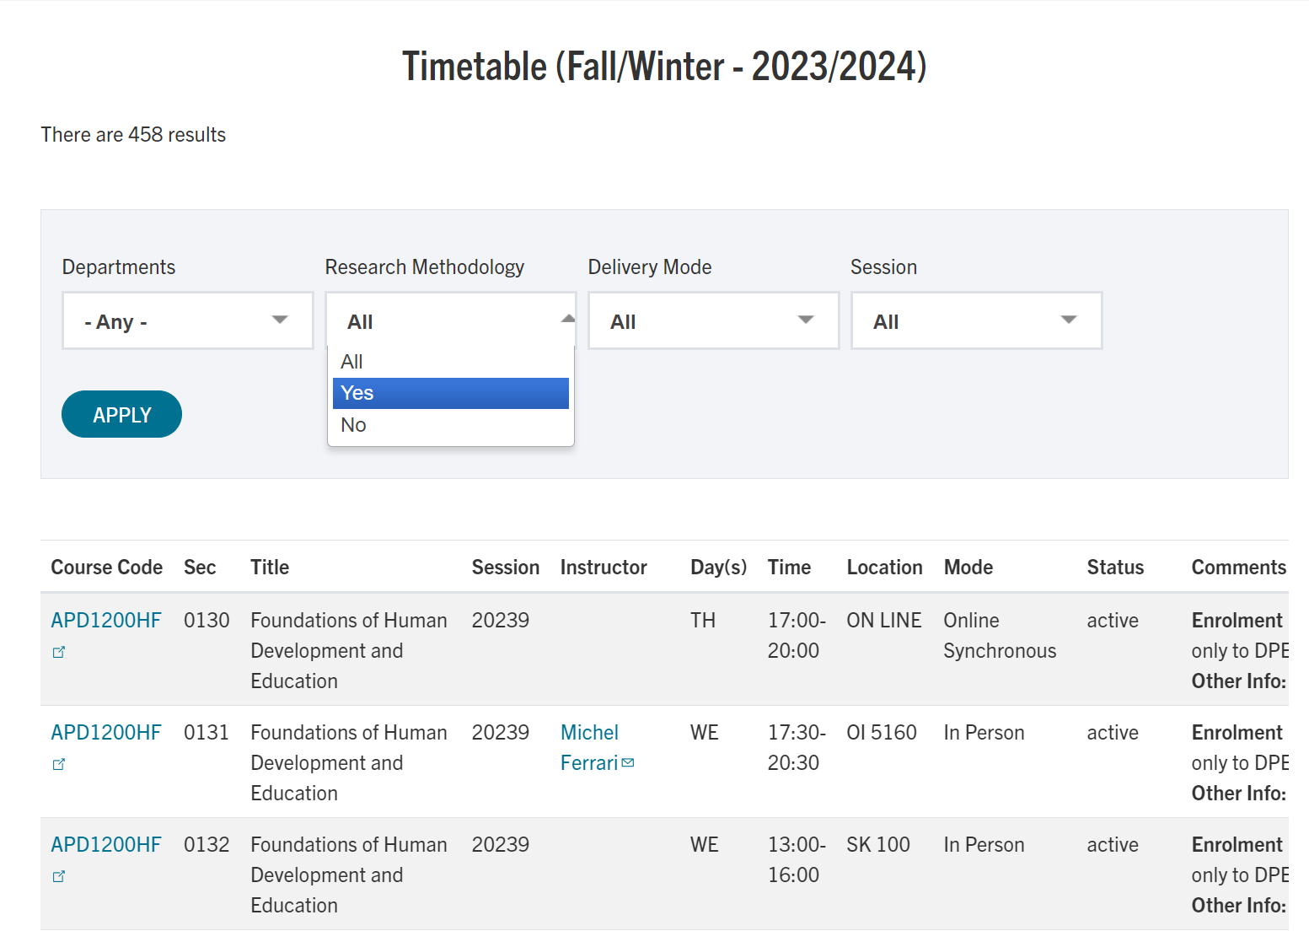
9. Where can I find up-to-date info on statistics course offerings?
Google “oise ro course schedules”
https://www.oise.utoronto.ca/home/registrar-students/course-enrolment

Slide 27
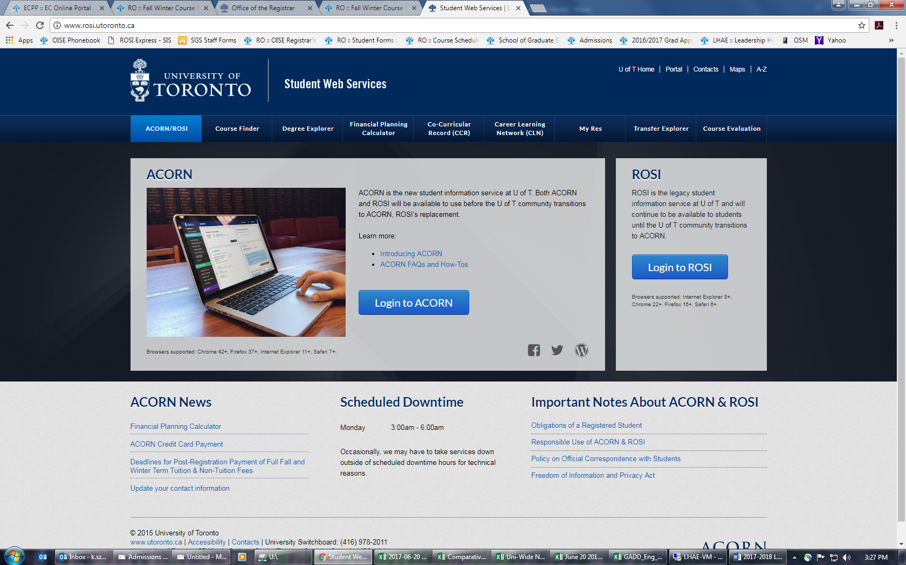
10. How can I enrol in statistics courses? www.acorn.utoronto.ca

Slide 28
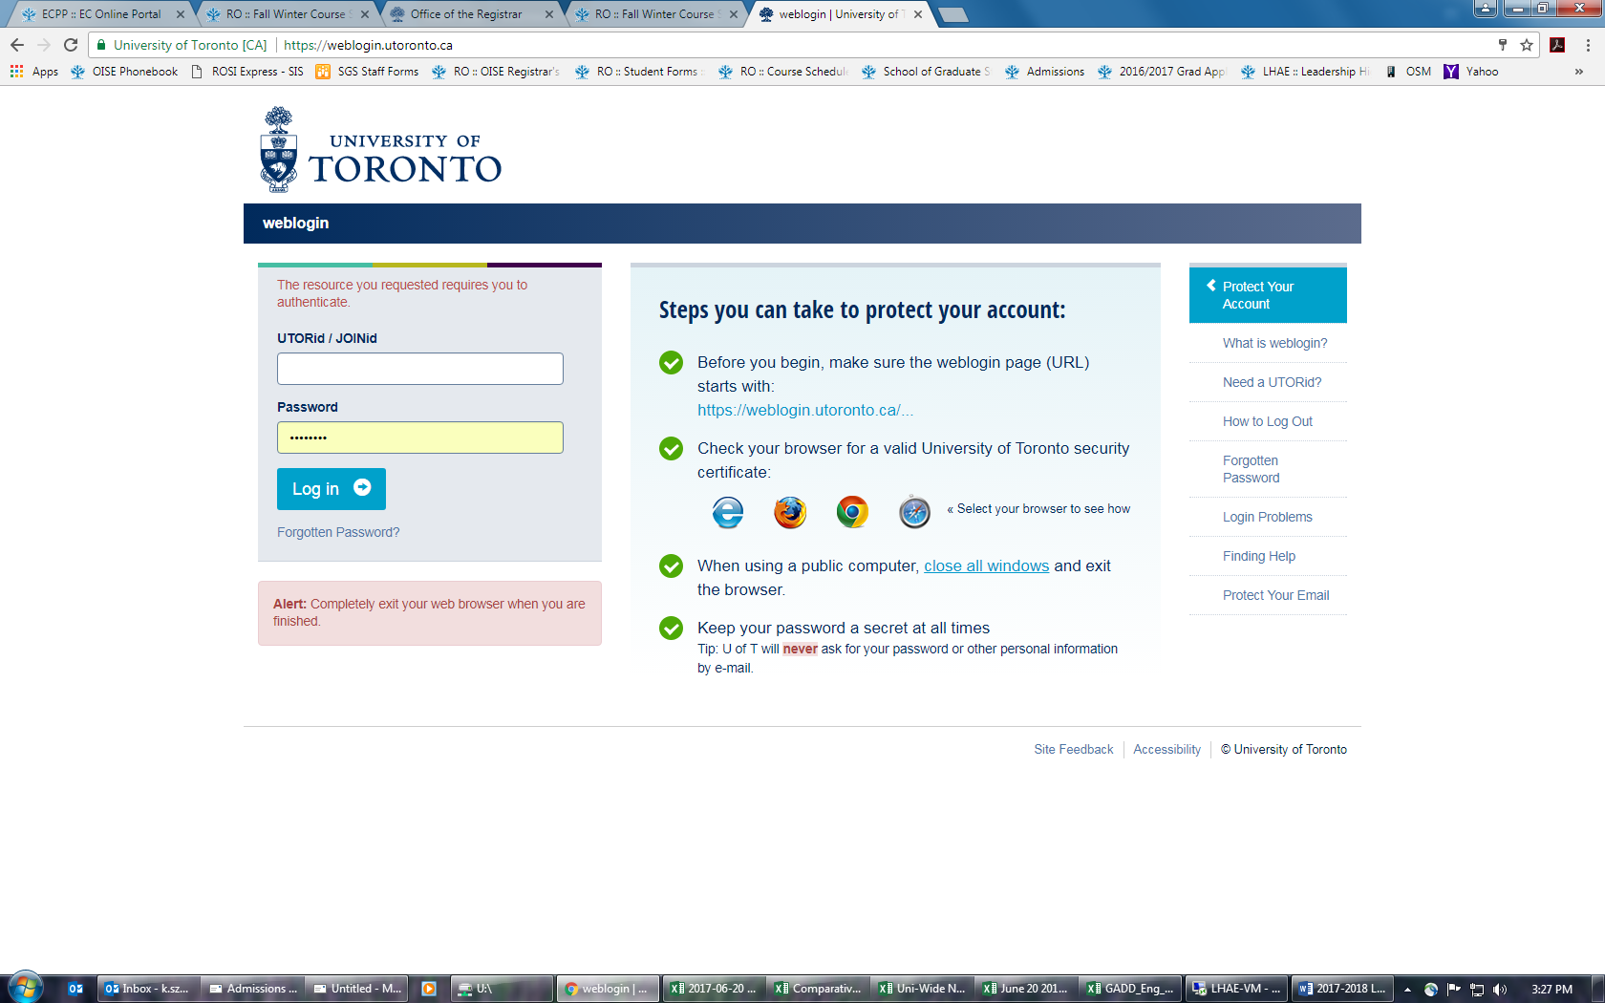
10. How can I enrol in statistics courses? www.acorn.utoronto.ca

Slide 29
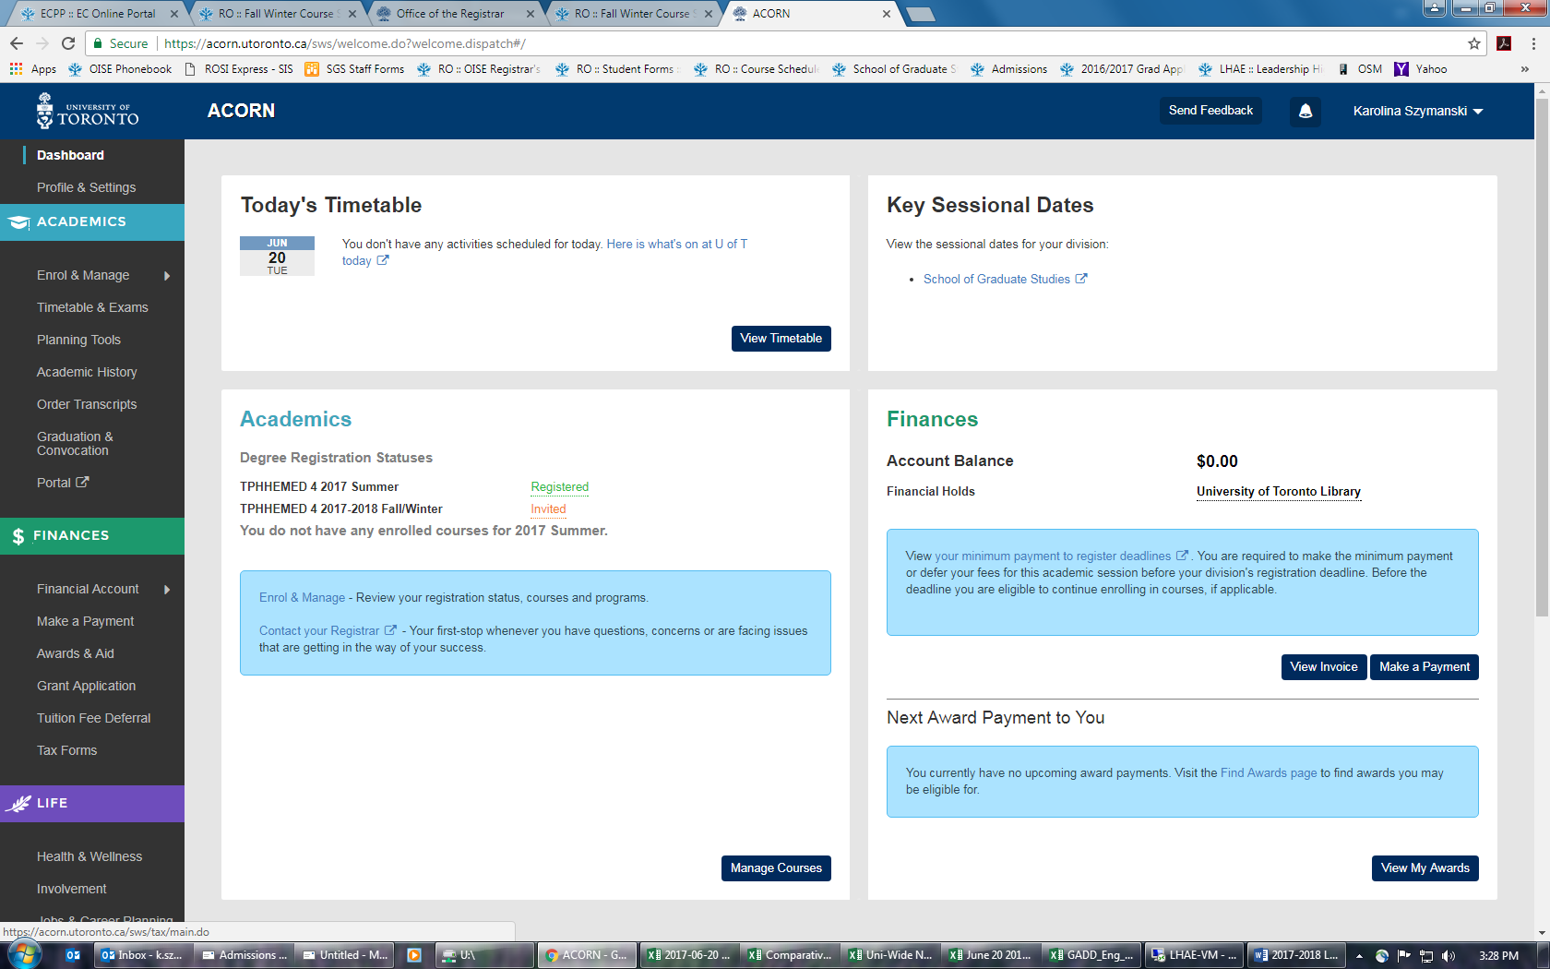
10. How can I enrol in statistics courses? www.acorn.utoronto.ca

Slide 30
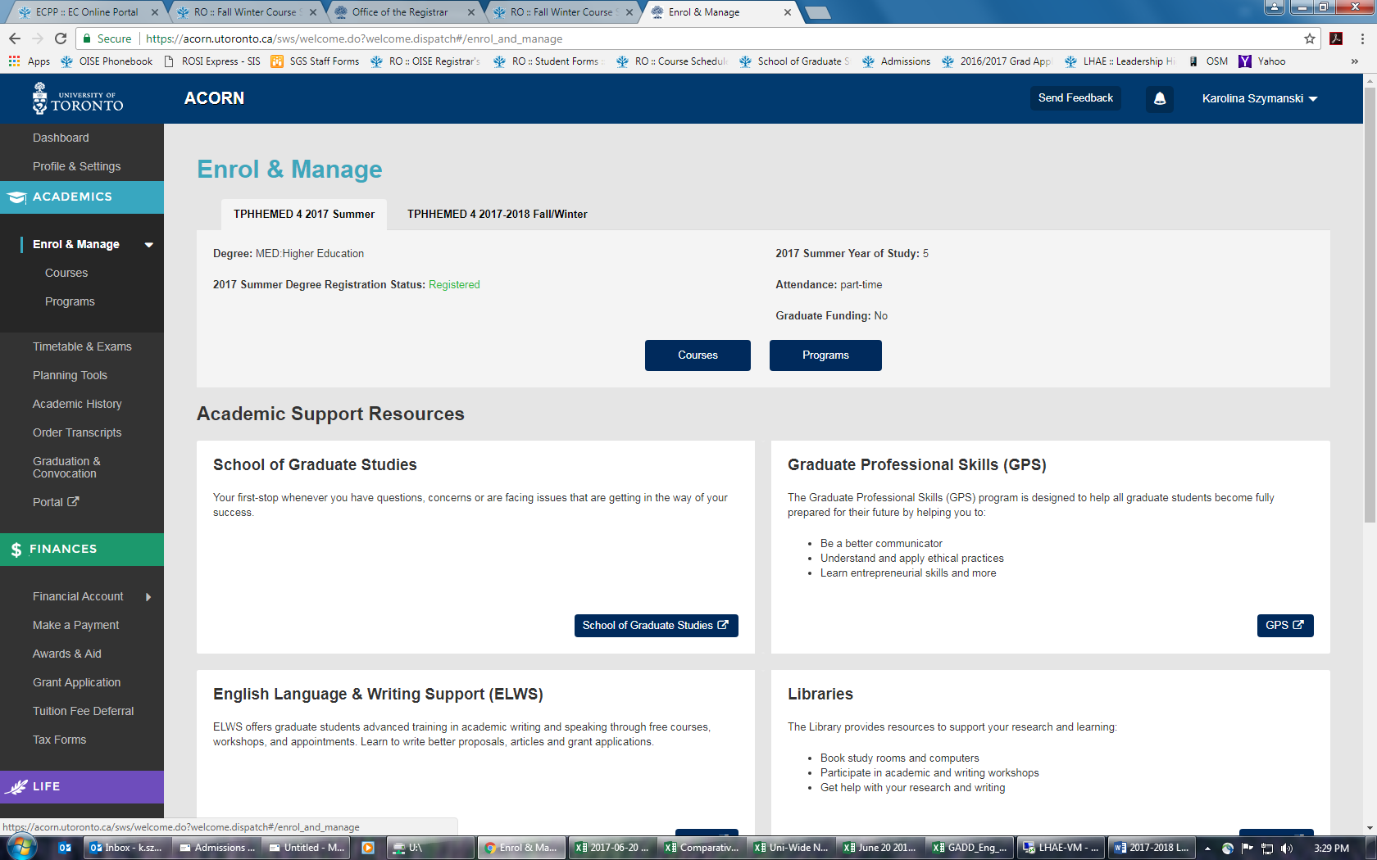
10. How can I enrol in statistics courses? www.acorn.utoronto.ca

Slide 31
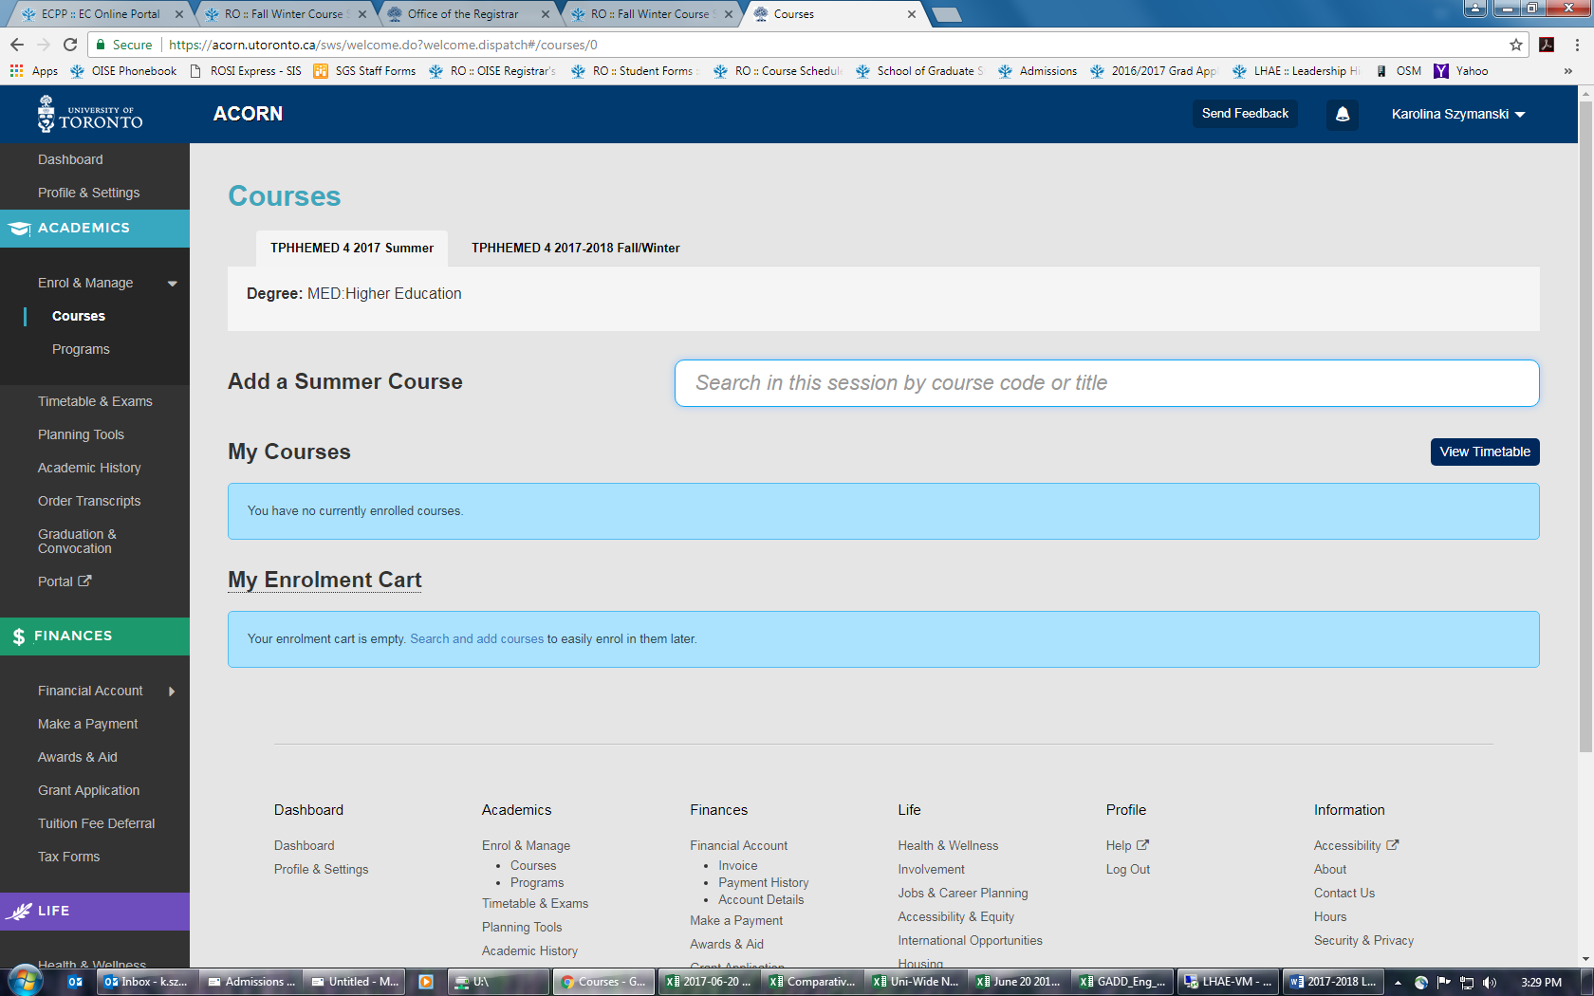
10. How can I enrol in statistics courses? www.acorn.utoronto.ca

Slide 32
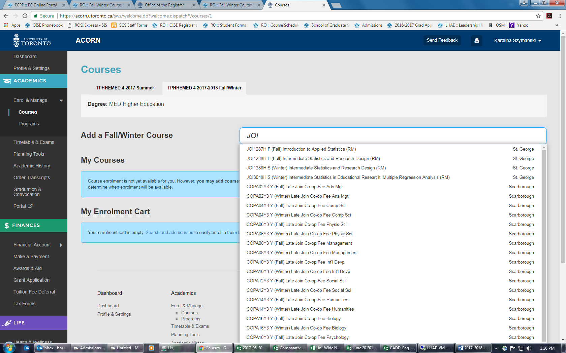
10. How can I enrol in statistics courses? www.acorn.utoronto.ca

Slide 33
11. Additional questions?

