Slide 1


Mature Students: Making Meaning and Meeting the Moment
Access & Equity in Higher Education for Mature Students (AEHEMS)
Research Symposium – October 4, 2024

Slide 2



Agenda
Key Points:
ASPO Team
ASPO Priorities
Access Programs University Fund (APUF)
Part 1:
About ASPO
Key Points:
Reflection on topics covered today at AHEMS
Back to basics:
  WHO are mature students?
  WHAT is the purpose of education for mature students?
  WHERE are the programs, policies and services that support
  mature students?
  d) WHEN is the right time for mature students to pursue education?
Part 2:
Some reflections on “Mature Students” in Higher Education
Concluding Points:
WHY should we support mature students in our programs and services?
Future Opportunities and Directions in Research
Part 3:
Next Steps

Slide 3

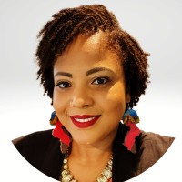
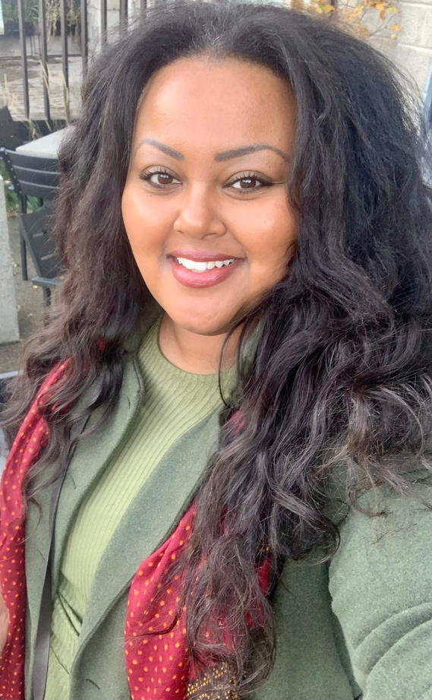
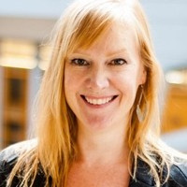
Anda Petro
About ASPO
Programs &
Pathways Officer
Chinelle Mcdonald
Partnerships &
Development Officer
Helen Tewolde
Director
Nancy Bakker
Executive Assistant &
Office Coordinator
Part 1:
About ASPO

Slide 4

About ASPO
The Access Strategy & Partnerships Office (ASPO) has a tri-campus mandate committed to supporting partners both internal and external to the University who support existing and prospective students to access and thrive in post-secondary education.
Part 1:
About ASPO

Slide 5
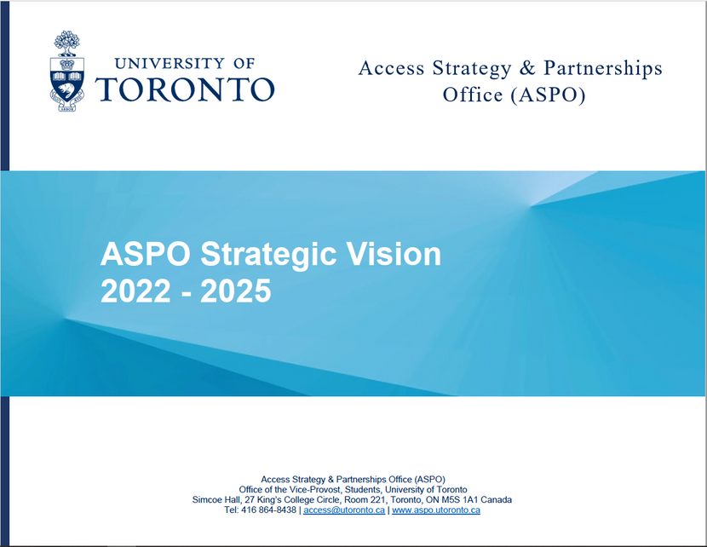
Strategic Vision
The ASPO Strategic Vision 2022-2025 document seeks to consolidate key access priorities and initiatives at
U of T over the past five years leading up to the establishment of ASPO.
aspo.utoronto.ca
ASPO Strategic Vision 2022-2025
Part 1:
About ASPO

Slide 6
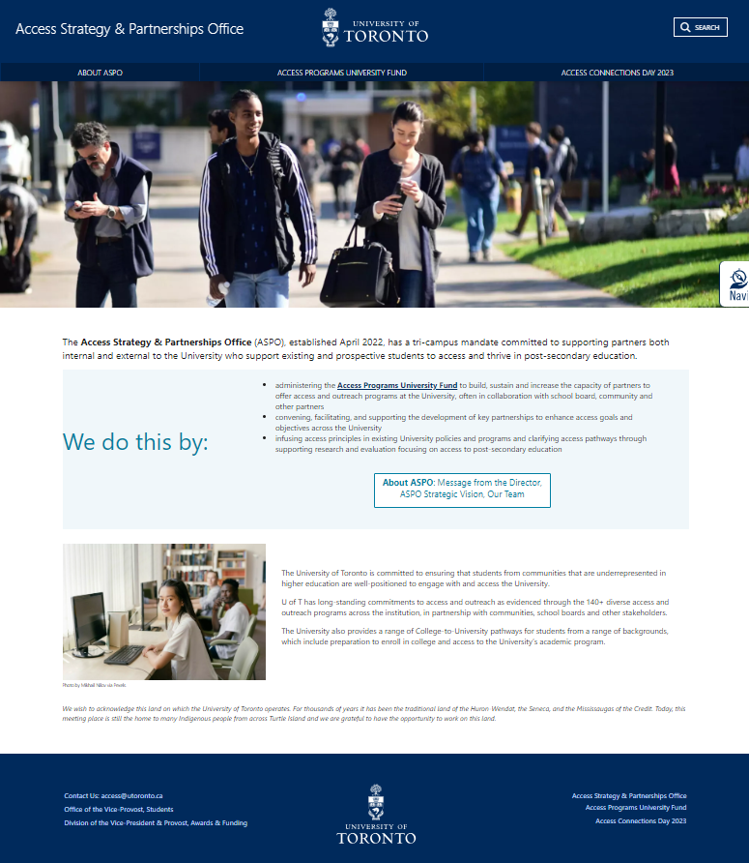
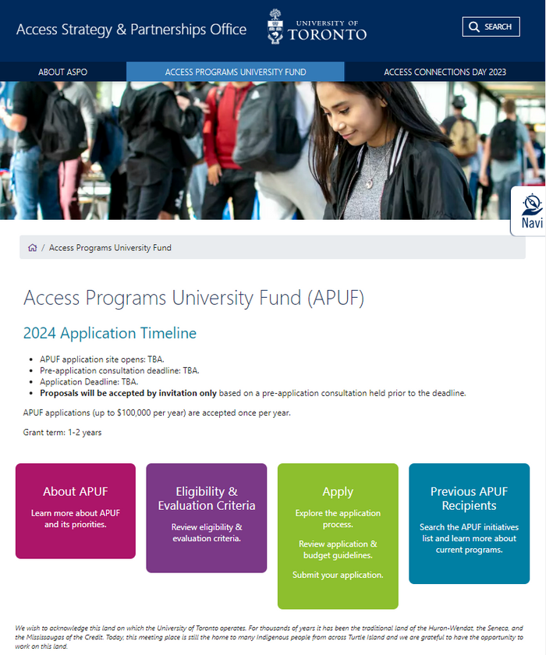
Website
Access Programs University Fund (APUF)
ASPO
Part 1:
About ASPO

Slide 7
Our 2 Top Priorities
1
Identify the structural barriers to access pathways in collaboration with institutional partners (internal) and community, postsecondary, school board and other partners (external).
2
Support and strengthen the capacity of U of T’s access, engagement, and outreach community to serve students and prospective students.
Part 1:
About ASPO
Notes:
There are five key priorities that have been consolidated through discussions with the access community across the tri-campus.
These priorities were presented to attendees of Access Connections Day on May 2, 2023, for ranking and feedback. Attendees identified these as the top two priorities for access at the University.

Slide 8

We Do This By:
  administering the Access Programs University Fund to build, sustain and increase the capacity of partners to offer access and outreach programs at the University. There are ~135 access and outreach programs at U of T. Close to 40% have been supported by APUF funding since 2019.
  convening, facilitating, and supporting the development of key partnerships to enhance access goals and objectives across the University
  infusing access principles in existing University policies and programs and clarifying access pathways through supporting research and evaluation focusing on access to post-secondary education
Part 1:
About ASPO

Slide 9

Access Programs University Fund (APUF)
Launched in 2019, APUF has supported 52 various access initiatives across U of T. Since 2019, $4,802,472 has been dispersed across the tri-campus.
Part 1:
About ASPO
Notes:
The purpose of this annual fund is to provide financial resources to help local units develop new and/or enhance existing programs dedicated to providing opportunities and support for students who, without intervention, may not access or succeed in post-secondary education.

Slide 10
Mature Student Landscape at the University of Toronto
Four (4) Joint College-University Programs
Nine (9) Access Programs
Program Focus
5 programs are youth-focused and have an upper age limit (e.g., 25, 29)
5 of the programs focus on bridging and/or transition to post-secondary education
3 programs focus on hands-on training and/or career development
Eligibility: Participant Age
Fields of Study
5 programs focus on specific fields like arts, science, physical education, fitness, and others.
College Partners
Fields of Study
Seneca Polytechnic, Humber Polytechnic, George Brown College, and Sheridan College
Social Sciences, Humanities (FAS/Woodsworth with Seneca, Humber and George Brown College); New Media, Paramedicine, Journalism (UTSC), Arts (UTM- Sheridan College)
Part 1:
About ASPO
Notes:
Joint Programs:
UTM: 1
UTSG: 1
UTSC: 2
Access programs:
UTM: 1-2
UTSG: 3-8
UTSC: 9
5 are active, 1 is on-hold (#9), and 2 have unknown status (#5,7)
The Access Programs University Fund (APUF) has provided over $800,000 in funding across multiple programs and their iterations

Slide 11

Themes in Access Programs for Mature Students
Bridging educational gaps​
  3 programs focus on early leavers and/or those who do not meet admission requirements​
Support for underrepresented students​
  Most programs (6) focus on one or more groups: racialized, Black, Indigenous, women, and LGBTQIA2S+ students​
Mentorship and peer support​
  Engagement with professionals, faculty and students​
Access to resources​
  May include equipment, space, books, and some financial supports​
  Programs also include holistic or wrap-around supports​
Community engagement​
  Collaboration with external community organizations​
Part 1:
About ASPO
Notes:
1. **Bridging Educational Gaps**: Many programs aim to bridge the gap between prior education and university requirements, providing pathways for those who do not meet traditional admission criteria (e.g., Millie Rotman Shime Academic Bridging Program, Transitional Year Programme).
2. **Support for Underrepresented Groups**: There is a strong focus on supporting marginalized and underrepresented groups, including BIPOC individuals, women, people with disabilities, and the 2SLGBTQI+ community (e.g., Equity, Access and the Co-Learning Classroom, TYP @ UTSC).
3. **Mentorship and Peer Support**: Several programs emphasize mentorship and peer support to help students navigate their educational journeys and build resilience (e.g., Bridging mentorship program, Hart House Group Fitness Mentorship Program).
5. **Community Engagement**: Many initiatives involve community engagement and collaboration with local organizations to enhance the impact and reach of the programs (e.g., partnerships with the City of Toronto, YWCA, and Nick Nurse Foundation).
6. **Access to Resources**: Providing access to university resources, such as courses, workshops, and facilities, is a common theme to help students succeed (e.g., auditing courses at U of T, access to the Electronic Music Studio). Programs often include financial support, such as stipends, funding for textbooks and exams, and barrier-free experiences to reduce the financial burden on students (e.g., Hart House Group Fitness Mentorship Program, TYP).

Slide 12
Overview of Access Programs for Mature Students
 | Program Name (*APUF-Funded) | Campus | Programs of Study
1 | Bridging Pathway | Mississauga | Not program-specific
2 | Bridging Pathway Mentorship Program | Mississauga | Not program-specific
3 | Future Sound 6ix: Connecting Youth and Music Industry in Toronto (14-20 age limit)* | St. George | Music
4 | Millie Rotman Shime Academic Bridging Program* | St. George | Arts and science
5 | Equity, Access and the Co-Learning Classroom | St. George | Social science
6 | Transitional Year Program* | St. George | Not program-specific
7 | Enhancing Post-Secondary Access for Black, Indigenous and other Marginalized Youth through Embodied, Cultural and Community-Engaged Learning* | St. George | Kinesiology and physical education
8 | Group Fitness Mentorship Program | St. George | Fitness
9 | Transitional Year Programme (TYP)* | Scarborough | Not program-specific
Part 1:
About ASPO
Notes:
5 are active, 1 is on-hold (#9), and 2 have unknown status (#5,7)

Slide 13
Overview: Joint College-University Programs
Program & University of Toronto Partners | College Partner | Programs of Study
Diploma to Degree Program Faculty of Arts and Science (FAS) and Woodsworth | Seneca Polytechnic, Humber Polytechnic and George Brown Colleges | Social science, humanities
UTSC Joint Programs with Centennial College | Centennial College | Arts and science (new media, paramedicine, journalism)
UTSC-Seneca College Pathway Program | Seneca Polytechnic | Liberal arts, arts and science
UTM-Sheridan Joint Programs | Sheridan College | Arts (art history, art, theatre, drama)
Part 1:
About ASPO

Slide 14

Reflections on How to Support Equity and Access for Mature Students
Part 2:
Reflections on Mature Students in Higher Education

Slide 15
Principle #1
People First
Part 2:
Reflections on Mature Students in Higher Education

Slide 16
Who are Mature Students?
Part 2:
Reflections on Mature Students in Higher Education

Slide 17

Who are Mature Students?
This is a “catch-all” phrase and we must ask ourselves whether and how the term still relevant? It was developed in the late 1960s when higher education institutions were expanding access for so-called ‘non-traditional’ students
The importance of Universal Design for Learning
From the diversity of presentations today it is clear that we need to be lucid and explicit about the educational trajectory of so-called ‘mature students’ to identify distinct educational needs, prior learning, and supports required
1. Any income bracket
2. African Canadian/Black Students
2. LGBTQ2SI+
2. Indigenous Students
3. Incarcerated Individuals
4. Students with Precarious Immigration Status
5. Women in STEM
7. Community Members
8. Differently Abled
9. Internationally Trained Professionals and Newcomers
10. Rural Students
Who is missing?
Part 2:
Reflections on Mature Students in Higher Education

Slide 18
Principle #2
Responsive Programs
& Services:
Document, Assess, Evaluate, Iterate
Part 2:
Reflections on Mature Students in Higher Education

Slide 19

What is the purpose of education for Mature Students?
What worked in the 1980s will not work now.
  Skill development based on personal interest and capacities
    Are we considering the needs of mature students in Work-Integrated and Experiential Learning
    How are we utilizing their Prior Learning? What is the state of Prior Learning Assessments?
    Online/hybrid learning; AI; digital divide
  Professional Development, Employment & Employability
    What is the role of regulatory bodies in developing pathways– e.g. In 2023, Professional Engineers of Ontario announced that Internationally-trained engineers will be able to get their license in Ontario without Canadian work experience
    College pathway programming
    Second Career/WSIB – learning more about the educational pathways of these students
Part 2:
Reflections on Mature Students in Higher Education

Slide 20

Where are the programs that support Mature Students?
Universal Design for Learning (UDL)
Higher Education Institutions
Adult Learning Networks (Canadian Association for the Study of Adult Education, CASAE) and National Adult Education Professional Development Consortium (NAPC)
Research organizations: HEQCO
Community Organizations
Online Directories: Edugraph; Adult Learning Canada
Government resources: MTCU
Part 2:
Reflections on Mature Students in Higher Education

Slide 21

When is the appropriate time for further study?
There is a short and long answer

Slide 22

Short answer
Anytime,
all the time.
Part 2:
Reflections on Mature Students in Higher Education

Slide 23

Long answer
Advise prospective students based on a balance of factors
Part 2:
Reflections on Mature Students in Higher Education

Slide 24
Principle #3
Coordination and Collaboration
Part 2:
Reflections on Mature Students in Higher Education

Slide 25

No Knowledge Siloes:
When we put people first, this happens naturally.
  Embed the needs of mature students across all our priorities
  Coordination to leverage existing resources
  Collaboration to inform education and labour market leaders to share data and stories about the experiences of mature students
  Working together to advocate for relevant tools and resources
Part 2:
Reflections on Mature Students in Higher Education

Slide 26

Next Steps
Part 3:
Next Steps

Slide 27
Data on Mature Students’ Access and Persistence
About the U of T Student Equity Census
The U of T Student Equity Census is a demographic data collection initiative with a set of eight questions, including questions on gender identity, sexual orientation, disability, Indigenous identity, race and/or ethnocultural identity, religious, spiritual affiliations or beliefs, and education attainment of parents or guardians.
While it does not collect data on mature students specifically, it can be linked to data on ROSI to do so.
This is very promising.
Within 5-6 years we will be able to track access, persistence and completion rates of all mature students registered at U of T.
Part 3:
Next Steps

Slide 28

Future Opportunities and Directions in Praxis
Focus on Demographics and Enrollment Trends
2. Courageously Address Barriers to Access:
3. Design Customized Support Services
4. Identify Gaps in Academic Progress and Retention
5. Experiential Learning and Prior Learning Assessment
6. Impact of Online Learning
Part 3:
Next Steps

Slide 29
Thank you!
Contact us:
access@utoronto.ca

