Slide 1
Learning Support for Mature Students in Higher Ed
Alyssia Bueno (She/Her), M.Ed, OCT
Student Success Programs Officer,
Office of the Faculty Registrar, Arts & Science
Notes:
Introduce self
Current role as SSPO, OFR, Arts & Science
M.Ed, teaching background, 7 years as a learning strategist

Slide 2
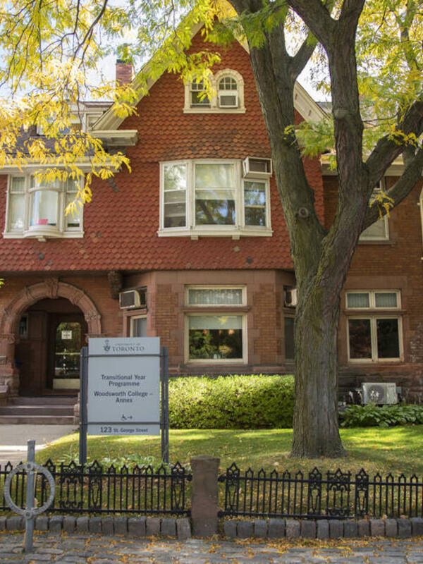
Learning Strategy Support
One-on-one, in-person appointments with students
Review individual learning histories
Identify previous and current learning-related challenges and needs
Individualized learning and study skill support
Navigate and access campus resources and supports
Notes:
Many students across higher ed landscape have access to academic support resources
These are designed to augment student learning experience sharing practical skills and strategies to help students engage with learning
In my role as a learning strategist worked to support two access programs, TYP & ABP
Role included 1:1 support
Review learning histories
Identify learning related challenges and needs
Provide individualized study skill support a
Assist students in navigating campus resources and supports.

Slide 3
Learning Needs + Challenges of Mature Students:
Reflections from Practice
Time Management & Organization
Language, literacy and academic writing skills
Study skills & test taking strategies
Mathematical/Numeracy skills
(Unidentified) Accessibility-related needs
Notes:
Reflecting on my own practice working with mature students, came to identify a number of trends as it relates to the learning needs of mature students,
Time Management & Organization
Many students required to balance responsibilities inside and outside of the classroom; multiple roles as students, parents, partners, caregivers, employees, or employers
Language, literacy and academic writing skills
Some students have non-linear learning histories, encountering obstacles that made learning difficult or impossible. Impact on language, literacy and writing skill development
Study skills & test taking strategies
Asked to engage differently with academic materials
Mathematical/Numeracy skills
Similar to writing may have completed math up until a certain level of proficiency, and are being asked to step into higher level math with limited foundation
(Unidentified) Accessibility-related needs
Unidentified accessibility-related needs that impact learning. Things that made learning difficult in previous contexts.

Slide 4
“Time management skills have been shown to have a positive impact on student learning and student outcomes”
(Kearns & Gardiner, 2007; Kelly, 2002; McKenzie & Gow 2004 as qtd in Adams & Blair, 2019)
Notes:
The research highlights that there is a strong correlation between time management and having positive student outcomes.
Time management of course, is a central challenge experienced by mature students, because of their identities and responsibilities beyond the classroom.
The university systems and structure are also not necessarily set up to support the learning needs of mature students.
So what are the strategies then, can we use to support mature students?

Slide 5
Create a list of responsibilities (academic and non-academic) Determine deadlines & importance Complete urgent and important tasks first Consider what can be delegated/supported by others
Strategy 1: Prioritization
Urgent
Less urgent
Important
Childcare pick up
Prepare Dinner
Sociology Exam
Meet the Teacher Night
Sociology Assignment
Assigned Readings
Less Important
Laundry
Optional Readings
Notes:
As a LS, one strategy is to help students identify what are the priority pieces in their lives.
School might not be one of them, and that is absolutely okay. How can we support students then?
Prioritization
The priorities of a mature student are diverse and different from someone from other students
Help them determine what those responsibilities are and identify if it’s a high priority task
Using something like this Eisenhower Priority Matrix can be helpful
Ask students to identify which items are important and urgent
Complete tasks that are important (value) and time sensitive (urgent first)
Recognizing that this is completely subjective for the individual student.

Slide 6
Determine non-negotiable items Stagger work hours; pockets of productivity Chunk academic tasks Identify family study time Lean on a community of support Communicate boundaries and bandwidth
Strategy 2: Scheduling
Time | Sun | Mon | Tues | Weds | Thurs | Fri | Sat
9-10 AM | Work | Commute | Commute | Commute | Drop-off | Drop-off | Work
10-11 AM |  | Soc Lect. | Bio Study | Study | Groceries | Commute
11-12 PM |  |  |  |  |  | Lab Prep
11-12 PM |  |  |  | Bio Lect. | Eng Study | Bio Lab
12-1 PM |  | Soc Tut. | Lunch
1-2 PM |  | Lunch | Writing Cent. | Lunch | Lunch | Lunch
2-3 PM |  |  | Eng Lect. | Math Help |  | Office Hr.
3-4 PM |  |  |  | Commute |  | Commute
4-5 PM |  | Daycare Pick up |  | Dinner
5-6 PM |  | Commute |  | Gym | Gym | Work
6-7 PM | Commute | Dinner | Eng Study | Kids | Dinner |  | Commute
7-8 PM | Dinner | Soc Study |  |  | Soc Study |  | Dinner
8-9 PM | Prep for Week | Kids
9-10 PM |  | Prep | Prep | Prep | Prep |  | Prep
10-11 PM | Sleep | Sleep | Sleep | Sleep | Sleep |  | Sleep
Notes:
A second strategy is around supporting students, organize and develop a schedule, that can allow them to visualize, plan
*
Scheduling
This strategy is about being intentional about time commitments and setting aside time to do the things that matter most
Start with non-negotiable items
Stagger work hours
For study chunk academic tasks & distribute practice
Identify shared family time
Lean on your community of support
Communicate boundaries and bandwidth

Slide 7
S | Specific | Implement a study plan for the next month.
M | Measurable | Create a study schedule and check off each completed study session.
A | Attainable/Action | Goal appears to be realistic for my situation. Set small study intervals, communicate goals & boundaries to others.
R | Relevant | Achieving this will allow me to prepare for my upcoming project & exam.
T | Time-based | Track progress over next month.
Mature students report an enhanced sense of self-determination & academic self-efficacy (Erb & Drysdale, 2017). Reflect on personal, professional & academic goals Determine purpose and motivation Identify a work-back plan
Strategy 3: Goal Setting
Notes:
Lastly, we’re thinking about helping students work towards their goals.
Goal Setting
Clear achievable goals increase the likelihood of success
Ask students to reflect on their personal, professional and academic worlds
Having a clear sense of ones goals can increase motivation and increase likelihood of success
Ask, what are your goals; big picture
Develop a work back plan, thinking about what are the medium term and shorter term goals that can support that vision
Developing specific goals using a SMART goals framework

Slide 8
Mature students have multiple, shifting and competing priorities
Critically reflect on the concept of Time Management; more than a ‘simple choice’ to make-time
No one-size-fits all approach to supporting student learning; individual and community-based needs
Recognize the strengths and skills mature students bring to the institution
Ongoing, tailored support for mature students
Final Reflections
Notes:
Must recognize that mature students have unique and shift priorities which don’t always run in alignment with the current higher ed landscape
Offering additional strategy and skill support is imperative for all students, including mature students
Critical Reflection
We must also recognize that, through I’ve shared a bit about some strategies, from a critical perspective, TM is more than a simple choice
The concept of time management in itself is rooted in capitalist, neoliberal thought with the idea that we must maximize production.
And so mature students, are also forced to operate within this landscape, but we must recognize that not all mature students have the same 24 hours for example, taking on child care, taking longer to read etc.)
With this in mind, we need to be offering both individual support to ensure students have the strategies they need, while also recognizing that there are supports and changes at the system level as well.
Examples of changes and supports at the system level:
Building in additional time; flexibility with assessment
Checking in mature students to identify their needs and priorities
Additional resources/programming for mature students; family friendly
Move away from ‘production, output and efficiency’ to student grown, development and confidence.
Offering classes and programming in the evening.
Family inclusive resources and spaces
Opportunities for peer-based learning/mentorship btwn mature students
Increased financial support

Slide 9
Adams R. & E. Blair (2019) Impact of Time Management Behaviours on
Undergraduate Engineering Students’ Performance. Sage Open. https://doi.org/10.1177/2158244018824506
Erb, S. & M.T. B. Drysdale (2017) Learning attributes, academic self-efficacy and
sense of belonging amongst mature students at a Canadian university,
Studies in the Education of Adults, 49:1, 62-74, DOI:
10.1080/02660830.2017.1283754
Heagney, M. & R. Benson (2017) How mature-age students succeed in higher
education: implications for institutional support, Journal of Higher Education Policy and Management, 39:3, 216-234, DOI: 10.1080/1360080X.2017.1300986
van Rhijin, T., Lero, D., Bridge, K. & V. Fritiz, (2016). Unmet Needs: Challenges to
Success from the Perspectives of Mature University Students. Canadian Journal for the Study of Adult Education.28-1. 29-47.DOI:10.56105/
cjsae.v28i1.4704
References:

