Slide 1
Information Session on Statistical Methods Offerings in LHAE and OISE
Prof. Anna Katyn Chmielewski
Prof. Danny Corral
Prof. Scott Davies
Prof. Sam Lucas
July 7, 2025

Slide 2

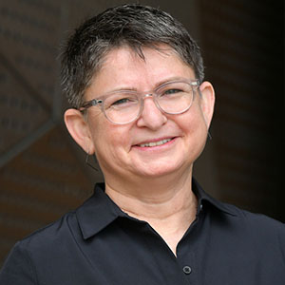
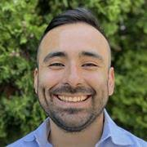
Introductions
Anna Katyn Chmielewski
Associate Professor of Educational Leadership & Policy
Research interests: Educational policy and social inequality; socio-economic disparities in academic achievement; school segregation; policies around school and program choice, streaming and tracking; international large-scale assessments (PISA, PIRLS, TIMSS, PIAAC); sociology of education; quantitative methods
Ruth Childs
Professor of Higher Education
Research interests: Assessment design and equity; admissions processes; access to post-secondary education; evaluation systems; and survey research
Danny Corral
Assistant Professor of Higher Education
Research interests: Higher education policy and finance; postsecondary access and persistence of racially minoritized students and immigrant students; minority-serving institutions; quantitative methods

Slide 3

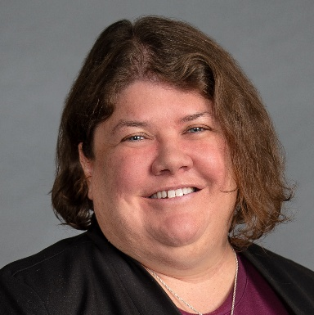
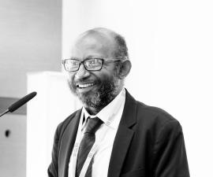
Introductions (cont.)
Scott Davies
Professor of Educational Leadership & Policy
Research interests: Sociology of education; large-scale data analysis; research design and methods; policy-oriented research; organizational analyses; student achievement
Elizabeth Dhuey
Professor of Economics and Educational Leadership & Policy
Research interests: Economics of education; program and policy analysis; quantitative methods; special education finance; skills and education for the future world of work; and early childhood education
Sam Lucas
Professor of Higher Education
Research interests: Social stratification, sociology of education, research methods, and research statistics.

Slide 4
Introductions
Departments
Applied Psychology & Human Development (APHD)
Curriculum, Teaching & Learning (CTL)
Leadership, Higher & Adult Education (LHAE)
Social Justice Education (SJE)
Degrees
MEd
MA
EdD
PhD
Programs
Adult Education & Community Development (AECD)
Educational Leadership & Policy (ELP)
Higher Education (HE)

Slide 5
Overview
Introductions
Why learn statistical methods?
Where can I find statistics courses at OISE?
Which statistics courses are available?
Which software is used in statistics courses?
How can I figure out which course(s) to take?
How can I plan my schedule of statistics courses?
Do I get “Research Methods [RM]” and/or elective credit toward my degree program for statistics courses?
Where can I find up-to-date info on statistics course offerings?
How can I enrol in statistics courses?
Additional questions?

Slide 6
2. Why learn statistical methods?
Fun!
Powerful tools for research
Valuable skills for the job market
  Past non-university research placements: HEQCO, Ministry of Advanced Education and Skills Development, Statistics Canada, People for Education, Ministry of Community of Social Services, Ministry of Education, Education Quality and Accountability Office (EQAO), Council of Ministers of Education Canada; TDSB and other school board research offices; college institutional research offices; UNICEF
  Past university placements: University of Guelph, Nipissing, Laurier, Waterloo, Harvard, Lakehead U, U of Saskatchewan, Western U, York U, Laurentian U, U of Ottawa

Slide 7
3. Where can I find statistics courses at OISE?
Applied Psychology & Human Development (APHD)
APD1292 (quant)
APD6001 (stats)
APD3209 (stats)
JOI1287 (stats)
JOI1288 (stats)
JOI3229 (stats)
JOI6001 (stats)
Curriculum, Teaching & Learning (CTL)
Leadership, Higher & Adult Education (LHAE)
LHA1006 (stats)
LHA1828 (quant)
LHA6019 (stats)
JOI3043 (quant)
JOI3048 (stats)
JOI3049 (stats)
JOI3050 (stats)
Social Justice Education (SJE)
APD – open only to APHD students
LHA – open only to LHAE students
JOI (joint OISE) – open to (or some spots reserved for) all OISE students – but still housed in a home department

Slide 8
4. Which statistics courses are available this year?
LHAE Department | APHD Department
Introductory (NO pre-requisites or experience with stats needed)
LHA1006: Introduction to Statistics for Educational Research [RM] – Fall 2025 – Thursdays, in person (R. Childs) | JOI1287: Introduction to Applied Statistics [RM] – Fall 2025 or Winter 2026 – in person (M. Azimi)
Intermediate (pre-requisite: LHA1006, JOI1287 or equivalent)
JOI3048: Intermediate Statistics in Educational Research: Multiple Regression Analysis [RM] – Winter 2026 – Thursdays, in person (A.K. Chmielewski) | JOI1288: Intermediate Statistics and Research Design [RM] – Fall 2025 or Winter 2026 – in person or online (F. Ji)
Advanced (pre-requisite: JOI3048, JOI1288 or equivalent)
LHA6019: Experimental and Quasi-Experimental Methods for Education Policy [RM] – Fall 2025 – Thursdays, in person (E. Dhuey) | APD3209: Applied Machine Learning [RM] – Winter 2026 – Mondays, online (F. Ji)

Slide 9
LHA1006: Introduction to Statistics for Educational Research
Fall 2025, Thursdays, 5-8pm, in person
Prof. Ruth Childs
NO prior experience with stats needed
Univariate and bivariate descriptive stats
Sampling, experimental design, statistical inference
Chi-square, t-test, ANOVA, regression
Intro to Jamovi software (free front-end for R)
Students will be able to analyze real data and interpret results
Examples: What is the average math score in the school, and how much do scores vary across students?
Is the math score of Classroom 1 significantly higher than Classroom 2?
Are the math scores of girls significantly different from boys?

Slide 10
JOI3048: Intermediate Statistics in Educational Research: Multiple Regression Analysis
Winter 2026, Thursdays, 5-8pm, in person
Prof. Anna Katyn Chmielewski
Bivariate and multivariate linear regression models
Curvilinear regression functions; dummy & categorical variables; interactions
Intro to Stata software (may use SPSS)
Students will be able to run, interpret and write about regression models in their own research
Examples: Do students of higher socio-economic status have higher math scores?
Does this relationship persist after we hold educational resources constant?
Does the relationship between socio-economic status and math scores differ between Ontario and Quebec?

Slide 11
Should I take LHA1006 or JOI1287 (intro)?
Should I take JOI3048 or JOI1288 (intermed)?
LHAE Department LHA1006 and JOI3048 | APHD Department JOI1287 and JOI1288
Probably slightly more appropriate for most LHAE students | Probably slightly less appropriate for most LHAE students
Policy-oriented | Psychology-oriented
Secondary analysis of existing large-scale data | Analysis of original small-scale data, collected by researcher (e.g., lab-based)
Non-experimental/observational | Experimental
LHA1006 (intro) – 25 spots available, fall, in person (evenings) | JOI1287 (intro) – additional spots available, fall/winter, in person (daytime)
…both departments’ classes are great options, depending on your needs and course availability!

Slide 12
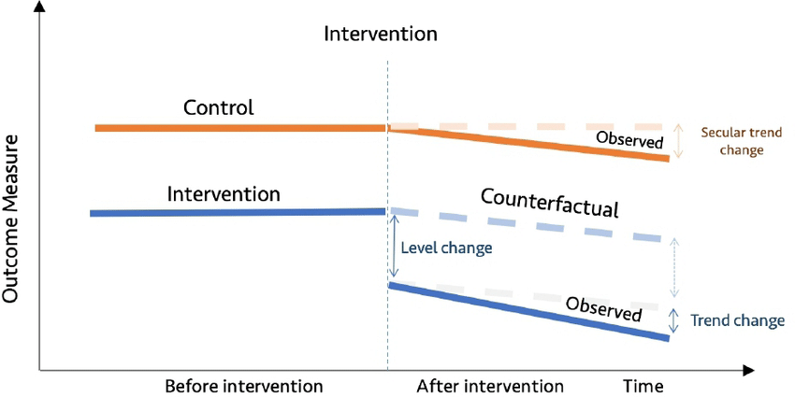
LHA6019: Experimental and Quasi-Experimental Methods for Education Policy
Fall 2025, Thursdays 5-8pm, in person
Prof. Elizabeth Dhuey
Principles and methods of causal inference
Randomized controlled trials, regression discontinuity designs, instrumental variables, difference-in-differences
Evaluation of empirical research, study design, interpretation of causal claims
Students will be able to assess effectiveness of interventions and develop evidence-based policy
Example: Evaluating the effects of a “natural experiment” (e.g., an extreme weather event that caused school closures in one city but not the neighbouring city)

Slide 13
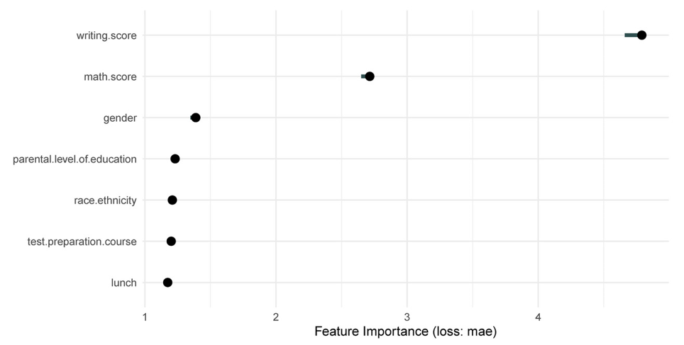
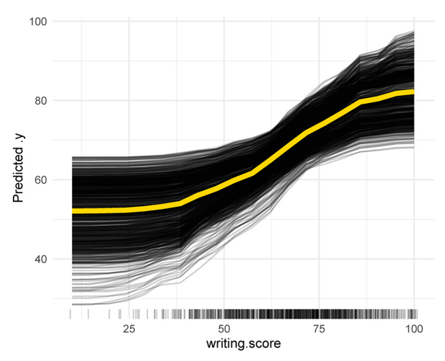
APD3209: Applied Machine Learning
Winter 2026, Mondays 9:30am-12:30pm, online sync
Prof. Feng Ji
Practical applications of machine learning within psych. and education
Supervised and unsupervised learning algorithms
Techniques for handling multimodal data types (e.g., text)
Real-world applications, examples & case studies
Examples: Analysis of “big data” (high-dimensional data), e.g., from online learning or assessments
Predictive modelling of student outcomes

Slide 14
JOI3050: Quantitative Research Practicum
Prof. Scott Davies
Date, Time and Location
Not offered in 2025-26
OISE 6-184 (Data, Equity and Policy in Education [DEPE] Lab)

Slide 15
JOI3050: Quantitative Research Practicum (cont.)
Purposes of this Course
Instruction in causal inference (quasi-experiments, propensity score matching), categorical analysis, missing data analysis
Guidance in management and analysis of large scale data sets, either provided or students’ own data
Access to unique educational data sets
Term papers: draft article involving data analysis

Slide 16
JOI3050: Quantitative Research Practicum (cont.)
(Hopefully) Available Data Sets
OISE Surveys 1978-2017: Public opinion on educational issues, Ontario adults
TDSB-UofT: track cohort of students from grade 9 to BA years
Ontario Summer Learning: cross-sectional and 3 year longitudinal
Ontario EDI-EQAO: track cohorts of students from Kindergarten – Grade 6

Slide 17
Other advanced courses offered in past/future years
JOI3049: Multilevel and Longitudinal Modelling in Educational Research [RM] (A.K. Chmielewski)
JOI3229: Meta-Analysis for Research in Psychology and Education [RM]
APD6001: Multivariate Statistical and Psychometric Applications in Education and Psychology [RM]
JOI6001: Categorical Data Analysis [RM]

Slide 18
5. Which software is used in statistics courses?
Introductory
LHA1006 Intro to Statistics for Educational Research | Jamovi
JOI1287 Introduction to Applied Statistics | SPSS
Intermediate
JOI3048 Intermediate Statistics in Educational Research: Multiple Regression Analysis | Stata (or SPSS)
JOI1288 Intermediate Statistics and Research Design | R
Advanced
LHA6019 Experimental and Quasi-Experimental Methods for Education Policy | Stata
JOI3049 Multilevel and Longitudinal Modelling | HLM (& Stata/SPSS)
JOI3050 Quantitative Research Practicum | Stata (or SPSS)
Other Quantitative Methods Courses
JOI3043 Development and Use of Surveys in Education Research | SPSS

Slide 19
6. How can I figure out which courses to take?
Ask your Faculty Advisor!
For general skills, mixed methods thesis – intro or intermediate
For quantitative-only master’s thesis – (at least) intermediate
For quantitative-only doctoral dissertation – (at least) one advanced course

Slide 20
6. How can I figure out which courses to take? (cont.)
Math Pre-requisites: high school math (algebra, graphing functions, solving equations, basic probability); NO calculus or matrix algebra necessary
Statistics Pre-requisites:
  Introductory (LHA1006, JOI1287) – no pre-requisite (i.e., NO prior experience needed)
    If you are not sure whether to take intro (e.g., you took a similar course in undergrad), a self-administered, non-credit placement test is available here: https://q.utoronto.ca/enroll/AFAGPG
  Intermediate (JOI3048, JOI1288) – pre-requisite: intro (LHA1006, JOI1287 or equivalent)
  Advanced (LHA6019, JOI3049, JOI3050, APD3209) – pre-requisite: intermediate (JOI3048, JOI1288 or equivalent)
Pre-requisites need not be taken at OISE

Slide 21
7. How can I plan my schedule of statistics courses?
Introductory courses are typically offered fall and winter
Intermediate courses are typically offered once per year
Advanced courses are typically offered less frequently (e.g., every 2 years)
Sample schedule:
1st Year |  | 2nd Year
Fall 2025 | Winter 2026 | Fall 2026 | Winter 2027
LHA1006 (intro) | JOI3048 (intermediate) | Advanced course

Slide 22
8. Do I get “Research Methods [RM]” and/or elective credit toward my degree program for statistics courses?
Yes (usually).
  See the SGS Calendar for official degree requirements, and consult your Faculty Advisor
Research methods [RM] credit:
  Most research-stream degrees (PhD, EdD, MA) in LHAE require 1 or more courses in research methods, chosen in consultation with Faculty Advisor. MEd students may take research methods courses as electives.
  Research methods courses are indicated by [RM] at the end of the course title in the OISE Registrar’s Course Schedule website and on ACORN. All stats courses have [RM] designation.
Elective credit:
  Stats courses can also be counted as open electives, and may count as program electives, if offered in LHAE (consult lhae.masters@utoronto.ca or lhae.doctoral@utoronto.ca for more info)

Slide 23
9. Where can I find up-to-date info on statistics course offerings?
Visit our webpage!
  Google “oise lhae quantitative courses”
  https://www.oise.utoronto.ca/lhae/quantitative-research-methods-courses
OISE Registrar’s Office Graduate Course Schedules site → use [RM] filter
  Google “oise ro course schedules”
  https://www.oise.utoronto.ca/home/registrar-students/course-enrolment

Slide 24
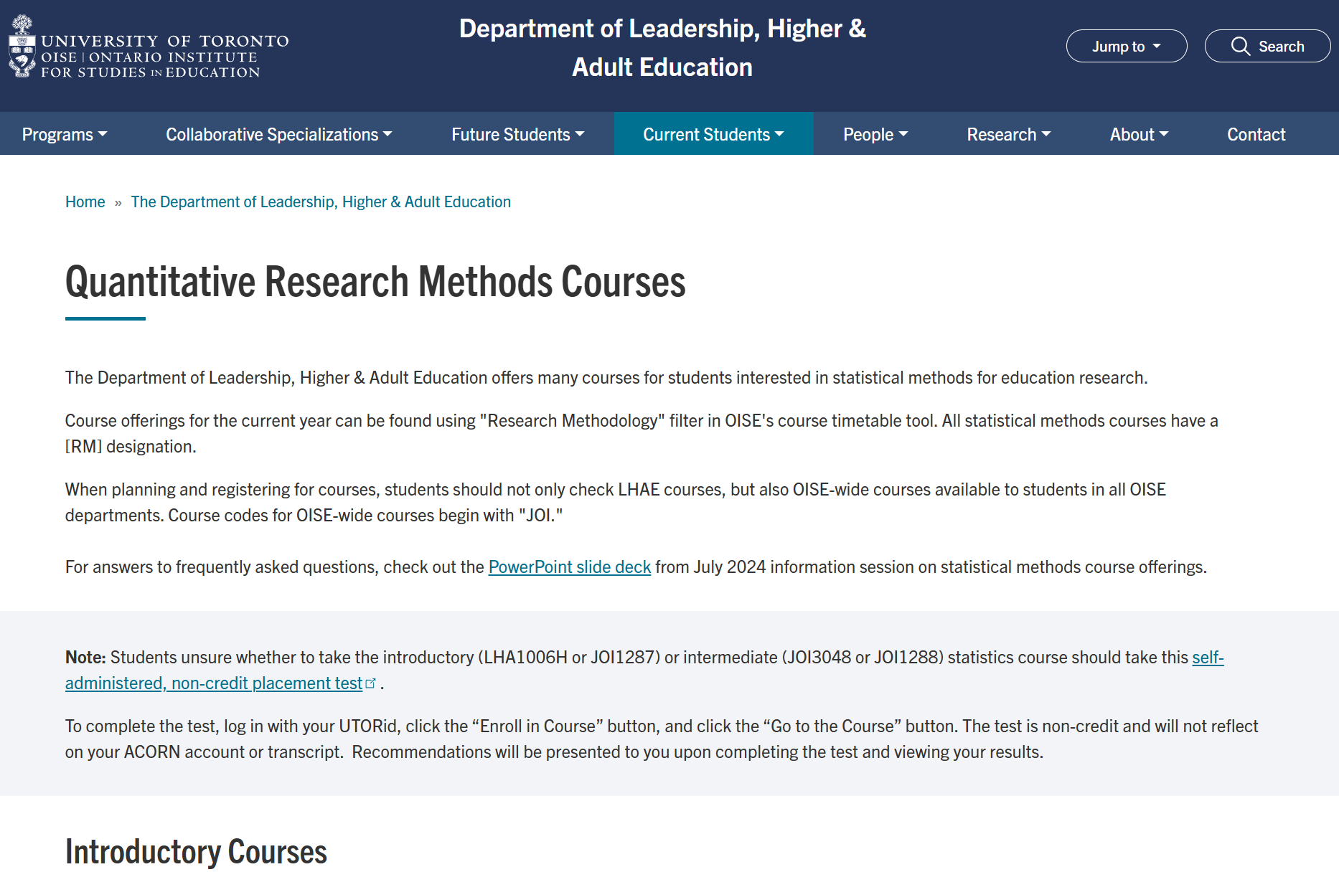
9. Where can I find up-to-date info on statistics course offerings?
Google “oise lhae quantitative courses”
https://www.oise.utoronto.ca/lhae/quantitative-research-methods-courses

Slide 25

9. Where can I find up-to-date info on statistics course offerings?
Google “oise ro course schedules”
https://www.oise.utoronto.ca/home/registrar-students/course-enrolment

Slide 26
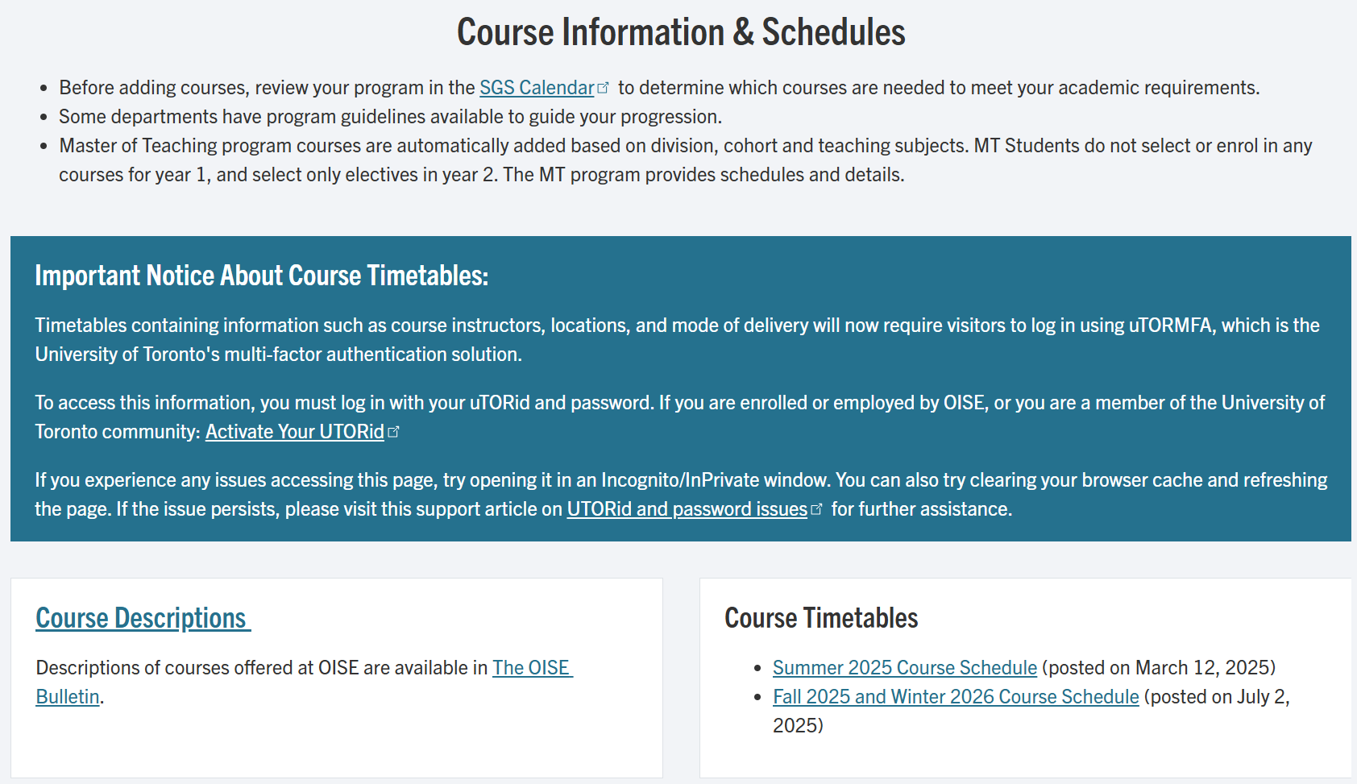
9. Where can I find up-to-date info on statistics course offerings?
Google “oise ro course schedules”
https://www.oise.utoronto.ca/home/registrar-students/course-enrolment

Slide 27
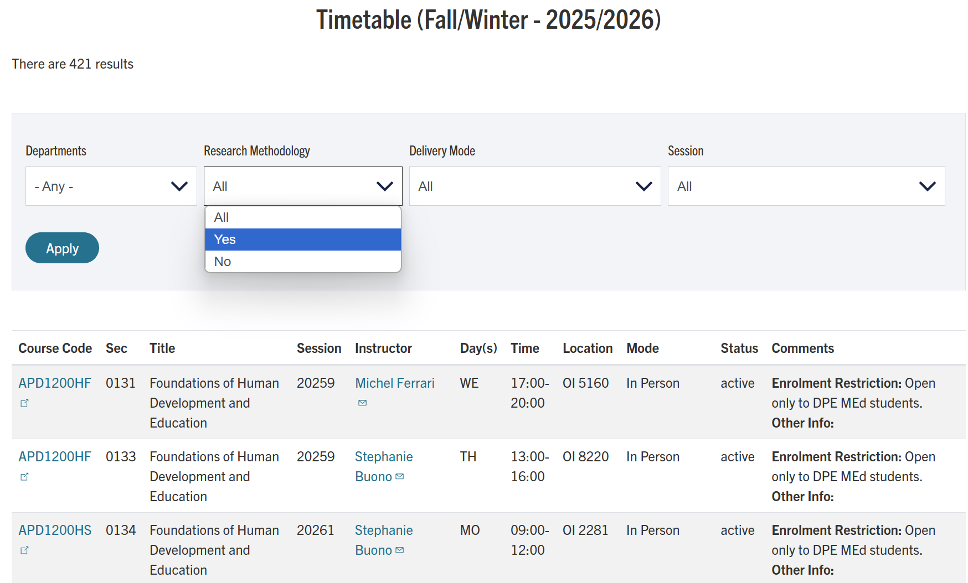
9. Where can I find up-to-date info on statistics course offerings?
Google “oise ro course schedules”
https://www.oise.utoronto.ca/home/registrar-students/course-enrolment

Slide 28
9. Where can I find up-to-date info on statistics course offerings? Enrolment restrictions & cycles
 | 1st Cycle (July 8) | 2nd Cycle – Fall (July 24) | 2nd Cycle – Winter (Oct 9)
LHA1006 Introduction to Statistics for Educational Research | Doctoral & MA students in LHAE | All degrees in LHAE (including MEd)
JOI3043 Development and Use of Surveys in Education Research
LHA6019 Experimental and Quasi-Experimental Methods for Education Policy
JOI3048 Intermediate Statistics in Educational Research: Multiple Regression Analysis |  |  | All degrees in LHAE (including MEd)

Slide 29
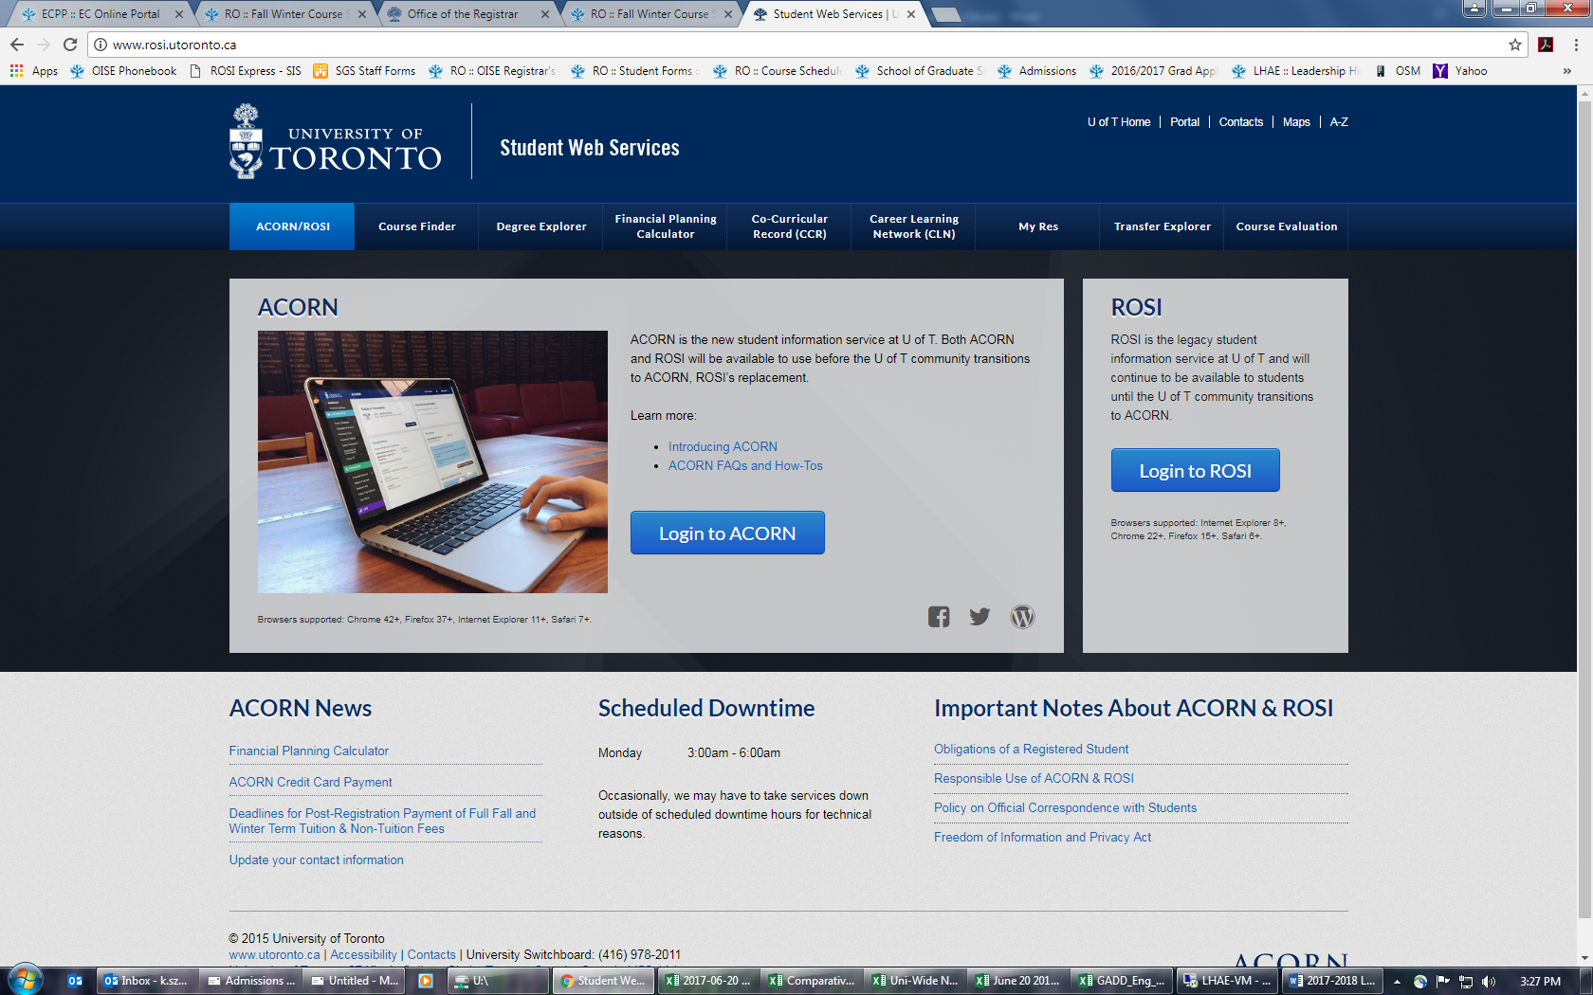
10. How can I enrol in statistics courses? www.acorn.utoronto.ca

Slide 30
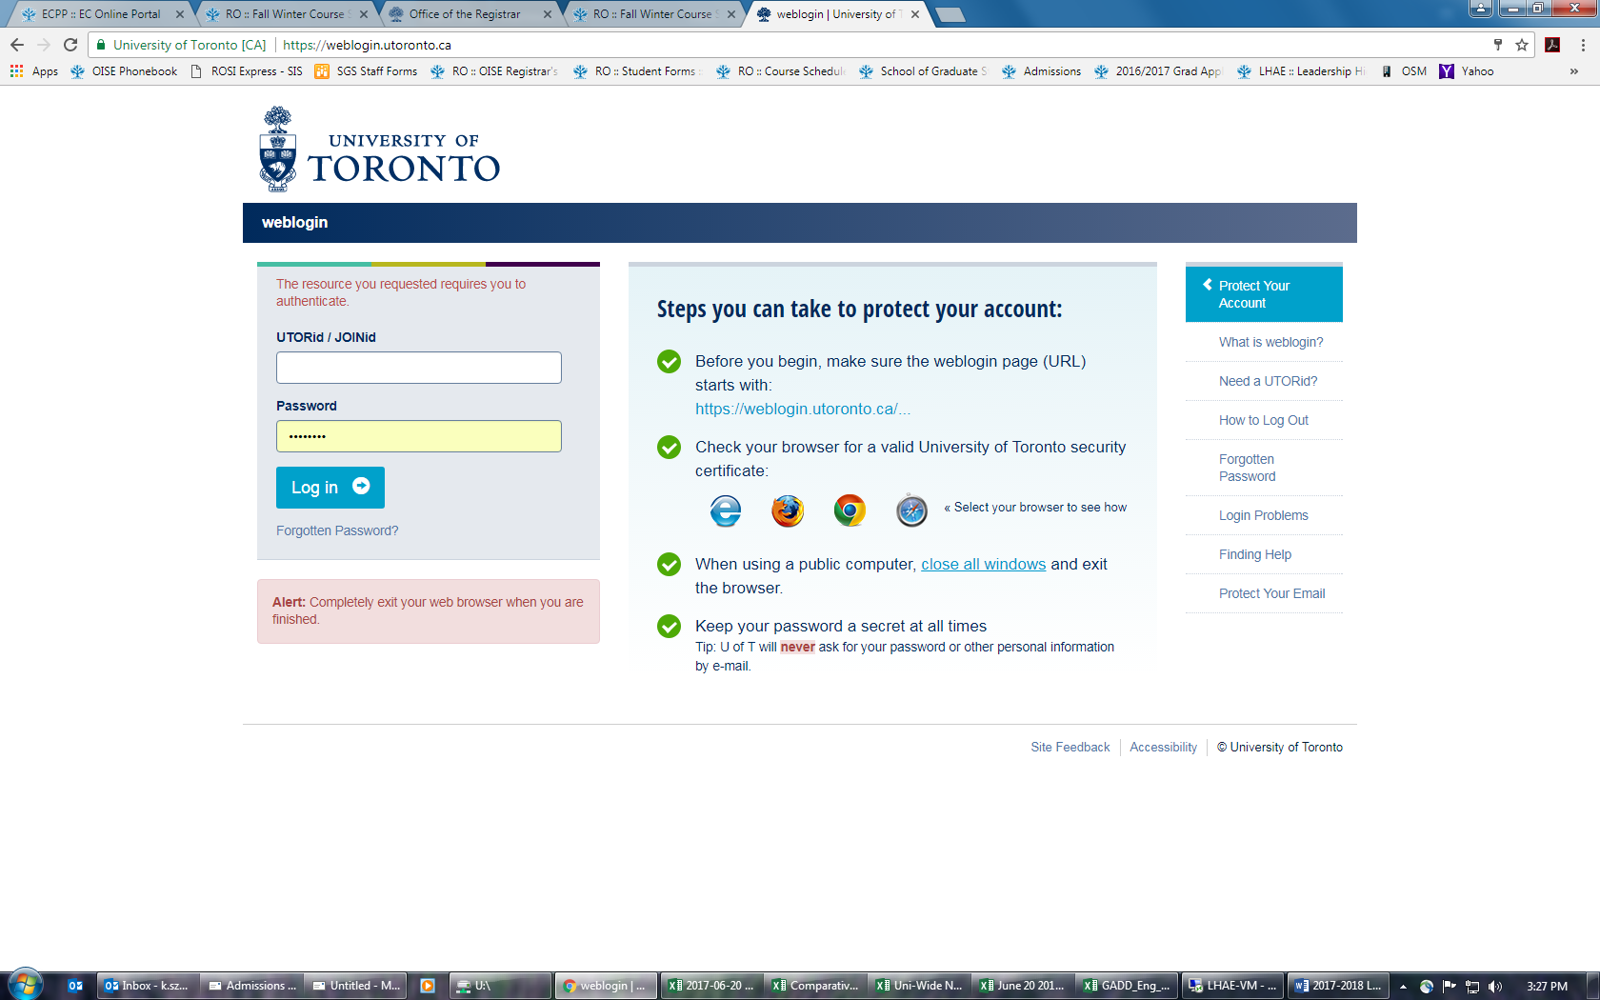
10. How can I enrol in statistics courses? www.acorn.utoronto.ca

Slide 31
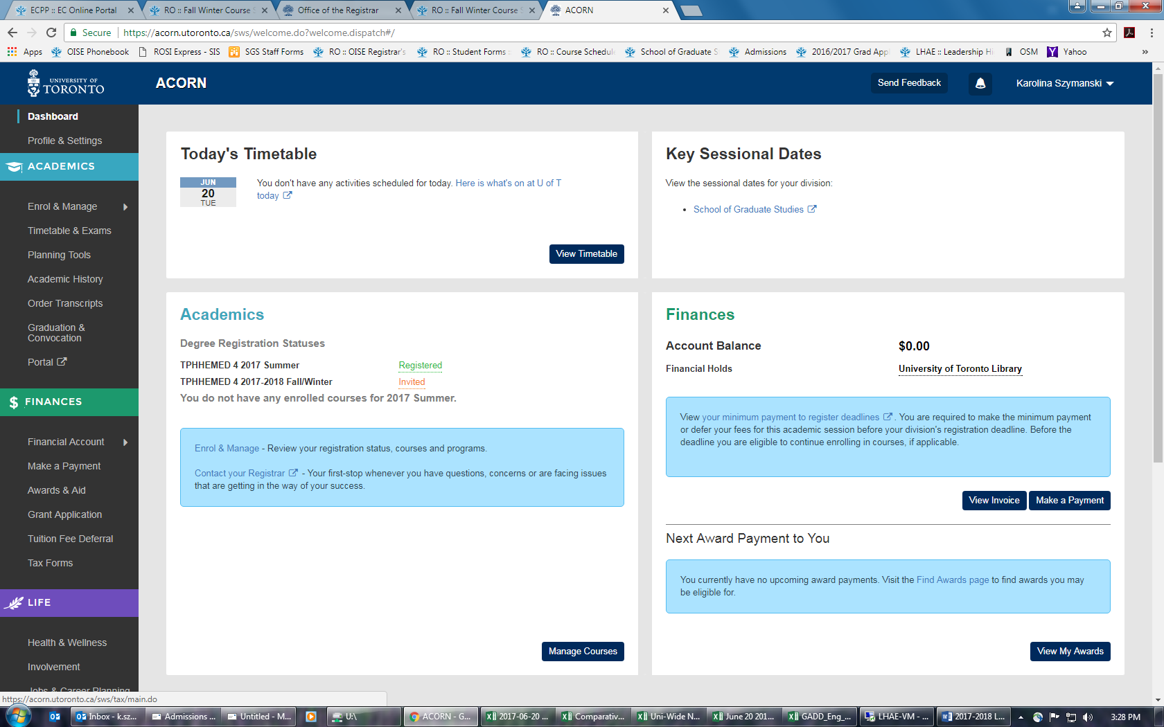
10. How can I enrol in statistics courses? www.acorn.utoronto.ca

Slide 32
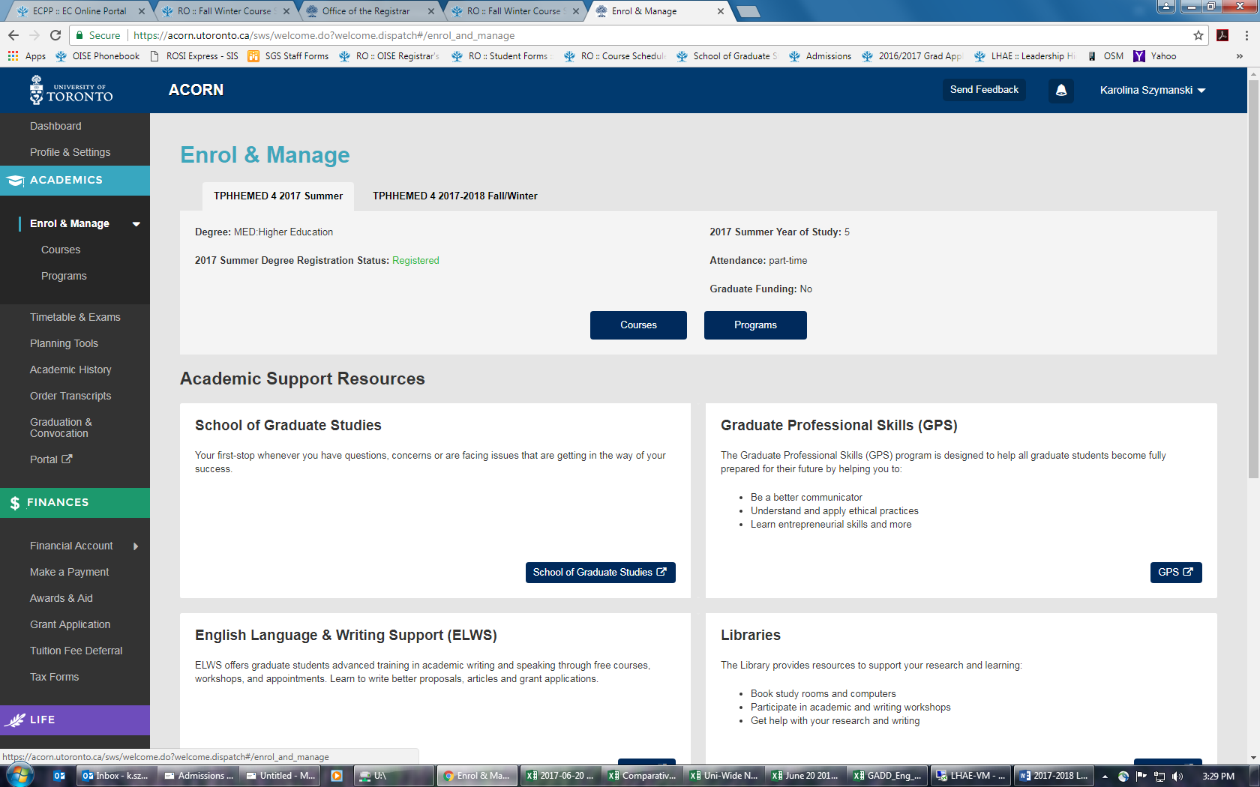
10. How can I enrol in statistics courses? www.acorn.utoronto.ca

Slide 33
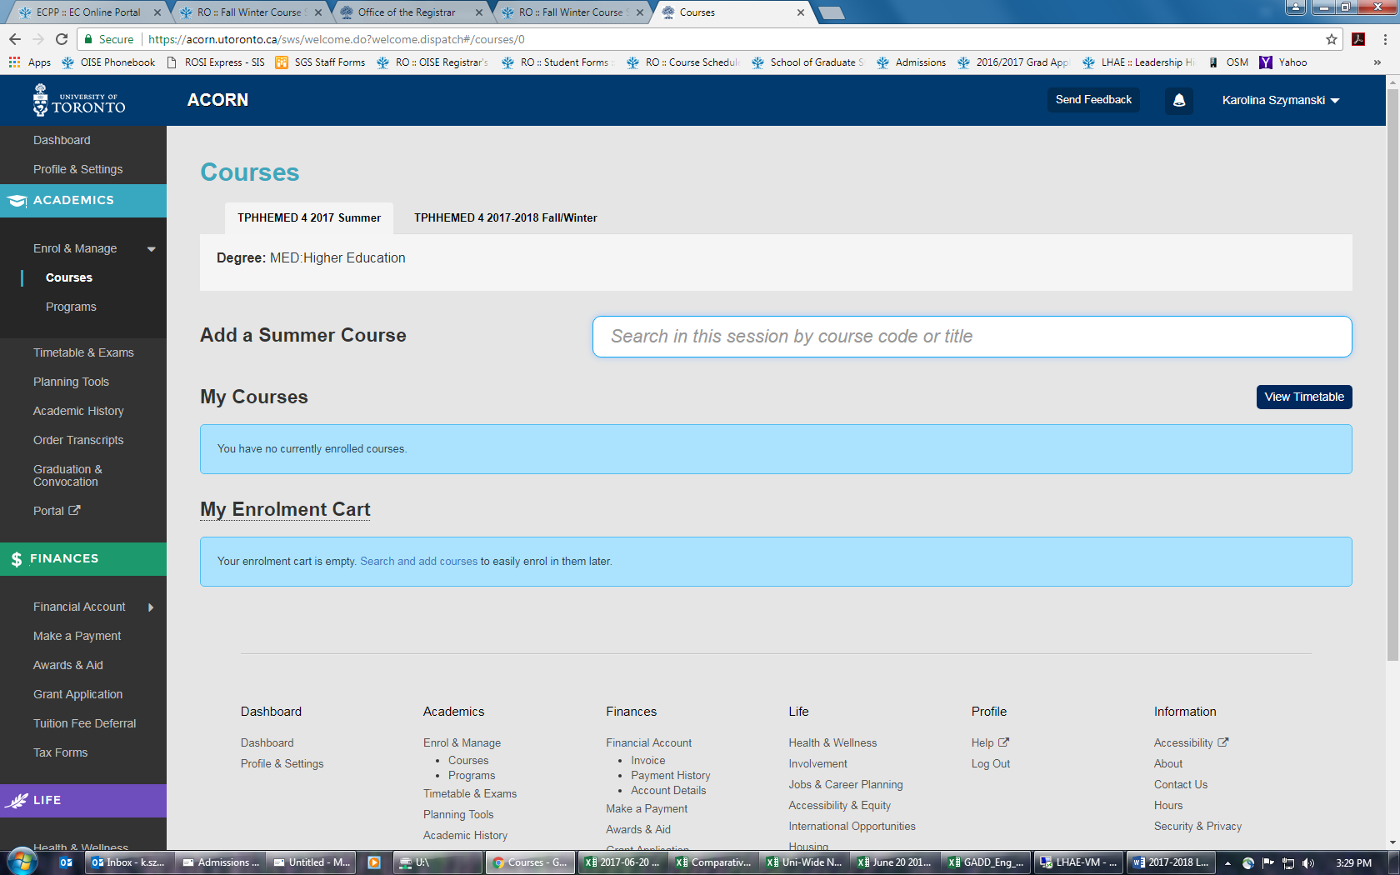
10. How can I enrol in statistics courses? www.acorn.utoronto.ca

Slide 34
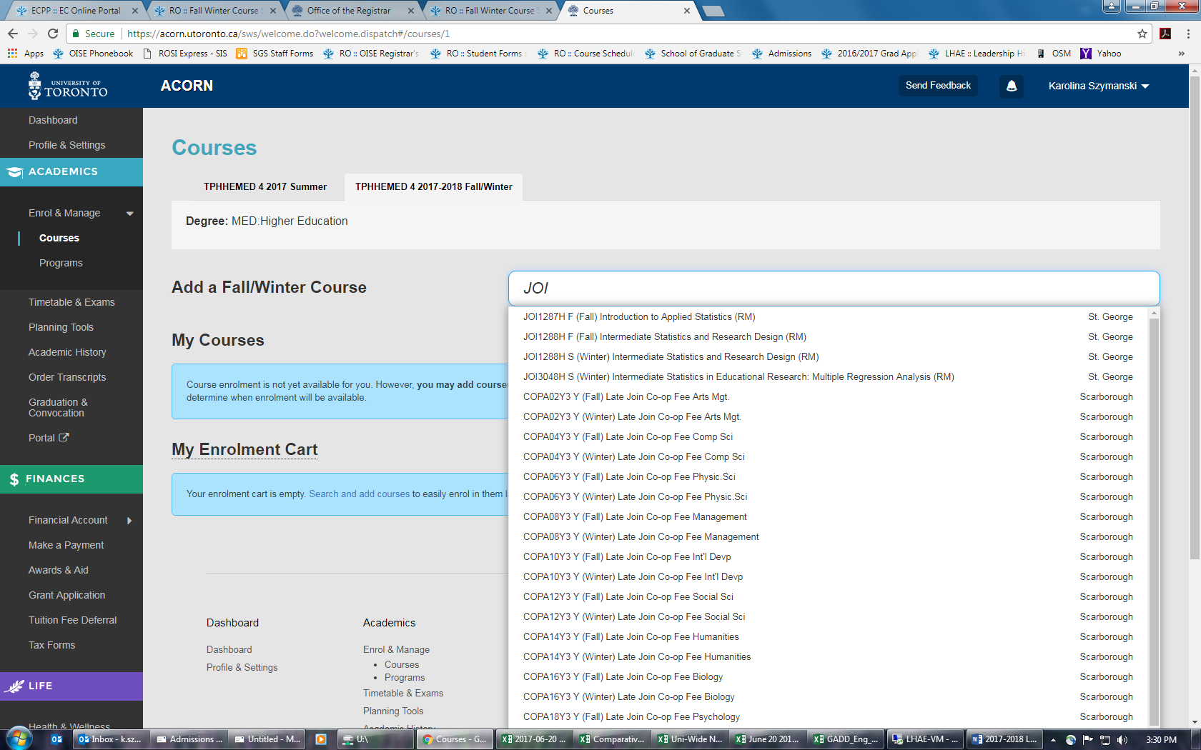
10. How can I enrol in statistics courses? www.acorn.utoronto.ca

Slide 35
11. Additional questions?

