Slide 1
Speaker Series
Graduate Education in a Global Context
Notes:
Thank you so much for joining us today!
This is the first in our new Speaker series on graduate education in global context.
As we all know, the landscape of graduate education, specifically doctoral education, is changing. Increasing knowledge is essential for economic and societal development. The interest in creating world-class universities to compete in the global knowledge society (Shin et al., 2018) has seen a corresponding increase in doctoral programs; participation has boomed, enrollments have increased by more than 150% since the mid-1990s in countries such as the United Kingdom (UK), Portugal, Australia, and Canada (UNESCO, 2017).

Slide 2
Upcoming :
CIHE Speaker Series – Graduate Education in a Global Context
2. Thursday, January 26, 2023, 12:00-1:00 PM EST
“Centering Justice and Equity in Supporting Graduate Students of Color” with Dr. Kimberly A Truong.
3. Friday, February 17, 2023, 12:00-1:00 PM EST
“Resource Use and Perception Across Demographic Characteristics With Maryrose Weatherton”
4. Thursday, March 9, 2023, 2:00-3:00 PM EST
“Online Learning Communities as Subversive Activity: Countering the Isolation and Silos in Graduate Supervision With Dr. Michele Jacobsen”
Join Us!
To register, visit https://www.oise.utoronto.ca/cihe/events/cihe-speaker-series/

Slide 3
Land acknowledgement
I want to acknowledge the land on which the University of Toronto operates. For thousands of years, it has been the traditional land of the Huron-Wendat, the Seneca, and the Mississaugas of the Credit.
Today, this meeting place is still the home to many Indigenous people from across Turtle Island and we are grateful to have the opportunity to work on this land.

Slide 4
The new normal? The practice of doctoral education in a global pandemic
Wednesday, January 18, 2023
Dr. Alison Elizabeth Jefferson
Postdoctoral Fellow | LHAE–OISE/UT
alison.jefferson@mail.utoronto.ca

Slide 5
Agenda
Background
Research design & Methods
Discussion of Results
Doctoral Experience in Canada
The Pandemic experience
Conclusions
The New field of Doctoral Education
Recommendations & Future directions
DISCUSSION – Questions?

Slide 6
background

Slide 7
What are the main issues/concerns faced by contemporary doctoral students?
https://app.sli.do/event/p2EHEM3itRktremLE7wJfp

Slide 8
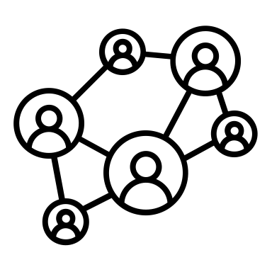
Why is doctoral education it important?
Altbach, 2017;
Marginson, 2010;
Shin, Khem, & Jones, 2018
Notes:
Academic institutions are central to the economic development of a nation (Altbach, 2017). They are objects and agents of globalization (Scott, 1998, in Marginson, 2010).
1--they act as communications hubs for international research communities (Altbach, 2017)
1--they provide training for high-level positions within the nation, vital to societal needs
3--they promote cultural diversity, through intellectual and geographic mobility
4--But also, many jobs which might once have only needed low levels of training now require more specific and complex, post-secondary education (Altbach, 2017), given the advances in science and technology over the past few decades.
Institutions have or are moving towards mass HE, creating world-class universities, to be a part of the global knowledge society (Shin et al., 2018). As such, we’ve seen an increase in doctoral programs, investing in nation’s talents.

Slide 9
Why is doctoral education it important?
Canadian doctoral enrolments
1992
2000
2004
2008
2012
130%
20-year period
Jones, 2018a

Slide 10
BUT…
40%

Slide 11
What do we know about the Canadian doctoral population?
Most recent Data from 2013/14 AY
Canadian Doctoral Population
25-29 years of age
Fewer women (47%)
Time to completion
~4.8 y
Women take longer to complete (4.9 y)
Statistics Canada. (2021, June 9).
Looker, E. D. (2016).

Slide 12
What do we know about the doctoral population more broadly?
Doctoral population
Often older
Working professionals, Commuters
Have caring responsibilities
Women
Financially independent
From underrepresented populations

Slide 13
the doctoral population…
First-Generation (FG)
24 +
Parents
Lower income

Slide 14
Perceptions of the doctorate
RESEARCH
Conferences / presentations
Dissertation

Slide 15
Perceptions of the doctorate
RESEARCH
Conferences / presentations
Dissertation
Teaching
Committee work
Mentoring
Grant writing

Slide 16
Perceptions of the doctorate
The Hidden Curriculum
Not written or explicit
Often unstructured
Often no timeframe
RESEARCH
Conferences / presentations
Dissertation

Slide 17
What do we know from the literature?
Financial support remains an issue, but is rarely directly addressed
Faculty-student relationships can impact retention
Perceived support (faculty/peers/department/family) can impact retention

Slide 18
Doctoral Socialization
Students integrate into academia through interaction with departments (i.e., faculty, peers) to develop the values, attitudes, and skills needed for their chosen profession, and for academia more broadly
Pandemic = WFH
What happens when that vital interaction changes?
(Bragg, 1976; C. M. Johnson et al., 2017; Weidman & Stein, 2003)

Slide 19
AIM
Discover how students’ experiences of doctoral study may have shifted considering the global pandemic, and how these changes may have affected their socialization
Field
Capital
Habitus
BOURDIEUSIAN CONCEPTS:

Slide 20
Research Questions
Part 1
How do we understand students’ experiences of their doctoral programs to have been affected in the immediate response to the COVID-19 pandemic?
Part 2
How can Bourdieu’s conceptual tools help us to conceptualize their experiences?

Slide 21
Research design & Methods

Slide 22
Research design & Methods
Overview
Participants were recruited from three large, research-intensive institutions in one Canadian province
Various departments
Recruited via GSAs
Total of 18 participants (17 doctoral students, and one assistant professor at time of interview)

Slide 23
Research design & Methods
Overview
~Hour-long semi-structured interviews using open-ended questions
Virtual, using MS Teams
Interview recordings transcribed manually
Coded in Nvivo
Intuitive coding
Thematic coding based on predetermined codes from literature

Slide 24
Research design & Methods
Coding Process
Phase 1. Intuitive, “open” coding
Using Nvivo, assigning codes (nodes) as they arise within the transcripts, sentence by sentence. Some codes were as follows:
Adjustment
Delay
Identity
Initiative
Mental health
Motivation
Resilience
Work-life balance

Slide 25
Research design & Methods
Coding Process
Phase 2. Coding using pre-determined themes from the literature and theory (a priori)
Using Nvivo, assigning codes (nodes) based on themes derived form the literature, using pre-constructed list. Codes included:
Communication (networking)
Education
Employment
Family and living situation
Finances and funding
Research
Supervision
Teaching
Valued activities (implicit and explicit)
Working from home

Slide 26
Research design & Methods
HABITUS
Career trajectory and motivation
Identity
Personal and Family background
Perceptions of the PhD
Coding Process → analysis
HABITUS
CAPITAL
FIELD
Pandemic effects on PhD
CAPITAL
Formal activities
Informal activities
Finances and funding
Supervision and support
Work experience
Grouped the codes/themes as per Bourdieu’s conceptual tools

Slide 27
Discussion of results
Doctoral Experience in Canada
The Pandemic Experience

Slide 28
How was your Doctoral experience?

Slide 29
Participants
44% (n=8) FG students, the first in their families to undertake post-secondary education
20-40 years old
16% (n=3) FG graduate students, with at last one parent with a bachelor’s degree
female to male ration of 5:1.
38% (n=7) from families with prior graduate credentials

Slide 30
demographics
Pseudonym | Institution | Affiliation (Department or Faculty)
Ashley | U1 | Faculty of Health Sciences
Alex | U2 | Faculty of Medicine
Alexandra | U1 | Faculty of Health Sciences
Bianca | U3 | Faculty of Arts & Science (science-based)
Billie | U1 | Faculty of Science
Diana | U2 | Faculty of Education
Grace | U2 | Faculty of Medicine
Jamal | U3 | Department of Psychology
Joan | U1 | Faculty of Science
Katrina | U1 | Faculty of science
Kelly | U3 | Department of Psychology
Mary | U3 | Department of Psychology
Gracie-Lou | U2 | Faculty of Medicine
Priscilla | U1 | Faculty of Engineering
Robert | U3 | Department of Physical and Environmental Science
Sarah | U3 | Department of Psychology
Sheila | U2 | Faculty of Education
Zara | U3 | Department of Psychology
Institution | Nbr of participants
U1 | 6
U2 | 5
U3 | 7
20-40 years old
female to male ration of 5:1.

Slide 31
Pseudonym | Institution | Affiliation | FG Status*
Ashley | U1 | Faculty of Health Sciences | —
Alex | U2 | Faculty of Medicine | —
Alexandra | U1 | Faculty of Health Sciences | FG PSE
Bianca | U3 | Faculty of Arts & Science (science-based) | FG PSE
Billie | U1 | Faculty of Science | FG PSE
Diana | U2 | Faculty of Education | —
Grace | U2 | Faculty of Medicine | FG PSE
Jamal | U3 | Department of Psychology | FG Grad.
Joan | U1 | Faculty of Science | —
Katrina | U1 | Faculty of science | —
Kelly | U3 | Department of Psychology | FG PSE
Mary | U3 | Department of Psychology | FG PSE
Gracie-Lou | U2 | Faculty of Medicine | FG Grad.
Priscilla | U1 | Faculty of Engineering | —
Robert | U3 | Department of Physical and Environmental Science | FG PSE
Sarah | U3 | Department of Psychology | FG Grad.
Sheila | U2 | Faculty of Education | —
Zara | U3 | Department of Psychology | FG PSE
44% (n=8) FG students, the first in their families to undertake post-secondary education
16% (n=3) FG graduate students, with at last one parent with a bachelor’s degree
38% (n=7) from families with prior graduate credentials

Slide 32
Doctoral Experience in Canada: “overeducated & underpaid”
Overview of Key Themes
Research
Imposter Syndrome
Teaching
Explicit versus implicit activities
Resilience
Supervision
Funding
Initiative
First-Generation
Mismatch between expectations and reality

Slide 33
Results: Doctoral Experience in Canada
Resilience
[supervisor] he told me, grad school, technically, you just buy the raw technical skills or technical knowledge, it’s not hard. Resilience is. (Robert)
everyone always thinking, like, "I have to be the one with the most publications. I have to be the one always writing". There's never a time to take a break. (Alexandra)
So, it's always a real struggle of there's just so many things that you have to work on all of the time… Like, you make like twenty thousand dollars a year and you work, like, constantly. You work seven days a week. (Sarah)

Slide 34
Results: Doctoral Experience in Canada
The Hidden Curriculum
Not written or explicit
Often unstructured
Often no timeframe
Expectations versus Reality – a hidden curriculum?
And so, I had this idea that you come up with the ideas, you train undergrads to help you implement them, and then you get the data, and you write these papers. And that's not exactly what it's been so far. (Kelly)
(Elliot et al., 2020) – The Hidden Curriculum in doctoral Education

Slide 35
Results: Doctoral Experience in Canada
when anyone ever asks me about what is most important, it's finding the right supervisor because they can, you know, a bad experience can make your life miserable. (Alex)
Supervision
But I felt like I felt like — and this has been disappointing to me — that there would have been… or should have been at least, more kind of touch base, you know? Especially with the clinician supervisor who just, you know, I feel like forgets about me and doesn't even know how to spell my name half the time. (Alex)

Slide 36
Results: Doctoral Experience in Canada
Finances & Funding
I'm too old to, and too smart to be this poor. (Sarah)
The majority of graduate students who do not secure external funding, such as a Canada Graduate Scholarship, live well below the poverty line…. (National Graduate Caucus, n.d)

Slide 37
Results: Doctoral Experience in Canada
Teaching and Research Assistantships
We go right through the summer and again with this kick of everyone always thinking, like, "I have to be the one with the most publications. I have to be the one always writing". There's never a time to take a break. (Alexandra)

Slide 38
How was your pandemic experience?
This Photo by Unknown Author is licensed under CC BY-SA

Slide 39
Results: The Pandemic Doctorate
Overview
ADJUSTMENT
FRUSTRATED
LANGUISHING
DELAYS
STRESSFUL
UNPRODUCTIVE

Slide 40
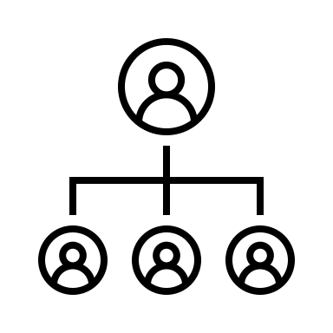
Results: The Pandemic Doctorate
Supervision
And I mean, my advisor was completely distraught, and he said, you know, “let's wait it out” … He's like, "you know, maybe in September". I'm like “in sept- what am I supposed to do until September?” (Sheila)

Slide 41
Results: The Pandemic Doctorate
Communication
“I don't know if I'm working hard enough” (Jamal).
Batman??
Or imposter?

Slide 42
Results: The Pandemic Doctorate
WFH
SHEILA
Husband WFH – teacher
Children at home – online learning
ALEX
Spouse - WFH
Toddler – daycare closed on and off

Slide 43
Results: The Pandemic Doctorate
Careers
My colleagues started to hate research a lot sooner than me, but every single person I know, the longer you continue on in your graduate studies, you just want to get out and not be in academia. (Sarah)

Slide 44
Conclusions
The New Field of Doctoral Education?
Recommendations and Future Directions

Slide 45
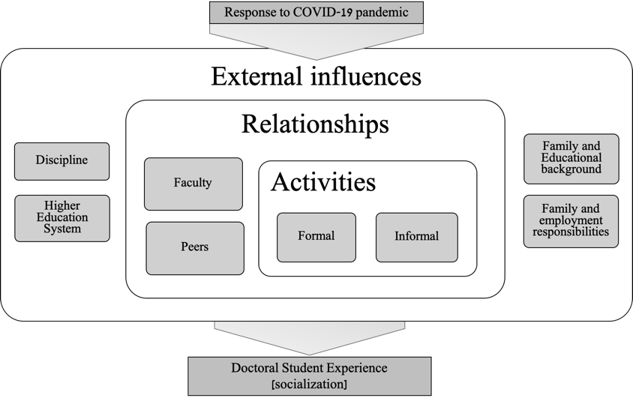
a “new” field of doctoral education?
Applying a Bourdieusian Frame: Is a New Field Emerging?

Slide 46
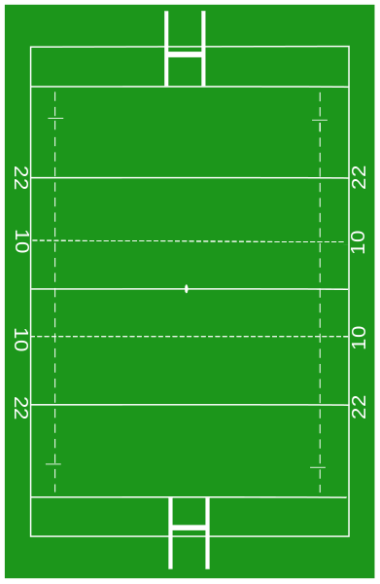
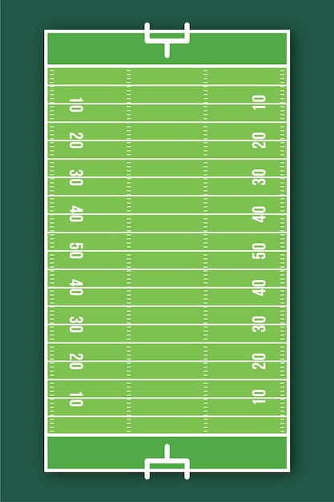
Rugby Union -- UK
American Football – US
Image by by Brieg
Image by by freepik

Slide 47
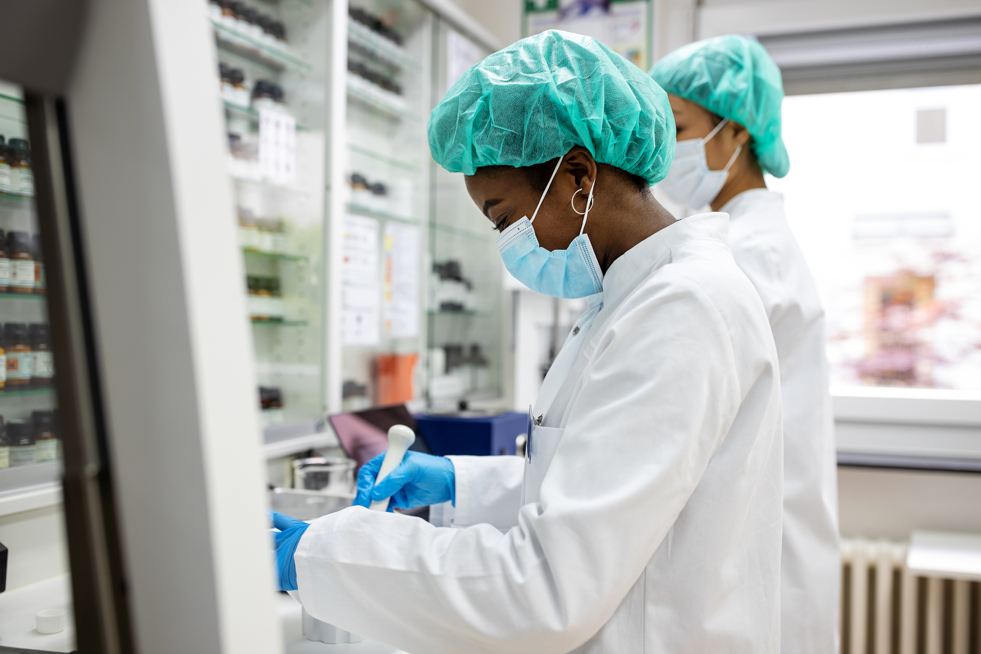
Pre-Pandemic
Mid-Pandemic

Slide 48
In Summary
Doctoral Education
Who benefits?
Pre-Pandemic
Pandemic
What has changed?

Slide 49
Less frequently on campus
Fewer opportunities to create meaningful networks
Fewer opportunities to collaborate
Fewer publications
Less chance of obtaining funding
Need to retain employment

Slide 50
FG Students
Questions were left unanswered :
Did first-generation status help or hinder these students in adapting to the pandemic?
Did those who were not first-generation still benefit from accrued social and cultural capital despite the changed nature of doctoral education in a pandemic?
Was there a slight levelling of the playing field due to the unusual context or were the advantages as stark as ever?

Slide 51
FG Students
I saw what my supervisor has been doing in terms of the work-life balance and the passion to- to research… Becoming a professor is not a day job. It's a, it's not even a full-time job. It's a full life kind of job. (Robert)
I can feel myself like looking still at other people's professions or like things that I'd like to do and like, maybe I don't have the academic criteria to get there, so I might continue afterwards. We'll see. I'm only halfway through my studies. (Gracie-Lou)

Slide 52
FG Students
I had a harder time than most other people in that cohort because they had come straight from undergrad right into their master's so they could remember things from undergrad. Whereas like I mean, it'd been years since I'd touch the stuff. (Gracie-Lou)
I like, I really did my own, I guess, networking research. I didn't really know, like, I kind of understood what the ins and outs were. Didn't really know as much of the challenges necessarily that that came with, that came with grad school. (Jamal)

Slide 53
FG Students

Slide 54
limitations
Methodological
Due to using online interviews, there’s always the chance that the participant won’t be familiar or favorable with virtual conversation
Unable to generalize findings due to small sample size
self-reporting → potential for untruths & SDB
Was limited by pandemic:
Recruitment had to happen virtually
Online data collection – unable to do anything in person
Study as a whole:
Results limited by time and place
54

Slide 55
Recommendations / future directions
Key Themes:
Teaching and research activities
Supervision
Financial issues
The field of doctoral education hasn’t necessarily changed, but simply shifted.
Prior barriers to successful socialization remain, despite the new working environment.

Slide 56
Implications
Recommendations / future directions
Is the doctoral program as we know it still relevant?
Greater importance of career intention than has been considered in existing literature thus far.
Are we helping or hindering doctoral students in terms of future career success?
Importance of sufficient funding for doctoral education, so we are not losing valuable talent
Increased importance of supervision for effective student socialization

Slide 57
To Sum Up…
A selection of the relevant literature discussed:
Bourdieu, P. (1977). Outline of a Theory of Practice (R. Nice, Trans.). Cambridge University Press.
Jefferson, A. E. (2021). The Academic Profession in Canada: Successful Socialization to the Scholarly Role. Brock Education Journal, 30(2), 31–62.
Jones, G. A. (2018a). Doctoral Education in Canada. In J. C. Shin, B. M. Kehm, & G. A. Jones (Eds.), Doctoral Education for the Knowledge Society: Convergence or Divergence in National Approaches? (pp. 147–164). Springer International Publishing.
Karram Stephenson, G., Jones, G. A., Bégin-Caouette, O., & Scott, A. (2020). Teaching, Research and the Canadian Professoriate: Findings from the 2018 APIKS survey. Higher Education Forum, 17, 25–41.
Statistics Canada. (2021c, June 9). Persistence and graduation of doctoral degree students, within Canada, by student characteristics. Statistics Canada. https://www150.statcan.gc.ca/t1/tbl1/en/tv.action?pid=3710013605
Weidman, J. C., & Stein, E. L. (2003). The Socialization of Doctoral Students to Academic Norms. Research in Higher Education, 44(6), 641–656.

Slide 58
Questions?
Thank You

Slide 59
Upcoming :
CIHE Speaker Series – Graduate Education in a Global Context
2. Thursday, January 26, 2023, 12:00-1:00 PM EST
“Centering Justice and Equity in Supporting Graduate Students of Color” with Dr. Kimberly .A Truong
3. Friday, February 17, 2023, 12:00-1:00 PM EST
“Resource Use and Perception Across Demographic Characteristics With Maryrose Weatherton”
4. Thursday, March 9, 2023, 2:00-3:00 PM EST
“Online Learning Communities as Subversive Activity: Countering the Isolation and Silos in Graduate Supervision With Dr. Michele Jacobsen”
Join Us!
To register, visit https://www.oise.utoronto.ca/cihe/events/cihe-speaker-series/

Slide 60
Upcoming :
CIHE Speaker Series – The Social Role of Colleges
Friday, January 26, 2023, 5:00-6:30 PM EST
“Defying the Primacy of the Market: the challenge of chile’s public higher vocational education,”
With Cristian lincovil Belmar and miski peralta rojas
Thursday, february 9, 2023, 5:00-6:30 PM EST
“eroding the social role of vocational education in Australia,”
with Dr. Steven Hodge
Join Us!
To register, visit https://www.oise.utoronto.ca/cihe/events/cihe-speaker-series/

