Slide 1
Eroding the Social Role of Vocational Education in Australia
Steven Hodge, Griffith University, Australia

Slide 2
I acknowledge the traditional owners of the unceded land from which I’m presenting, and pay my respect to Elders, past and present, and to all Aboriginal and Torres Strait Islander people.

Slide 3
Overview
Australian vocational education
Some terms and history
Some ruling ideas of contemporary Australian vocational education
Ways these ideas erode the social role of vocational education
A glance toward the future

Slide 4
Some terminology
Vocational education?
‘Vocational Education and Training’ (VET): a common term for competency-based vocational education provision in Australia
Institutes of ‘Technical and Further Education’ (TAFEs): public colleges within the VET system
‘Registered Training Providers’ (RTOs): formal term for providers of vocational education with the VET system
‘Adult and Community Education’ (ACE): a small, fragmented form of post-compulsory provision that has largely been subsumed by the VET system

Slide 5
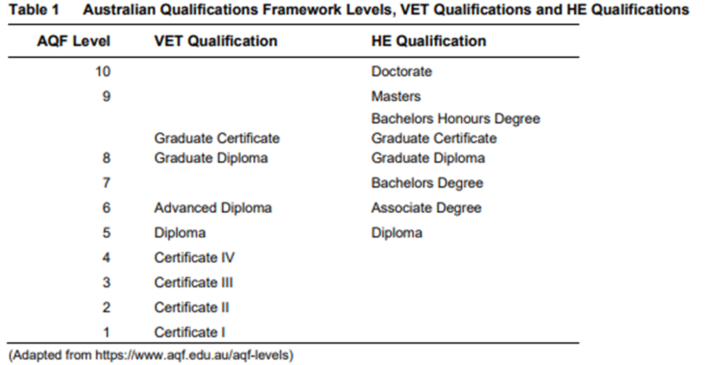
Australian Post-compulsory Education
Post compulsory education structured by a binary of VET and higher education
The Australian tertiary binary shows up in numerous ways, for example in the Australian Qualifications Framework (AQF):

Slide 6
Australian vocational education timeline
The Australian VET system as we know it is a product of reforms set in motion in the late 1980s
Prior to those reforms, vocational education has a complicated history
A history of First Nations learning and education is yet to be written
Apprenticeship-based vocational education was brought by the English
Other borrowed models followed: Mechanics Institutes, Workers’ Educational Associations, Technical Colleges, etc.
In the federal system of Australian government, vocational education has traditionally been a state-government concern except under special circumstances

Slide 7
Kangan Reforms
The Commonwealth Government first attempted to impose a national identity upon vocational education in the 1970s
Birth of the ‘TAFE sector’ – public vocational education system
The new system was shaped by the ‘Kangan Report’
The report defines vocational education in various ways, promoting a vision of a system that would serve individuals, communities and employers

Slide 8
Kangan Reforms
The main purpose of education is the betterment and development of individual people and their contribution of the good of the community. Technical and further education should be planned accordingly.
…it is important that general education be seen as relevant to vocational purposes and that vocational education in turn becomes more general in its content and methods so that people can be better prepared to adapt themselves to changing conditions and to re-training, as necessary, at any time of their working lives.
(1974, p. xxiii)

Slide 9
National Training Reform Agenda
In the late 1980s a second wave of national vocational education reform commenced
The case for fundamental reform to vocational education (‘The National Training Reform Agenda’) was made in the context of economic and social challenges facing Australian governments
An early argument for vocational education reform is presented in a policy statement titled ‘Skills for Australia’ by Ministers Dawkins and Holding. The Forward of the statement puts the situation like this:

Slide 10
The Government is determined that our education and training systems should play an active role in responding to the major economic challenges now facing Australia.
The adjustments required in the structure of the economy, and improvements in Australia's international competitiveness, will make heavy demands on our human resources and labour force skills. Our skills formation and training arrangements are not yet adequate to meet those demands.
The world’s most successful economies over the past two decades have given high priority to education, skills and competence at work as vital factors in economic performance, and have supported their skills development policies accordingly. Now we must do likewise.
(1987, p. iii)

Slide 11
Key elements of the Training Reform Agenda
Re-conceptualising the purpose of vocational education
Positioning ‘industry’ as leader of the vocational education system
Adopting competency-based training as a system-wide curriculum model
Marketising vocational education provision

Slide 12
The purpose of vocational education
In the context of national crisis, the purpose of vocational education was reconceptualised in economic terms
‘National skills formation’ became the focus
Note that disadvantaged and unemployed people are specifically addressed in the policy with a view to their full participation in the workforce
The economic rationale assumed that ‘national prosperity’ would automatically produce social benefits. Therefore, if VET is re-oriented to economic ends, the system will ultimately fulfil a social role
Human capital theory supports the repurposing of VET

Slide 13
Industry leadership of vocational education
Educators were portrayed as having had too much influence over vocational education
National skills formation would require input from ‘industry’
Industry became the new leader of VET
However,
Not necessarily clear what is ‘industry’
Not necessarily the case that ‘industry’ knows what it needs from VET
Do industry interests coincide with public interests?

Slide 14
Competency-based training (Australian version)
Instrument of industry leadership of VET
Focus on immediately applicable, narrowly construed skills
Some problems:
rapid redundancy of learning
constrains mobility (in work and education)
blocks access to ‘powerful knowledge’
limits agency of educators
difficulties accommodating local conditions and practices

Slide 15
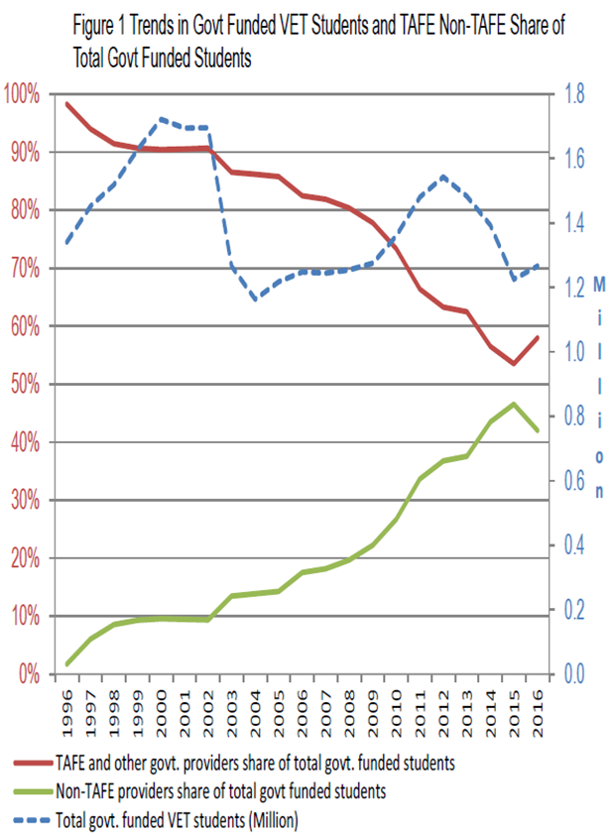
Marketisation of VET
Private provision has grown considerably as a result of training reform policy
The focus of public providers has shifted
(Source: Toner, 2018)

Slide 16
Marketisation of VET (cont.)
Marketising VET originally promoted as a way to expand provision
However, marketisation has led to a range of quality problems noted by the VET regulator and employer associations
From an economic theory perspective, problems of marketisation of VET in Australia include:
Poor market information to consumers
Restricted consumer choice
Incentive structure creates a market for low-quality training
Barriers to enter and exit the market
Limits of regulation
Reduced government funding overall (Toner, 2018)

Slide 17
Eroding the social role of vocational education
Of a population of 25.7 million in 2021, 4.3 million participated in the VET system (most recent available figures [NCVER, 2023]).
The dominance of the economic discourse crowds out alternative conceptualisations of vocational education
Industry leadership has promoted interests of capital at considerable public cost (in latest figures, the Australian public contributed $10.4 billion to vocational education in 2021 [NCVER, 2023])
Competency-based training limits educational outcomes for learners and has de-skilled the teaching workforce
Marketisation has undermined the quality of vocational education

Slide 18
The future?
Require sophisticated debate about the role of vocational education
The social role of vocational education would be a generative starting-point
Industry/employers have a role, but should it be the dominant one?
Sophisticated forms of curriculum and pedagogy are demanded by contemporary conditions
Marketisation needs to be fundamentally contested and rethought

Slide 19
References
Australian Qualifications Framework Council (2013). Australian Qualifications Framework, Second Edition. AQFC.
Dawkins, J. & Holding, A. (1987). Skills for Australia. AGPS.
Kangan, M. (ACOTAFE) (1974). TAFE in Australia: Report on needs in technical and further education. AGPS.
National Centre for Vocational Education Research (2023). Latest VET Statistics. Accessed 22/1/23 https://www.ncver.edu.au/research-and-statistics/visualisation-gallery/latest-vet-statistics
Toner, P. (1918). A tale of Mandarins and Lemons: Creating the market for vocational education and training. In D. Cahill & P. Toner (Eds.), Wrong Way: How Privatisation & Economic Reform Backfired (pp. 58-83). La Trobe University Press.

