Slide 1

Equal Partnerships and Ethical Internationalisation in Higher Education:
EU-ASEAN and Sino-Foreign partnerships
Miguel Antonio Lim, University of Manchester
13 June 2023
OISE, University of Toronto

Slide 2
The session will present research on international student mobility, which has mostly been studied in terms of South to North and East to West patterns. This seminar will discuss mobility in the East and Southeast Asian region, and discuss the evolving role of transnational higher education (TNHE) and HE policy coordination as part of wider national development policies. By exploring international student mobility in ASEAN and Sino-foreign HE partnerships, the session will outline the evolution of policies to promote, govern, and achieve more “equal” transnational partnerships and raise the importance of understanding “South-to-South” HE mobility. The session is meant to engage and raise further discussions about alternative definitions and conceptions of HE internationalisation.
Notes:
De emphasise ISM … more on policy

Slide 3
Outline
Context
Research Aims
Methodological Notes
Findings: TNHE
Discussion and Future Agenda

Slide 4
Context (1)
Positionality:
  ‘Global South’ origin and ‘Global North’ platform / infrastructure
  Prof experience in ISM management / partnership management among ‘elite’ Global North HEI

Slide 5
Context (2)
Internationalisation of HE
  Various types / areas
    ‘World Class-ness’ / Rankings
    Student experiences, student recruitment
    Pedagogy: Internationalisation of the Curriculum
    Intl research collaboration
    Science diplomacy
    etc
  This discussion focuses on Intl Student Mobility (ISM) and Transnational Higher Education (TNHE) partnerships

Slide 6
Context (2)
Global ‘North-South’ dynamics
  Various national (eg Chinese, etc) ‘World Class University’ Initiatives, esp in the global South
  General trends of ISM: South to North and East to West flows
  Critiques of extractive flows, international students as cash cows
  Marginalisation of global South in international HE networks / spaces

Slide 7
Research Aims
Study the differences between ‘foreign’ and ‘local’ understandings of international HE partnerships
Determine what, if any, are the understandings of ‘equal’ partnerships?
Understand South-South partnerships (eg ISM flows)

Slide 8
Session Aims
Learn more about trends in ISM / TNHE in Canada
Consider role of global north institutions in South-South mobilities and partnerships
Extend thinking / analysis beyond:
  Institutional partnerships (eg reflect on regional partnerships such as EU – ASEAN)
  ISM (eg faculty / research / professional staff mobilities)

Slide 9
Conceptual notes
Internationalisation in Education
Instrumental Internationalisation

Slide 10

1. Internationalisation in Education
Jonas Stier
Intercultural studies
Internationalisation in education

Slide 11
1. Internationalisation in Education
Stier (2004)
Internationalisation as:
  a state of things
  a process
  a doctrine

Slide 12
1. Internationalisation in Education
Stier (2004)
Internationalisation as:
  a state of things
  a process
  a doctrine

Slide 13
1. Internationalisation in Education
Internationalisation as doctrine / Ideologies of internationalisation (Stier, 2004)
Idealism: internationalisation is a good per se
Educationalism: internationalisation enriches the overall academic experience of staff and students and leads to their “Bildung” (Stier, 2003) or lifelong learning
Instrumentalism: internationalisation in education is a means to an end

Slide 14
1. Internationalisation in Education
Internationalisation as doctrine / Ideologies of internationalisation (Stier, 2004)
Idealism: internationalisation is a good per se
Educationalism: internationalisation enriches the overall academic experience of staff and students and leads to their “Bildung” (Stier, 2003) or lifelong learning
Instrumentalism: internationalisation in education is a means to an end

Slide 15
2. Intrumentalism in IE
International HE partnerships as means to an end(s)
Much scholarship on the interests of the ‘sender’ or dominant partner; less on the ‘receiver’
Opportunity to contribute in areas of South-to-South HE mobilities and TNHE partnerships

Slide 16
2. Intrumentalism in IE
Varieties of Capitalism framework to explain motivations of sending countries (Graf, 2009)
  Graf (2009): study of British and German Universities’ Internationalisation Strategies
  Importance of “institutional complementarity and comparative institutional advantage”

Slide 17
Notes on Data and Methods
Policy and document analyses
ASEAN analysis: commissioned research by the EU Support to ASEAN Region (EU SHARE) / DAAD
Case Studies: Sino British College and Sino Danish Center
Notes:
For ASEAN
● The UNESCO Institute for Statistics (UIS) database for inbound and outbound student mobility
● WorldBank EdStats Education Statistics, for share of tertiary graduates by discipline
● United Nations (UN) International Migrant Stock by Origin and Destination 2019 (statistics available from 1990 to 2019) for total number and share of migrants within and beyond the ASEAN as well as their origin and destination countries
● The ILO’s International Labor Migration Statistics (ILMS) in ASEAN 2017 for the share of migrant workforce by occupational level

Slide 18
Findings [1]
The years 1999 to 2018 saw intra-ASEAN student mobility grow by 270% from 7,643 to 28,333.
Intra-ASEAN mobility remains limited, accounting for only 9.4% of the total outbound mobility (ASEAN total 301,792 in 2018).
In 2019, the top 3 destinations were Australia, Japan, and the United States. Together, these countries accounted for about 59% of ASEAN outbound student mobility.

Slide 19
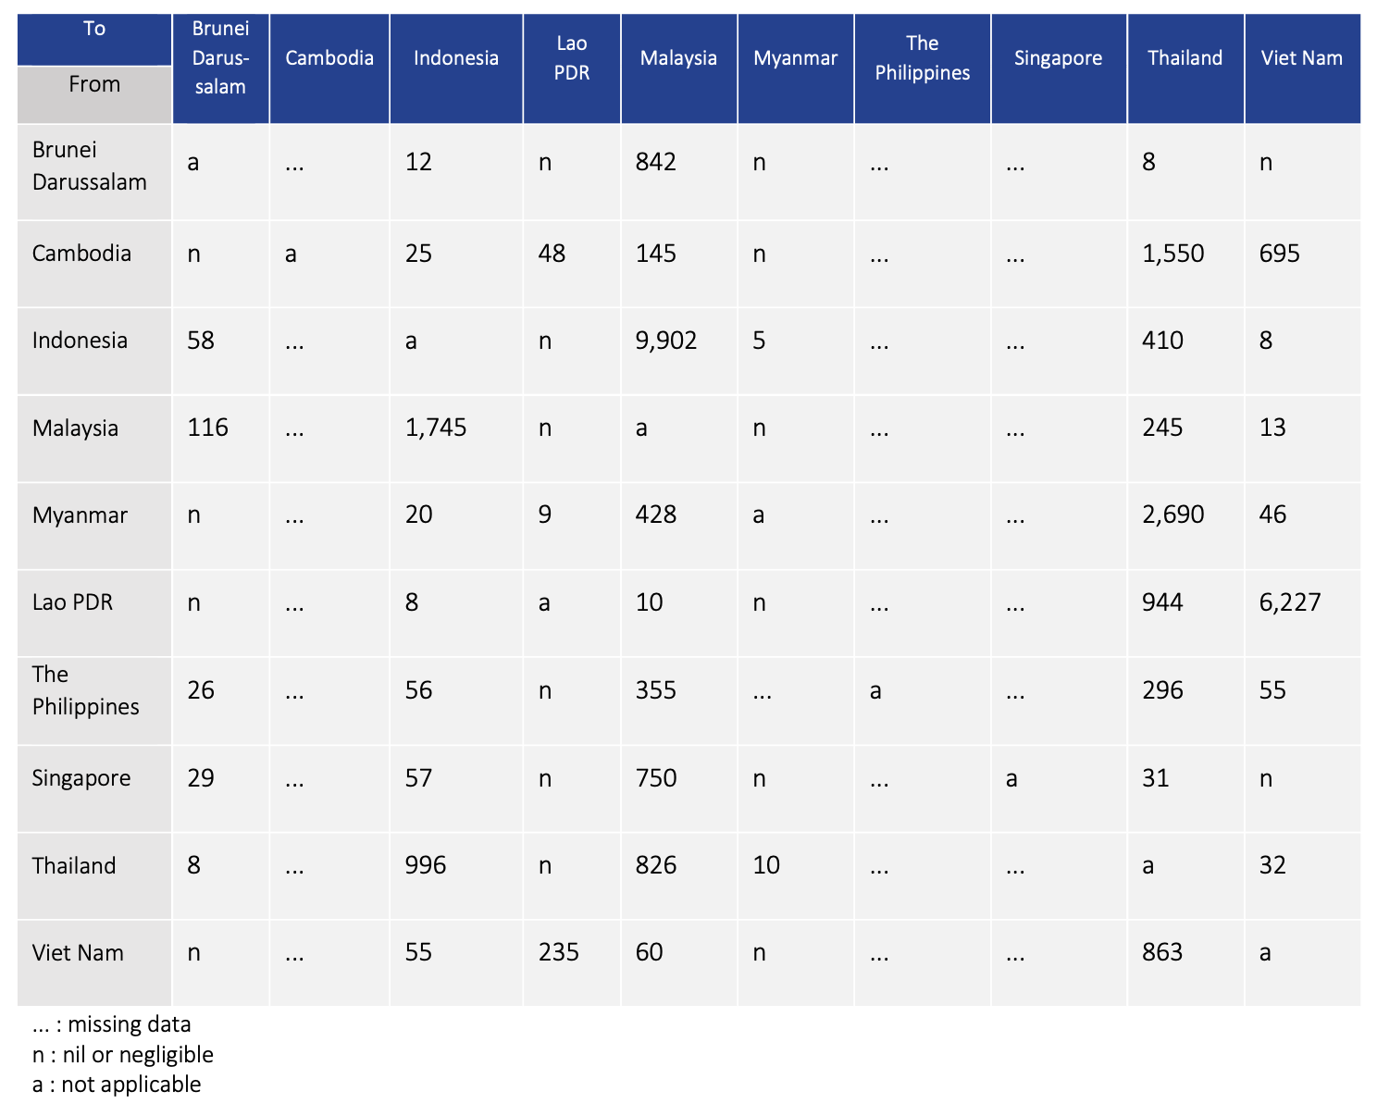
There has been a significant increase in intra- ASEAN student flows in recent decades.
Intra-ASEAN student mobility grew by 270% from 7,643 to 28,333 from 2010 to 2018
Top 3 hosts are Malaysia, Viet Nam and Thailand, which respectively received 13,318, 7,076, and 7,037 tertiary education students from within the region (not including data from Cambodia, the Philippines, and Singapore) (UIS)
13,318
7,037
7,076

Slide 20
Questions
Are these ISM patterns fixed?
Is it possible to increase proportion of intra ASEAN (or South-South ISM flows)?

Slide 21

Findings [2]
TNHE in China
University of Nottingham Ningbo
About the University: https://www.nottingham.edu.cn/en/about/who-we-are.aspx
Notes:
Example of 1:, New York University Shanghai
Example of 2: Sydney Institute of Languages and Commerce at Shanghai University
Example of 3:

Slide 22
TNHE in China
China is using joint ventures with other countries’ universities to accelerate its efforts to globalise its higher education sector (Feng 2013)
TNHE was seen as a way of not only boosting China’s accessibility to HE, but also accessing the world’s most advanced education systems (Yang 2008:274).
  Policy Discourse: bringing the Chinese and foreign partners together could carry mutual benefit.

Slide 23
Transnational higher education in China
3 Distinct Sectors/Types in Chinese TNHE (Mok & Han, 2016):
Chinese-foreign cooperation universities. Stand-alone organisations.
Institutes affiliated to Chinese universities (often with second-tiered colleges).
Individual programmes affiliated to Chinese universities. e.g. Joint Undergraduate Programs
Notes:
Example of 1:, New York University Shanghai
Example of 2: Sydney Institute of Languages and Commerce at Shanghai University
Example of 3:

Slide 24
Increasing scale (Sep 2018)
9 Chinese-foreign cooperation universities
79 Chinese-foreign cooperation institutions
1024 Chinese-foreign cooperation programmes
(Centre of Research on CFCRS, 2018).

Slide 25
Governance of TNHE in China
  highly developmental policy that draws upon foreign expertise where desirable for national purposes

Slide 26
Governance of TNHE in China
CFCRS constrictions: examples
  “Impose strict control over the CFCRS in the disciplines of business, management and other disciplines that China has tried to curb…”
  “Impose strict control over the entry of foreign resources; protect China’s educational sovereignty…”

Slide 27
Governance of TNHE in China
CFCRS
  Rule of 1/3“Four Indices of 1/3” (Xue, 2016)
    > Foreign provider needs to contribute resources
    > But limited to half
  1. Teaching hours
  2. Foreign teachers
  3. Courses
  4. Aspects of the curriculum as a whole

Slide 28
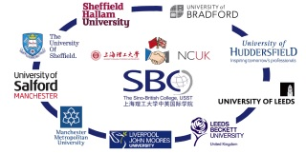
Sino-British College

Slide 29
Sino British College
More traditional partnership
Oriented towards student mobility
Revenue generation

Slide 30
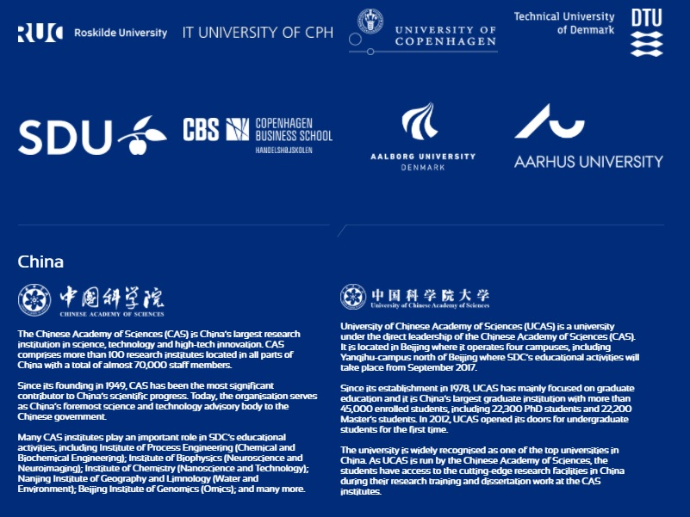
Sino-Danish Center

Slide 31
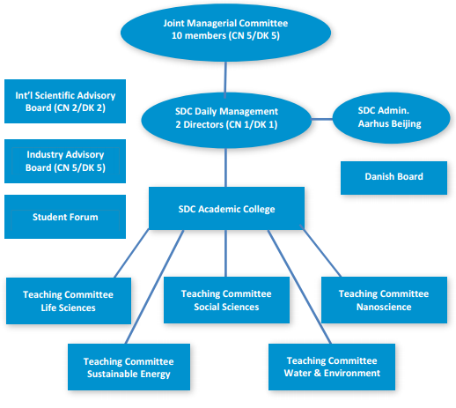
Sino-Danish Center:
The “50:50” policy

Slide 32
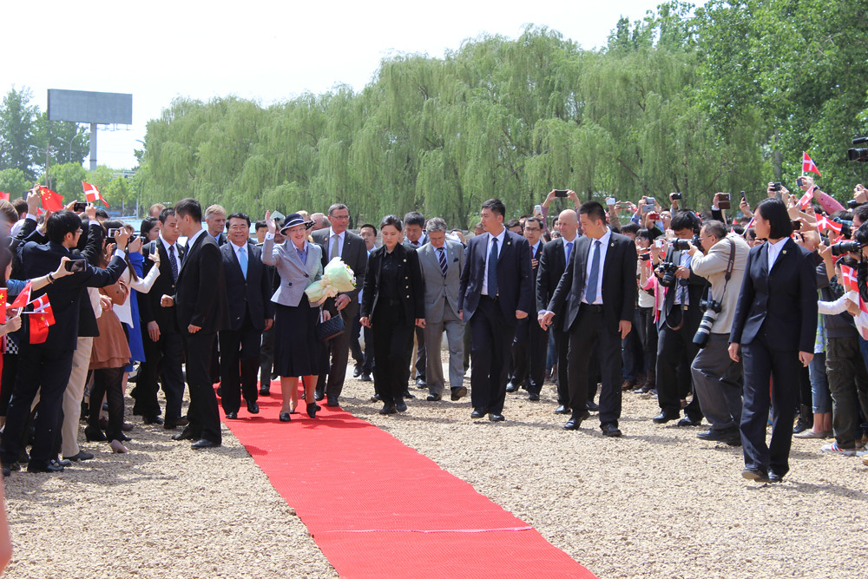
Sino Danish Center
Involvement of political actors
Symbolic orientation (eg involvement of all Danish Universities)
Non-commercial orientation

Slide 33
2018 MOE Reforms
Closure of 234 partnerships
Approval of new partnerships

Slide 34
Questions
Should TNHE move from a market model to a ‘political’ model
  eg partnerships are symbolic and involve political capital
Should TNHE move from student flows to resource flows? Are they the same?

Slide 35
Future / intended findings [3]
Analysis of the EU-ASEAN partnership
EU Support to Higher Education in the ASEAN Region
Comparison of EU to other ASEAN regional partners

Slide 36
Resources
Cockayne, H., Gao, J., & Lim, M.A. (2020). Pursuing Ideal Partnerships: The Discourse of Instrumentalism in the Policies and Practices of Sino-Foreign Higher Education Cooperation. In Universities as Political Institutions (pp. 58-80). Brill Sense.
Lim, M. A., Anabo, I. F., Phan, A. N. Q., Elepano, M. A., & Kuntamarat, G. (2022). Graduate Employability in ASEAN: The Contribution of Student Mobility . EU Support to Higher Education in the ASEAN Region. https://www.share-asean.eu/sites/default/files/FINAL%20Digital%20Version%20-%20V1_221108%20REVISED_SHARE%20Employability%20Study_0.pdf
Lim, M.A. (2015). Global University Rankings: Determining the Distance Between Asia and ‘Superpower Status’ in Higher Education. Asia: The next higher education superpower, 23-38.
Si, H., & Lim, M. A. (2022). Neo-tributary geopolitics in transnational higher education (TNHE): a regional analysis of Sino-foreign higher education partnerships. Globalisation, Societies and Education, 1-12.
Zhang, B., Mittelmeier, J., Lomer, S., & Lim, M. (2022). Mismatched expectations of internationalisation: Lived experiences of Chinese returnee academics in an international joint university. International Journal of Chinese Education, 11(3), 2212585X221139298.

Slide 37


Thank you
miguelantonio.lim@manchester.ac.uk

Slide 38
Session Questions
What are the new TNHE / ISM trends in Canada?
What kind of TNHE partnerships does Canada pursue and why?
Can Canada reshape international HE partnerships, eg global ISM flows (and contribute to more ‘equal and /or equitable’ partnerships?)

